Slide 1
Innovation in Water Treatment
Dennis Bitter
July 2012

Slide 2
Atlantium Hydro-Optic™ Technology can significantly lower Operating costs
through increased efficiencies, better heat transfer and improved productivity
  PROVEN CONTROL FOR BOTH MACRO AND MICRO-FOULING
    AQUATIC INVASIVE SPECIES – invasive mussels (zebra, quagga, clams, bannacles, etc.)
    Cleaner surfaces – minimal biofouling – improved heat transfer
    NON Corrosive
  ENVIRONMENTALLY FRIENDLY, SIMPLE, SAFE AND SECURE
    No hazardous chemicals or harmful by-products – SAFE for the water
    SAFE for employees – no chemical handling
    COMPLETE SOLUTION IN RISK MITIGATION
  EASY TO CONTROL AND BEST OVERALL VALUE
    Continuous control

Slide 3
The HOD Systems
The problem

Slide 4
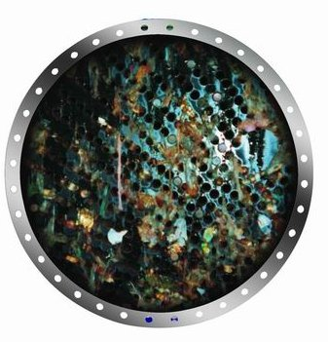
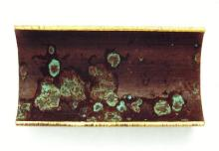
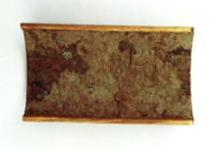
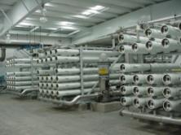
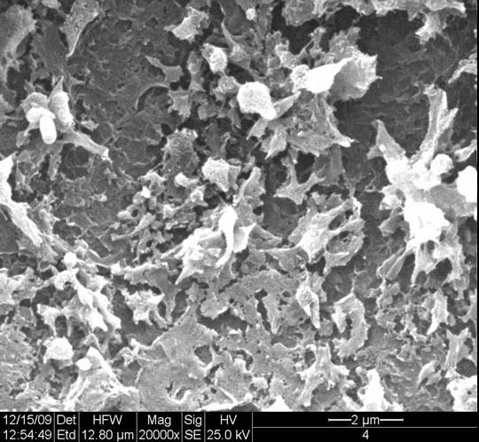
Macro & Micro fouling
Invasive species can cause significant $$$ in
Economic and Environmental Damage
Heat exchanger in a steam power station contaminated with macro-fouling
Cut tubes with Corrosion and Bio-fouling
RO Membrane with Bio-fouling

Slide 5
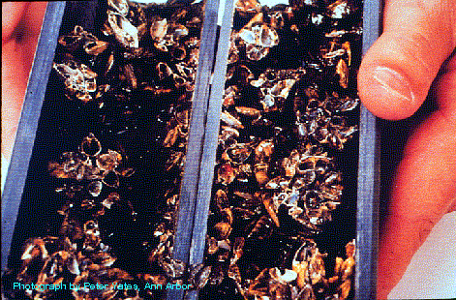
Mussel blockage of pipes

Slide 6
The HOD Systems
SOLUTION
COMPLETE BIO SECURITY

Slide 7
Atlantium’s HOD Technology
Cutting edge, environmentally-friendly, disinfection solution based on new generation UV technology
new era in water treatment & disinfection

Slide 8
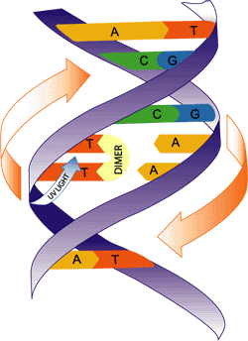
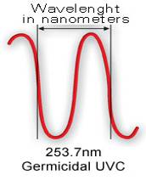
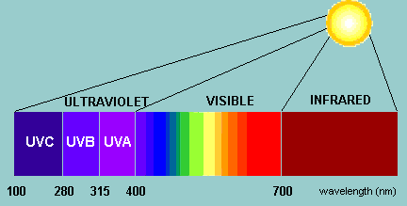
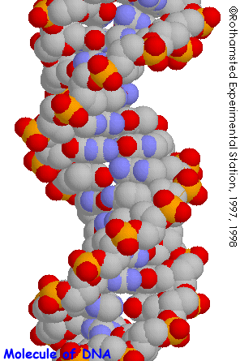
General principle of UV operation
UV light inactivates cells by damaging their DNA
Creates Thymine Dimers
Inhibits DNA replication
8

Slide 9
Basic Terminology
UV Dose is the amount of UV light energy that the microorganism was exposed to, crossing the reactor.
The UV Dose units are mJ/cm².
UVT is the % amount of light that passes through 1cm of water
(Water) Flow

Slide 10
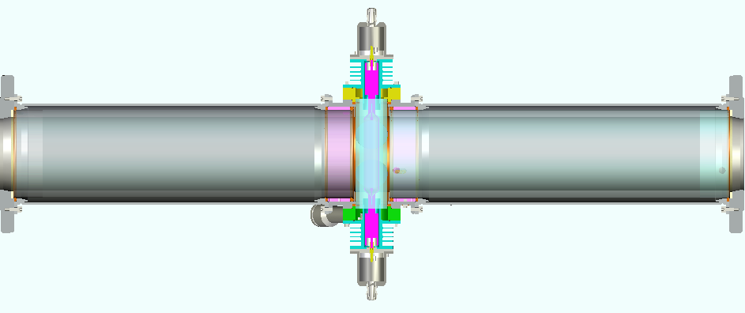
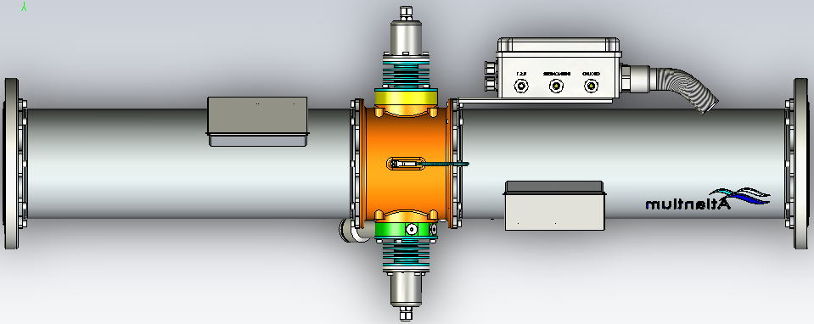
Operation principles:
Stainless
Air Block
Quartz Tube

Slide 11
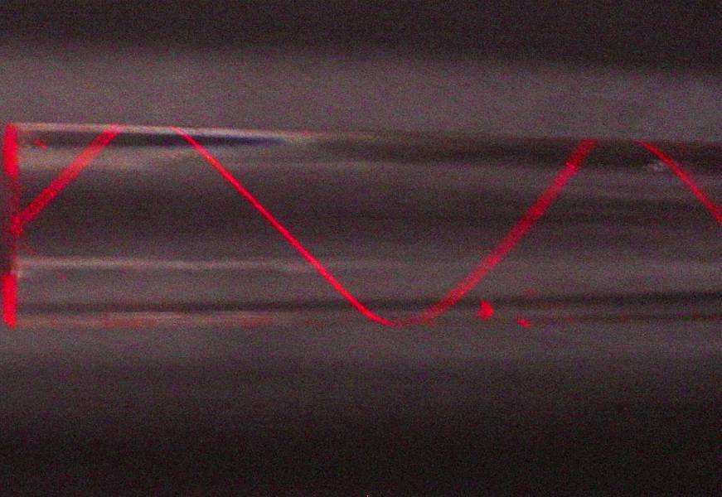
Total Internal Reflection - The hunt goes on…

Slide 12
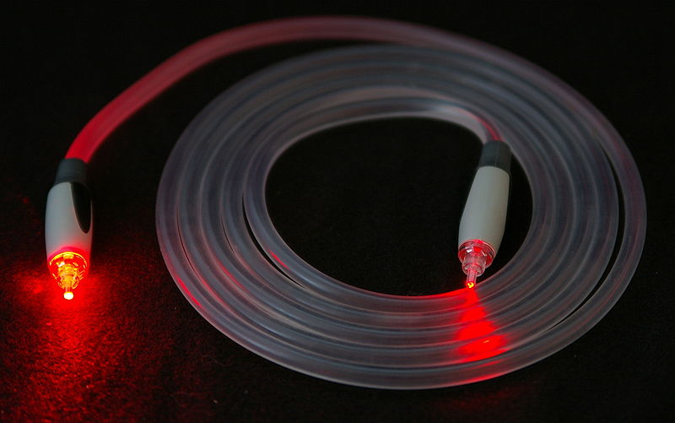
Total Internal Reflection
12
Notes:
12

Slide 13
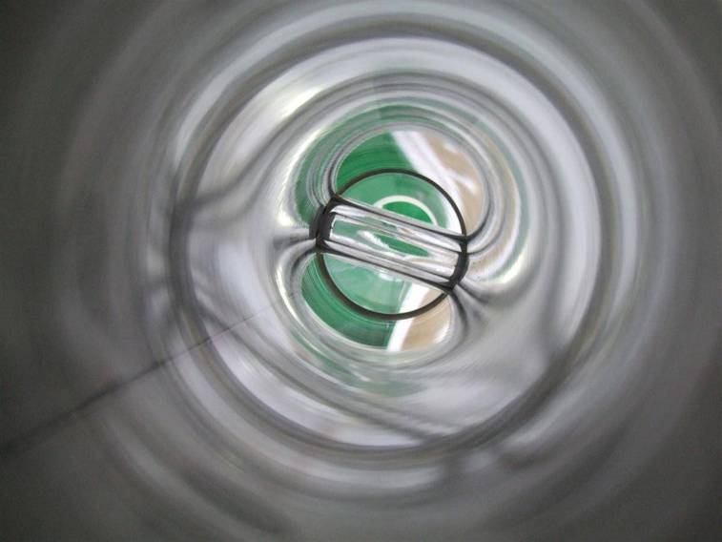
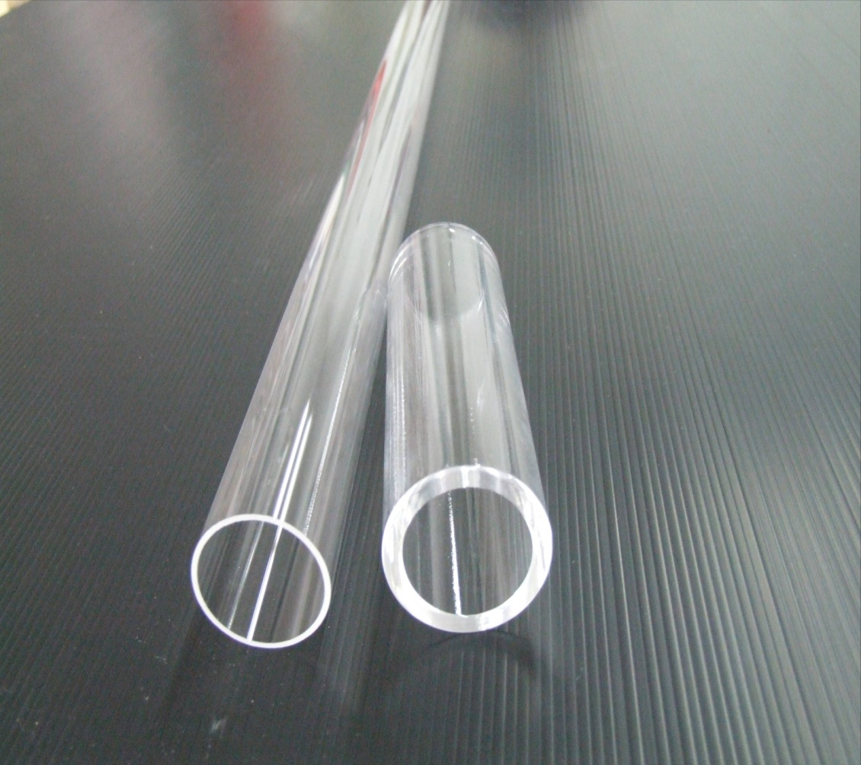
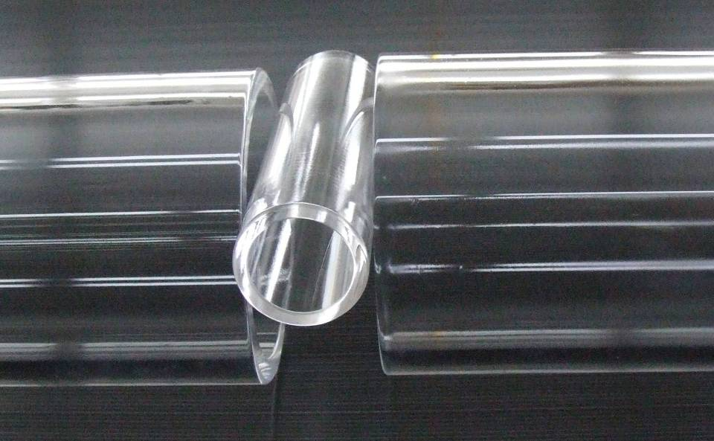
The Difference…
Commonly used
RZ series

Slide 14
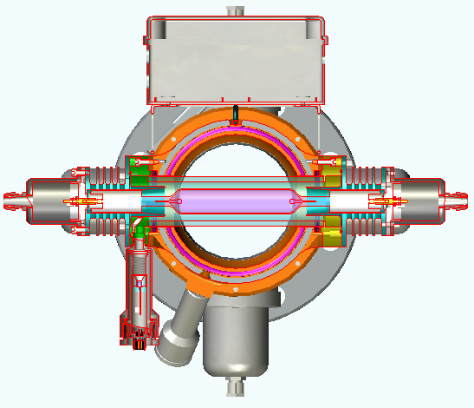
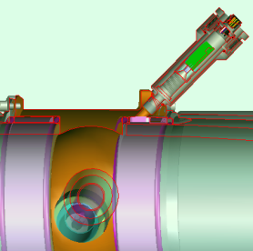
Sustained Performance - Dual sensors configuration provides actual dose measurement
Direct measurement of UV lamp efficiency
Built-in monitor for water Transmittance (UVT)
14

Slide 15
Dose Distribution and RED Effect
Average dose is not the REAL dose
Average Dose
Minimal Dose-
RED
3 LOG
Bacilus Subtillis
5 LOG
Escherichia. coli
5 LOG
Pseudomonas Aeuriginosa
5 LOG
Cryptosporidium hominis

Slide 16
UV Dose Distribution– Hydraulic & Light
Narrow Dose Distribution (No “Dim-Tracks”)
Average dose is not the REAL dose
Dose-Distribution Function Calculated for the HOD system with a UVT of 92% waters.
The “Chiu” Dose Distribution Function – Conventional Reactor
HOD System
Actual Dose
RED
Average
Dose
Low-Dose tracks
16
Notes:
16

Slide 17
The HOD Systems
  Control System

Slide 18
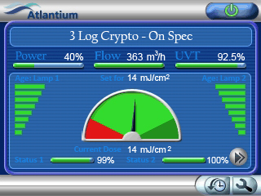
Lamp Power
Real Time UVT
Flow Rate
Lamp Hours
Minimum Allowed Dose
Validated RED
Maximum Allowed Dose
Lamp Performance

Slide 19
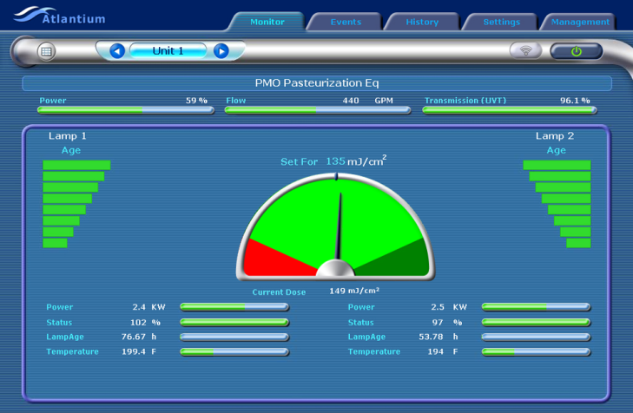
What You See is What You Get
  Water receives at least the minimum validated RED (Reduction Equivalent Dose) and not an average dose.
Required validated dose
Actual delivered dose

Slide 20
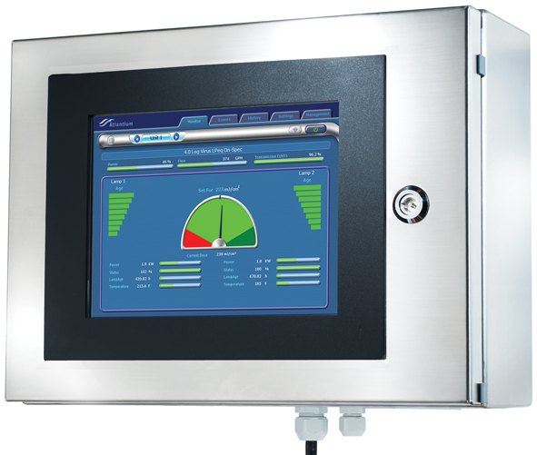

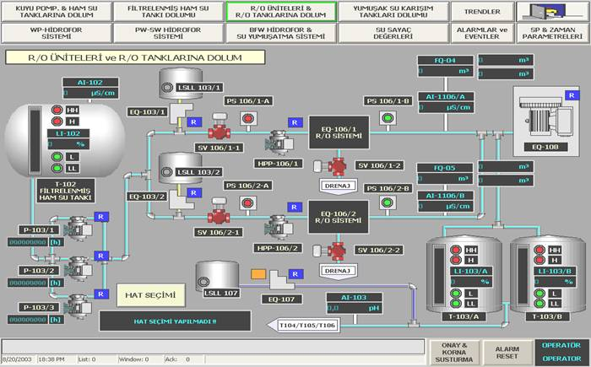


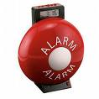


Comprehensive I/O Abilities
Computer
PLC
SMS
Alarm
Siren
Internet
Valve

Slide 21
The HOD Systems
TECHNOLOGY

Slide 22
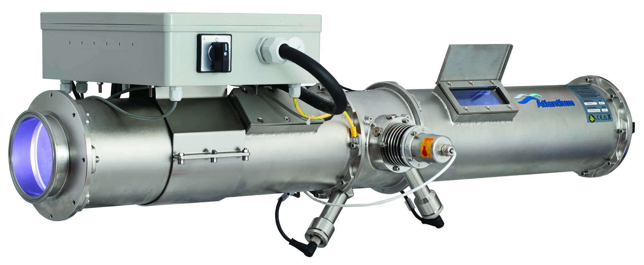
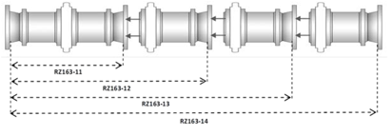
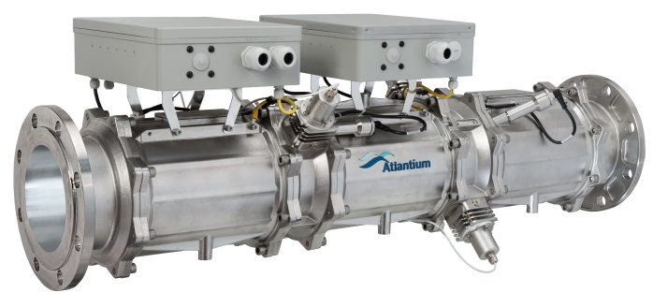
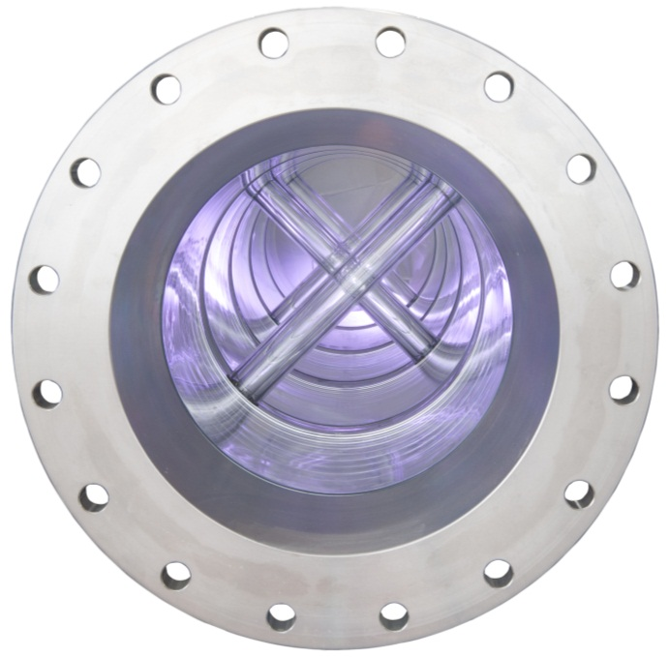
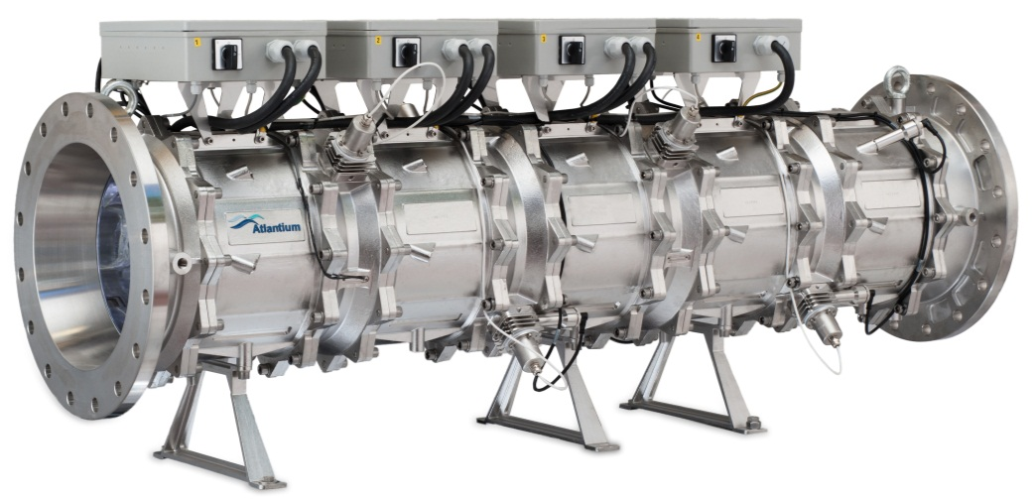
Hydro-Optic Disinfection – Product Lines
Modular Systems
RZ104-11
RZ163-12
RZ300-14

Slide 23
Validation

Slide 24
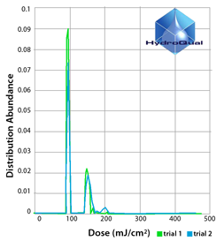

Uniform UV dose distribution
  Validation tests by Hydroqual tested true UV dose distribution of different UV systems
  The Atlantium system consistently delivered a uniformly-distributed UV dose throughout the water (more than any other UV system)
  All water receives at least the
  minimum regulated dose all the time
  All target pathogens inactivated
  UV energy used most efficiently

Slide 25
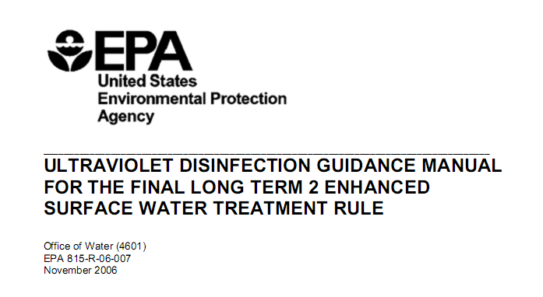
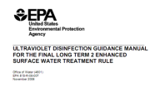
UV Systems – EPA Validation
  EPA validation guidance is the most expensive, strict and
  hard to obtain validation process for assuring that the validated
  UV system will meet the requirements
  Actually acts as an entry barrier
All Atlantium’s Hydro-Optic Disinfection systems
were designed and tested according to Dose approach method
and utilized validated dose delivery algorithm
Assuring delivering the needed dose
for avoiding the risk of under and over dose
25

Slide 26
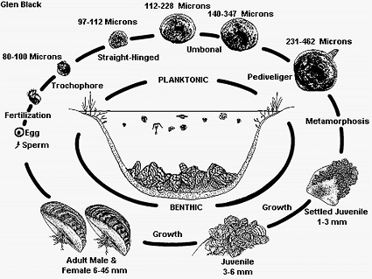
Mussels life cycle
Dose applied around shell – no where to hide
Source: http://el.erdc.usace.army.mil/zebra/zmis/zmishelp4/life_cycle.htm

Slide 27
Key points for HOD bio-security
No “low-dose” tracks within the HOD disinfection systems = no pathogen escapes the required UV dose.
Design according to RED as was defined by EPA third party validation
Medium Pressure lamps which a wide range of germicidal wavelength.
  Medium pressure also demonstrated to be much more effective against multicellular organisms such as larvae of macrofoulers
  Ref: Renata Claudi MSc. & Tom Prescott PEng. - RNT Consulting Inc.
Two sensors per lamp to ensure optimal and correct lamp operation.
Extensive laboratory and in-field testing of various industry-related micro organisms to ensure adequate dose is used in design.
Maximum utilization of UV photons ensures low electrical consumption.

Slide 28
Power plants - Pilots and Reference installations
Successful installation at Israel Power Authority : 4 and 6 months of follow up
Successful results from our pilot test on the Davis Dam located on the Colorado River (The pilot test is performed by Renata Claudi MSc., a recognized expert in the field of invasive species, accompanied by the compliance manger of RECLAMATION – U.S. Department of the Interior, Bureau of Reclamation) The statement from the intermediate report regarding the presence of Zebra Mussels after the Atlantium Unit following 5 weeks of follow up:
Pilot in Europe / Spain with Endesa – Endesa is one of the largest electric power companies in the world active in Europe, Latin America and Far East / China – pilot is operation – preliminary results from the first run – 100% kill following the HOD
Installation / Pilot in Brazil - hydroelectric plant – we have defined the installation with one of the biggest electrical power companies in Brazil, pipes at the plant were modified for our unit, the pilot is aimed for preventing the mussels penetrating the cooling system
“Results continue to look wonderful”
“The numbers are so low that any power plant would be happy with the result”

Slide 29
Israel Power Authority: installation results
Two lines with similar vacuumed pumps.
  Line #1 - 2 units one with HOD protection
  Line #2 – 2 units conventional operation
Line #2:
  Change over once a week (switching to standby system)
  Cleaning once a week (see photo)
  Temperature increased over 35C^{O} (requires cleaning)
Line #1:
  Change over once a week
  Unit with HOD protection - No unexpected cleaning required – 4 month.
  No Algae or mussels proliferation: no need for mechanical cleaning of the pipes.
  Temperature remains steady over one month 28C^{O}

Slide 30
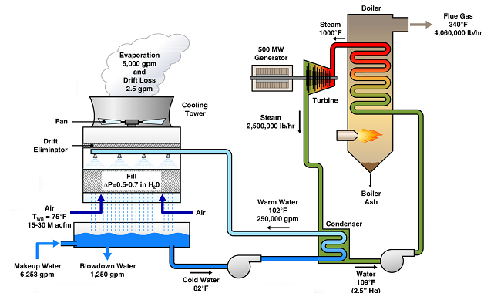
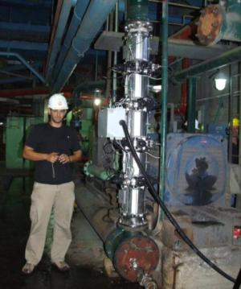
Successful Installation/Pilot at Israel Power Authority
Dramatic and immediate improvement:
Reduced fouling,
Eliminated need for cleaning!
Pilot description:
Two lines with similar vacuumed pumps
  Line #1 Atlantium system protection
  Line #2 Conventional operation
Conventional protection: high maintenance,
persistent fouling
  Change over once a week (switching to standby system)
  Cleaning once a week (see photo)
  Temperature increased over 35C^{O} (requires cleaning)
Atlantium system: immediate positive impact, reduced maintenance, no fouling
  Change over once a month
  No unexpected cleaning required.
  No Algae or mussels proliferation: no need for mechanical cleaning of the pipes
  Temperature remains steady over one month 28C^{O}
4 and 6 months of follow up - next three slides speak for themselves…..

Slide 31
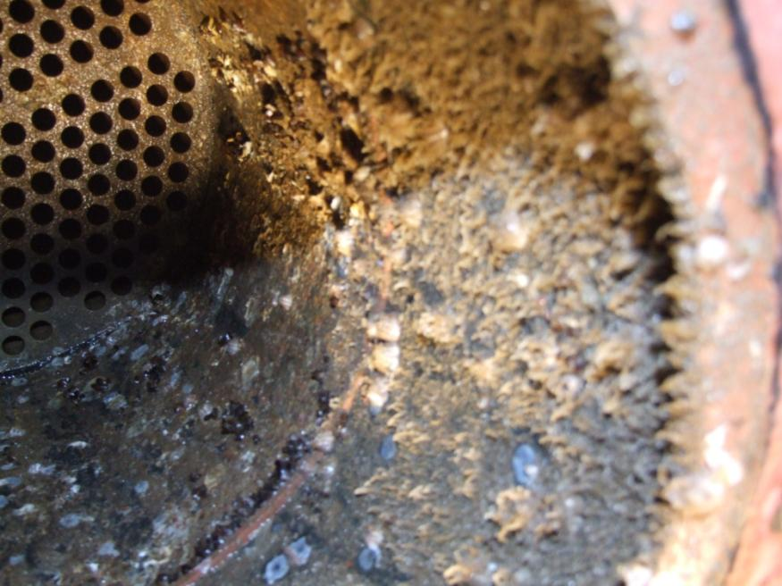
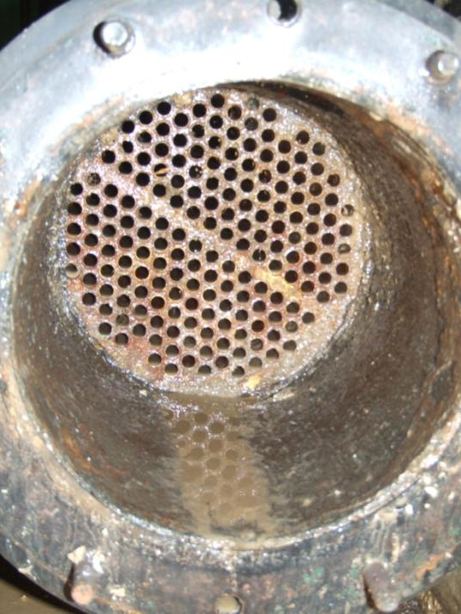
4 month follow up
Without HOD
With HOD

Slide 32
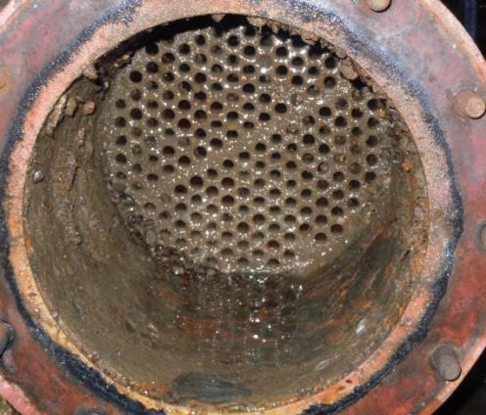
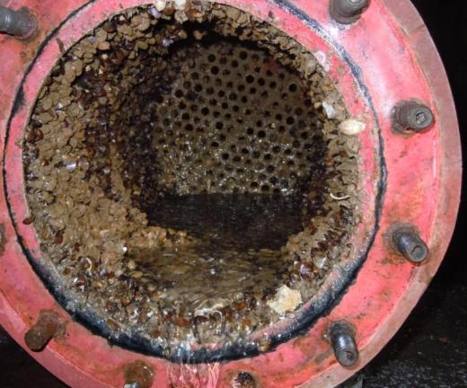
Unprecedented Results After 6 Months 11/11-5/12
With Atlantium System
Without Atlantium System

Slide 33
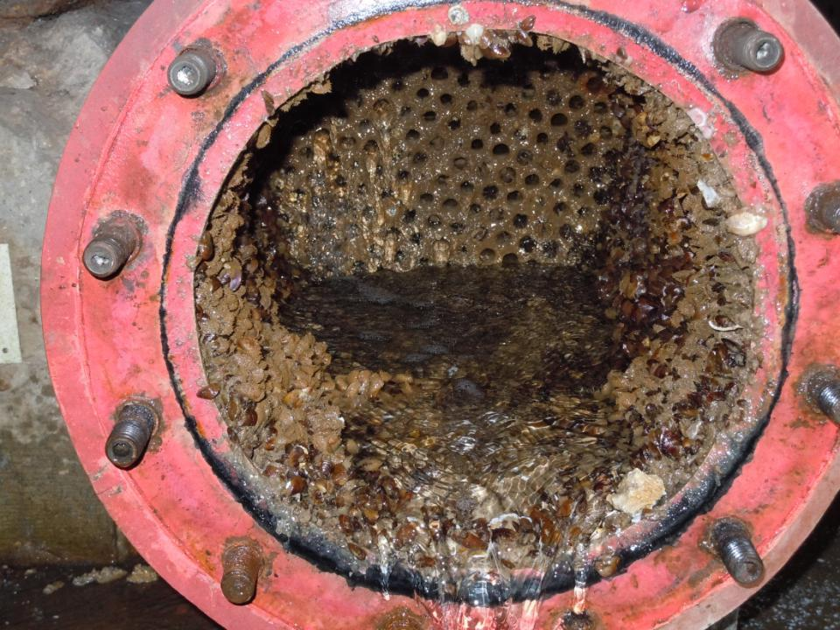
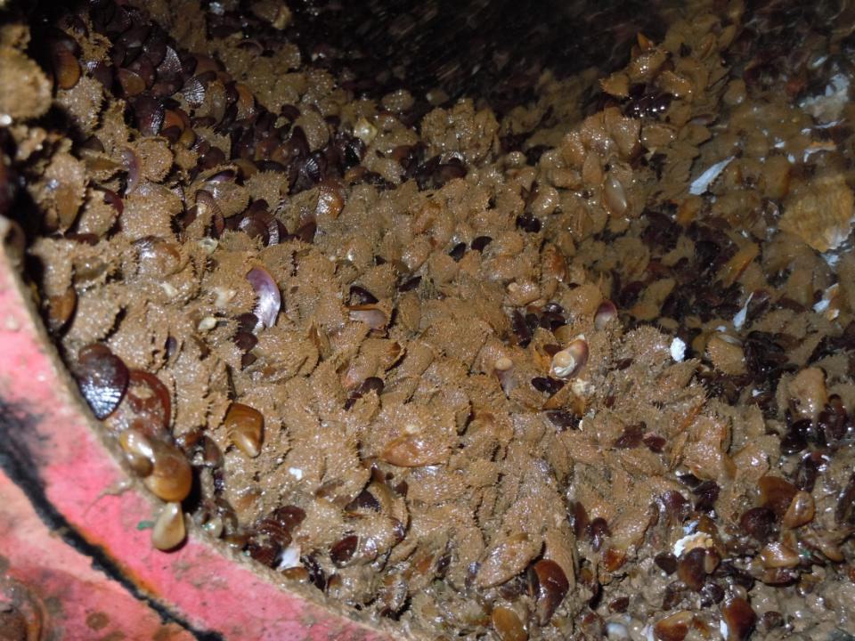
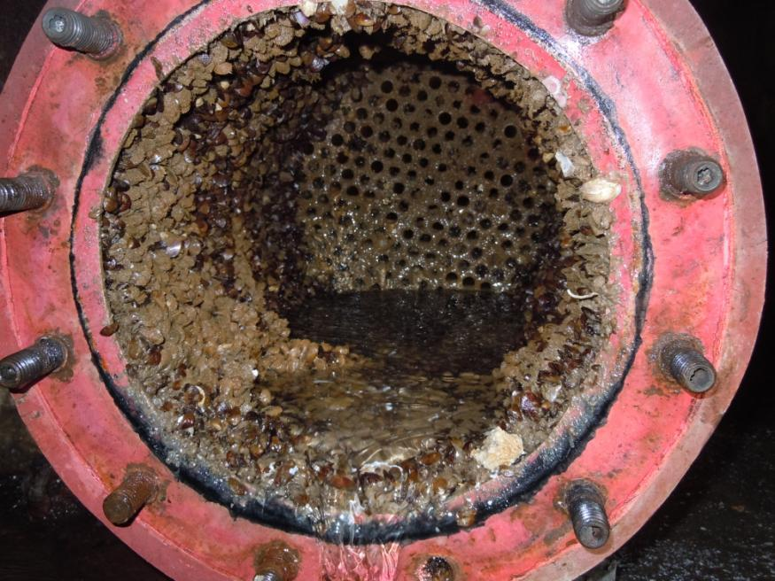
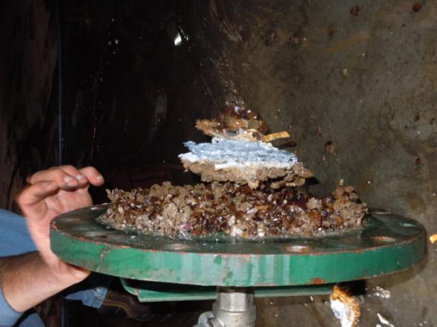
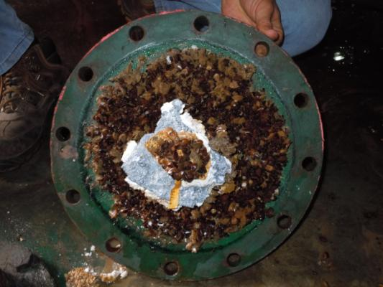
Unprecedented Results After 6 Months 11/11-5/12
Without Atlantium System

Slide 34
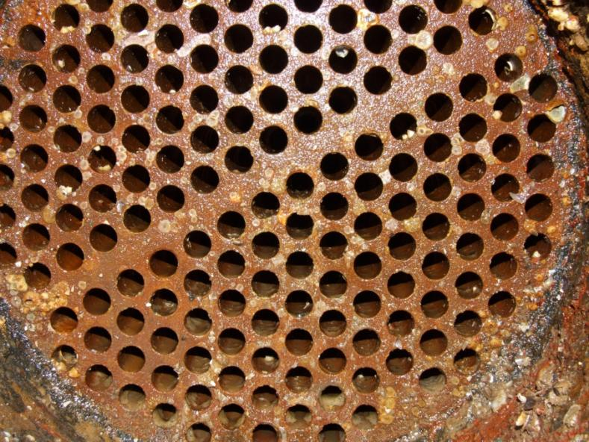
HOD treated heat-exchange: all pipes remain open

Slide 35
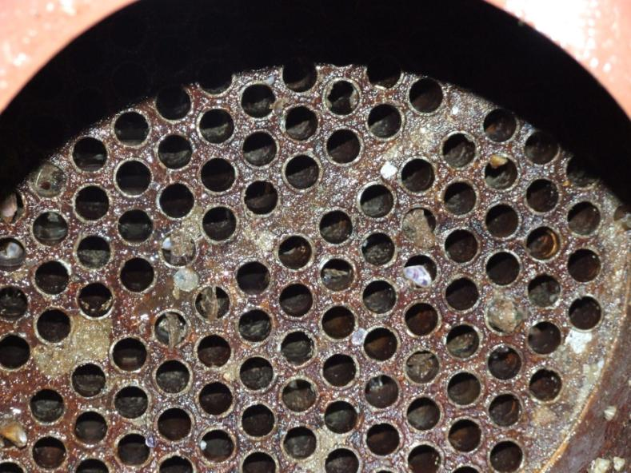
Blocked pipes in non-treated heat exchange

Slide 36
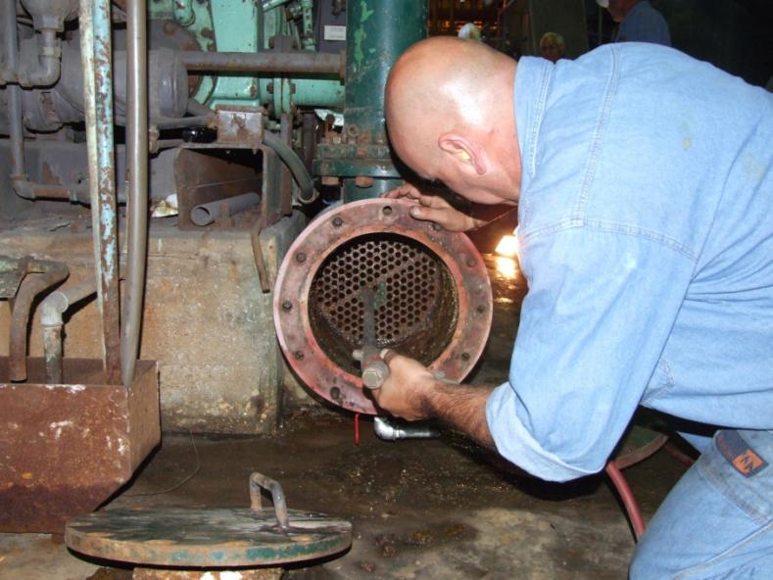
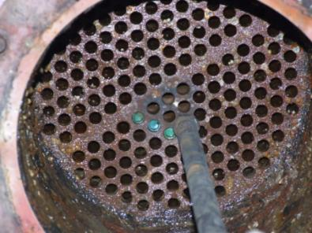
Bullets shooting for heat-exchanger cleaning

Slide 37
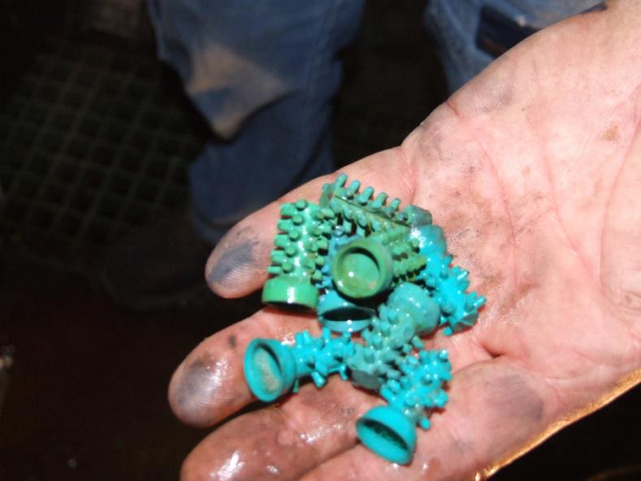
Bullets in HOD treated heat-exchanger: note no microbiological load

Slide 38
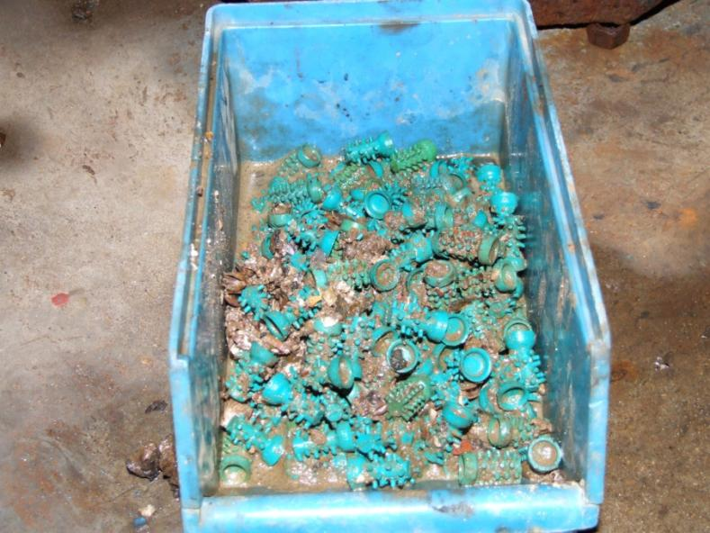
Bullets in non-treated heat-exchanger: note high microbiological load and sludge

Slide 39
Heat-transfer co-efficiency: a basic diagram
Shut-down and maintenance
Heat-transfer co-efficiency
Fouling formation
Energy usage
t_{n}

Slide 40
Heat-transfer co-efficiency: HOD solution
Shut-down and maintenance
Heat-transfer co-efficiency
Fouling formation
Energy usage
t_{n}
t_{t}

Slide 41
Comparison HOD Vs. 3 different competitors
Flow | Competitor A | # of lamps | Atlantium | # of lamps | Power ratio Atlantium / Competitor
95%, 90mJ/cm² 474m³/hr | 18kW | 3 | 8.4kW | 2 | 1:2.1
Flow | Competitor B | # of lamps | Atlantium | # of lamps | Power ratio Atlantium / Competitor
95%, 60mJ/cm² 350m³/hr | 3.6kW | 2 | 1.7kW | 1 | 1:2.1
Flow | Competitor C | # of lamps | Atlantium | # of lamps | Power ratio Atlantium / Competitor
98%, 60mJ/cm² 230m³/hr | 4.0kW | 1 | 2.4kW | 1 | 1:1.7
Notes:
The above data is from the bidding!!!
All HOD dose indications are EPA validated RED,

Slide 42



HOD Solutions
Reverse Osmosis
HOD system

Slide 43
ENDESA PILOT TEST RESULTS

Slide 44





Pilots in target territories
Pilot in Spain
Pilot in USA

Slide 45


Pilot in USA - Initial Results (5 weeks)
Mussels at early stage
About 98% -99% less, all are dead
Pilot in USA
Without Atlantium System
With Atlantium System
“I am confident the efficacy is in the 98% to 99% range” – Renata Cloudi
Notes:
RENTA 9899 אחוז

Slide 46

Low Total Cost of Operation
  Inline system, easy to install, easy to maintain: 4-minute lamp replacement
  Fully automated system requires minimum manpower
  Easily integrated to plant controls
  Protects against breakthrough and reduces bio-fouling: less down-time
  Reduces frequency of CIP schedules
  Replaces heat for water pasteurization
  Can replace chemicals for certain applications: storage/disposal/worker health issues

Slide 47


Hydro-Optic Optimization
1
  Fiber-Optic and Hydraulic principles applied to UV system design change the way that UV is delivered
  Quartz disinfection chamber surrounded by an air block
  Traps germicidal UV light rays and reflects them back into the water
  Longer light paths (more inactivation opportunities per UV photon)
  Attacks microorganisms from all directions
  Uniform dose

Slide 48
Integrated Software Layer
2a
2b
  Integrated Sophisticated software
  Two sensors per lamp enables automatic dose adjustment according to conditions in real time, for total reliability
  Integrated sensor continuously monitors UV lamp intensity
  UVT sensor continuously monitors water quality for UV transmittance
  External flow meter transmits water flow rate data
The required UV dose is maintained all the time
The most efficient use of UV energy: lower energy consumption, longer lasting lamps

Slide 49

Optimized UV Lamp Efficiency
3
  Fiber-Optic and Hydraulic principles applied to UV system design
  lamp
  Medium Pressure high-intensity polychromatic lamps
  1x Medium Pressure High-Intensity Atlantium lamp generates more UV than
  16x LP lamps or 2x MP lamps
  Fewer lamps needed: fewer replacements, fewer ballasts: lower costs
  Polychromatic light leverages entire germicidal spectrum
  Inactivates even highly resistant microorganisms and their repair mechanism
  Short lamps much easier to handle

Slide 50


Surface water – 25.3MGD / 4000 m³/hr - Aquaculture in Chile
Sea water - 14MGD / 2250 m³/hr - Aquaculture in Norway

Slide 51
ATLANTIUM’S CHARTER AIS PROGRAM
ATLANTIUM’S CHARTER MACRO/MICRO FOULING CONTROL PROGRAM
  ATLANTIUM WILL SUPPLY - AT NO CHARGE:
    System designed / supplied, at no charge, to client
    Hire RNT to oversee study, results and write up white paper
    Maintenance & lamps during trial
  Utility will supply:
    Installation of system
    Analytical / testing mutually agreed upon by RNT and Utility
  At conclusion of trial:
    With success:
      Utility can purchase the system or continue on a lease / maintenance fee
    Return system at no charge

Slide 52
Atlantium Solution: More Efficiency Less Costs.
Proven Comprehensive solution
  Directly targets mussels and algae
  Pro-active instead of a Re-active approach
Dramatically improves power efficiency
  Optimize heat-transfer coefficient - $$$
  Extend maintenance intervals and plant shut-down
Significantly reduces chemicals usage
  Decreases corrosion, erosion and scaling
  Improves compliance with regulations – BEST in RISK Mitigation
  Employee Safety
Easy to implement:
  Small foot print
  No contact time needed (tanks)

Slide 53
SAFE, SIMPLE AND SECURE
Thank You
Atlantium Technologies Ltd.
DENNIS BITTER
Director of Sales - Aquatic Invasive Species
(714) 305-6111 mobile
(941) 923-9990 office
Atlantium Technologies Ltd.
Har Tuv Industrial Park
POB 11071, Israel 99100
Tel: +972-2-992 5001
Fax: +972-2-992 5005
info@atlantium.com
www.atlantium.com

Slide 54
Operation principles:
Stainless
Air Block
Quartz Tube

Slide 55


Medium Pressure Lamps are Better
  Uses entire germicidal spectrum for much better efficiency (200 - 415nm)
  Totally inactivates cells by damaging their repair mechanism
  Creates Thymine Dimers to inhibit DNA replication
  Adenoviruses are 2-3 times more sensitive to Medium Pressure UV
Sun’s light spectrum
Penetrates cell membrane
55
55

Slide 56
Atlantium - Dual sensors configuration
Dual sensors configuration provides actual dose measurement
Direct measurement of UV lamp efficiency
Built-in monitor for water Transmittance (UVT)
Notes:
לעשות בקליקים

Slide 57

Atlantium - Advanced Monitoring Capabilities
► Accurate monitoring and real-time control - Cruise control

Slide 58


Unprecedented Results After 4 Months 7/11-11/11
Without Atlantium System
With Atlantium System

