Slide 1
Hydro-Optic Disinfection™ Technology
Achieve high levels of primary disinfection with Atlantium’s environmentally-friendly solution - unmatched reliability and cost effectiveness
Notes:
Atlantium technical presentation
HOD technology
Rev_V2
01.02.07

Slide 2
About Atlantium Technologies

Slide 3
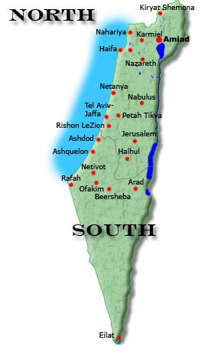
Atlantium H Q

Slide 4
Established 2004
HEADQUARTER ISRAEL – BEIT SHEMESH
EMPLOYEES 70
SEILLING IN OVER 50 COUNTRIES
DISTRIBUTORS OVER 50
Facts and figures

Slide 5
Company profile
Headquartered in Israel – home to renowned innovation in high-tech and water technologies
  Local offices and activity areas
    North America
    Latin America
    China
    Australia
    East & West Europe
    Scandinavia
    Asia Pacific
    Africa
Comprehensive intellectual property portfolio
Field-proven technology
Focus on green, environmentally friendly technology
  No chemicals
  Lower energy consumption
5
Notes:
5

Slide 6
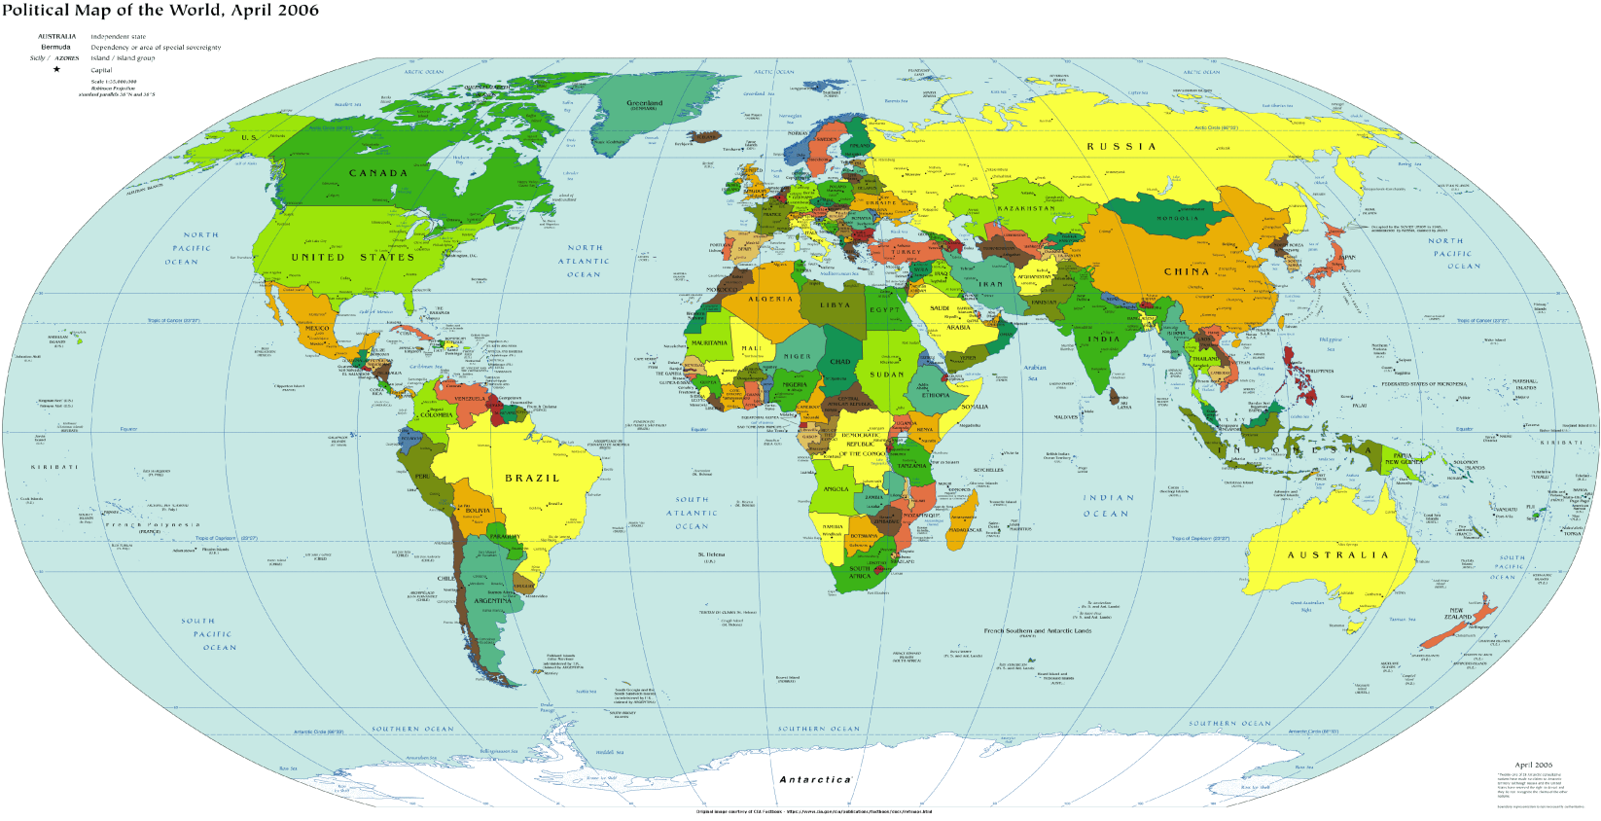
Notes:
6

Slide 7





About Atlantium
Israeli-based Atlantium is a world leader in sustainable water technologies that provide safe, energy-efficient water disinfection for water-dependent industries and municipalities
Atlantium’s technology is transforming the world’s water disinfection landscape with an ultraviolet (UV) based system that reaches levels of disinfection, performance and reliability never before attained without chemicals.
Atlantium's patented Hydro-Optic Disinfection technology is the only system that has been validated by third parties to meet stringent U.S. Environmental Protection Agency -EPA protocols for full virus protection.
A step beyond conventional UV reactors, Atlantium provides real time dose measurement and management that sustains better performance and greater reliability

Slide 8




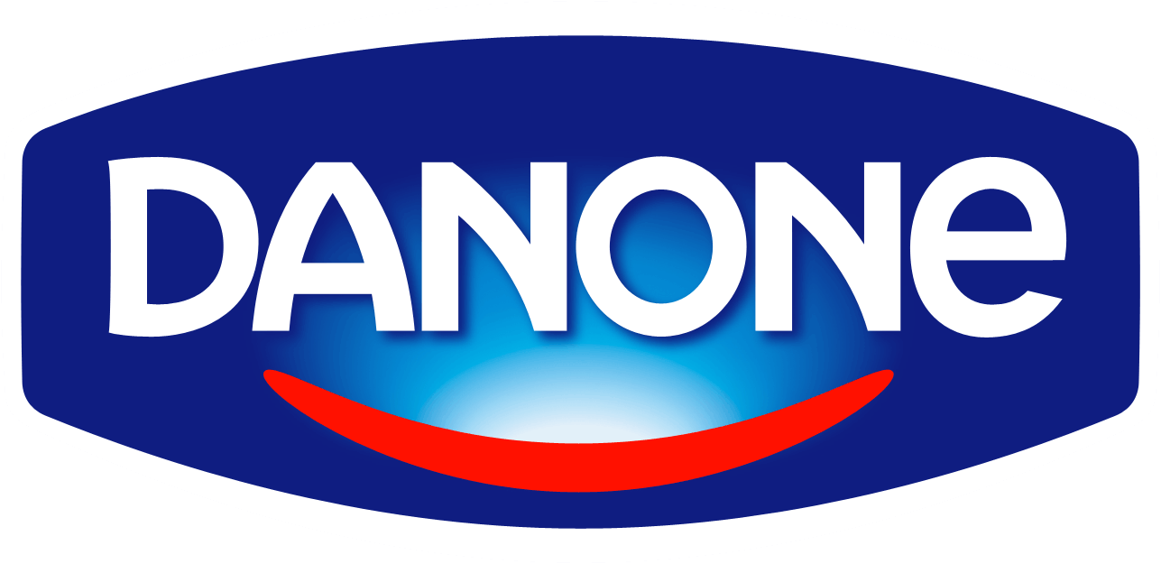




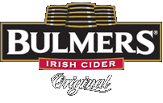




























Atlantium 's Segments & Main Customers
Beverage
Brewery
Dairy
Aquaculture
Pharma
Municipal

Slide 9
Atlantium’s Market Segments
Food and Beverage :
  Over 400 systems sold to plants around the world that are now protected by Atlantium’s HOD
  Dairy:
    New FDA (PMO) regulations places HOD technology as a cost-effective alternative to water pasteurization
    And for COW water disinfection
Aquaculture:
  Vast experience, combating viruses, fungus, algae and a wide variety of bacteria, the HOD technology has proven itself to provide effective and invaluable protection for fish producers.
Municipal:
  All systems are validated by third party according to EPA 2006 guidelines, Adeno virus validation,
  AOP –Advance Oxidation Process - Trace contaminants removal (AOP)
Pharma
  De-chlorination at the speed of light: avoid carbon filters and chemicals and the associated by-products with HOD de-chlorination application
Oil and Gas
  Atlantium is a sustainable Chemical free solution for the Oil and Gas segment
Power plants – invasive spices and Ballast water
  Atlantium in the process of expanding its offering including ––Ballast ;Zebra mussels (power station ) ; Low UVT applications;

Slide 10
The HOD advantages
Uniform Dose distribution
  All microbes exposed to the same UV-dose
High dose delivering capabilities
  Highest inactivation level
  Process Safety
Comprehensive monitoring and control
  Sustainable Performance

Slide 11
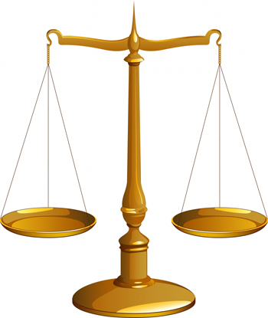
ROI
ROE

Slide 12
Atlantium advanced disinfection technology: Higher performance at a lower cost
Performance (log)
Atlantium
Hydro-Optic
Disinfection
Pasteurizers
Membranes
Ozone
Conventional
UV
Chemical
Treatments
Total Cost
Notes:
12

Slide 13
The HOD Systems
TECHNOLOGY

Slide 14
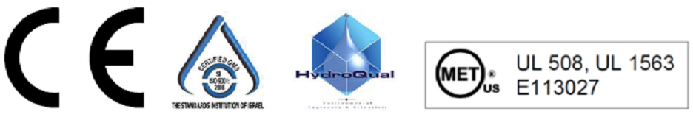
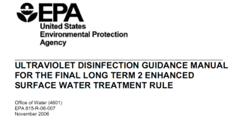

HOD Technology
Atlantium’s Hydro Optic Disinfection Technology is not a conventional UV system
* In process

Slide 15
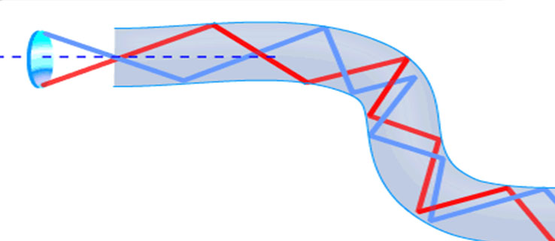
Atlantium’s Technology Principle
“The Liquid Wave Guide“
Adapts “Total Internal Reflection” principle as used in optical fibers

Slide 16
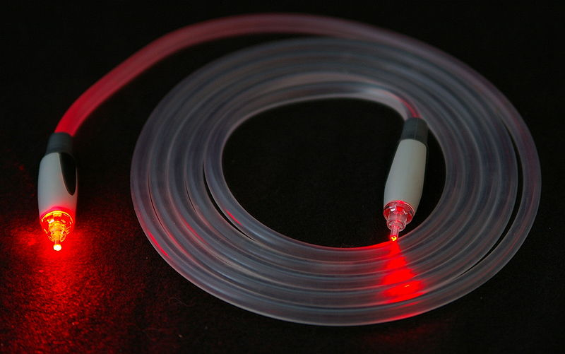
Total Internal Reflection
16
Notes:
16

Slide 17
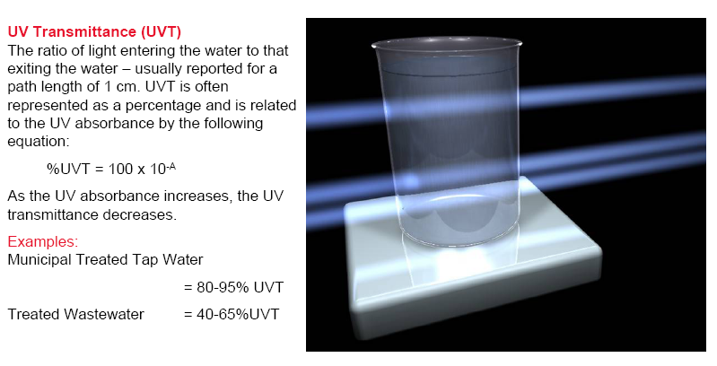
What is UVT?

Slide 18

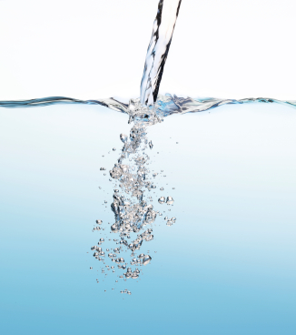

The Dose Function
UV DOSE
[mJ/cm²]
UVT [%]
FLOW
[m³/hr]
LAMP POWER [%]

Slide 19
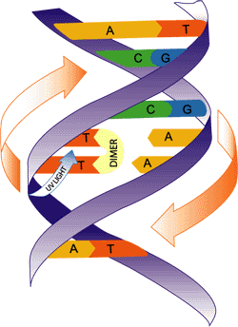
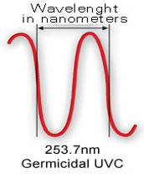
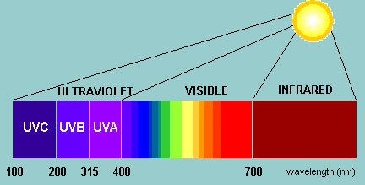
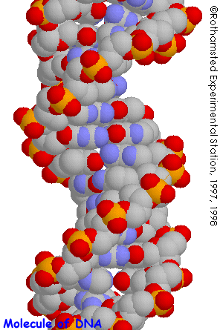
General principle of UV operation
UV light inactivates cells by damaging their DNA
Creates Thymine Dimers
Inhibits DNA replication
240 – 280nm is the most effective
Depends on target’s action spectrum
Disable repair mechanisms
Injure cell membranes
19

Slide 20
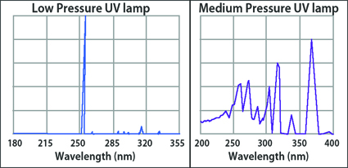
Medium Pressure vs Low Pressure UV Lamps
  Microorganisms such as E.Coli undergo repair following exposure to Low Pressure lamps. No repair is detected following exposure to Medium Pressure lamps
  A bench-scale study in 2009 indicated that Medium Pressure UV lamps can achieve >4-log reduction at economically viable doses lower than 100mJ/cm2, whereas Low Pressure lamps require 186mJ/cm2.
Low Pressure lamps emit one single wavelength (254nm), whereas Medium
Pressure lamps emit a broad band of wavelengths all over the germicidal UV areas (200 – 320nm).
20

Slide 21
  Designing for the right DOSE
120 mJ/cm² RED
FDA –
Pasteurized equivalent
HOD solution is 120 mJ/cm²
~16mJ/cm² RED – this is the actual min. dose that you get from conventional UV lamps suppliers
Atlantium’s Microbial Commitment
40mJ/cm² Average – All other UV lamp suppliers

Slide 22
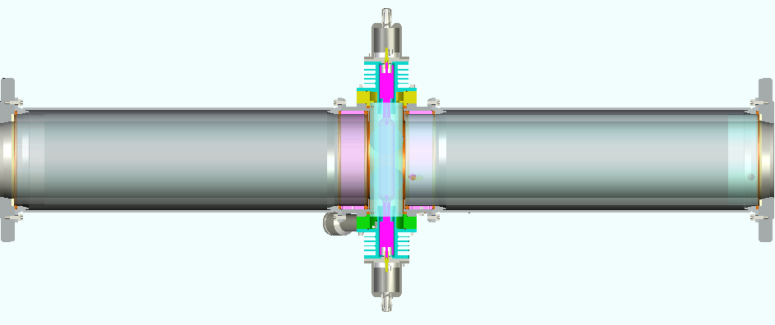
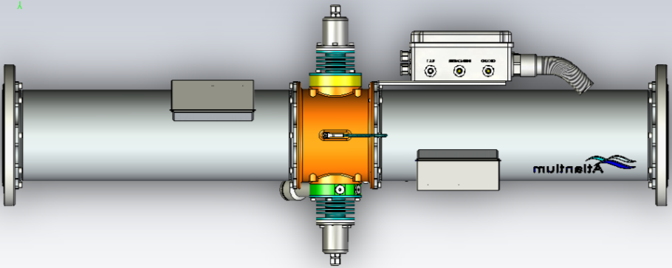
Operation principles: HOD system cross section
RZ104-11 a member of RZ series HOD system
Stainless
Air Block
Quartz Tube
HOD
Conventional

Slide 23
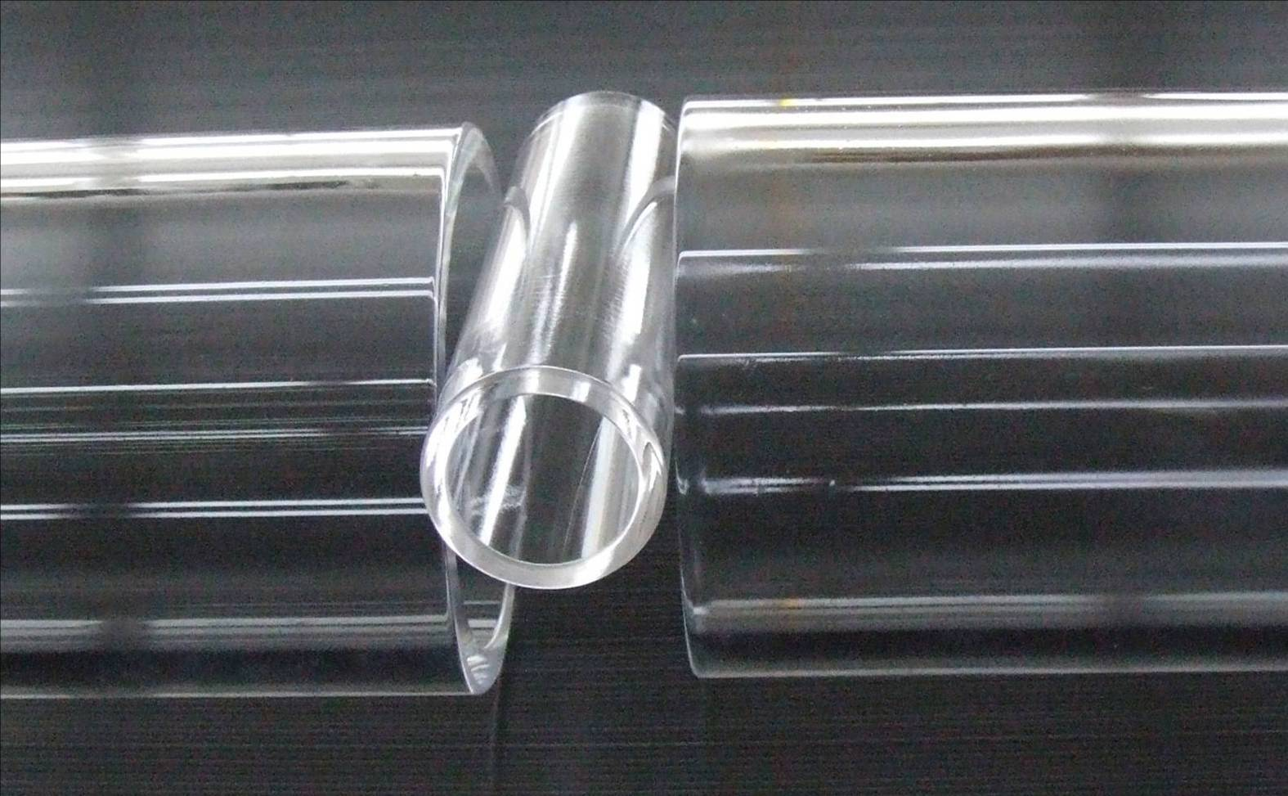
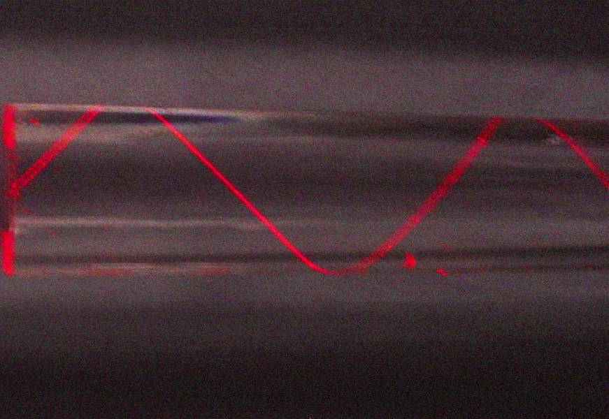
Total Internal Reflection - The hunt goes on

Slide 24
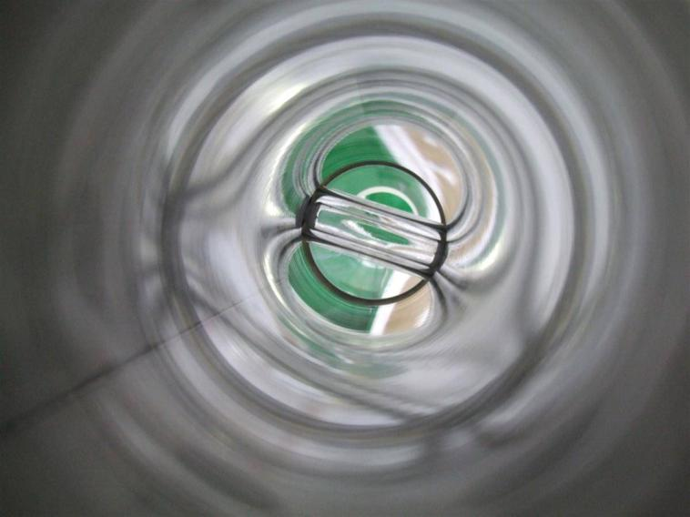
24

Slide 25
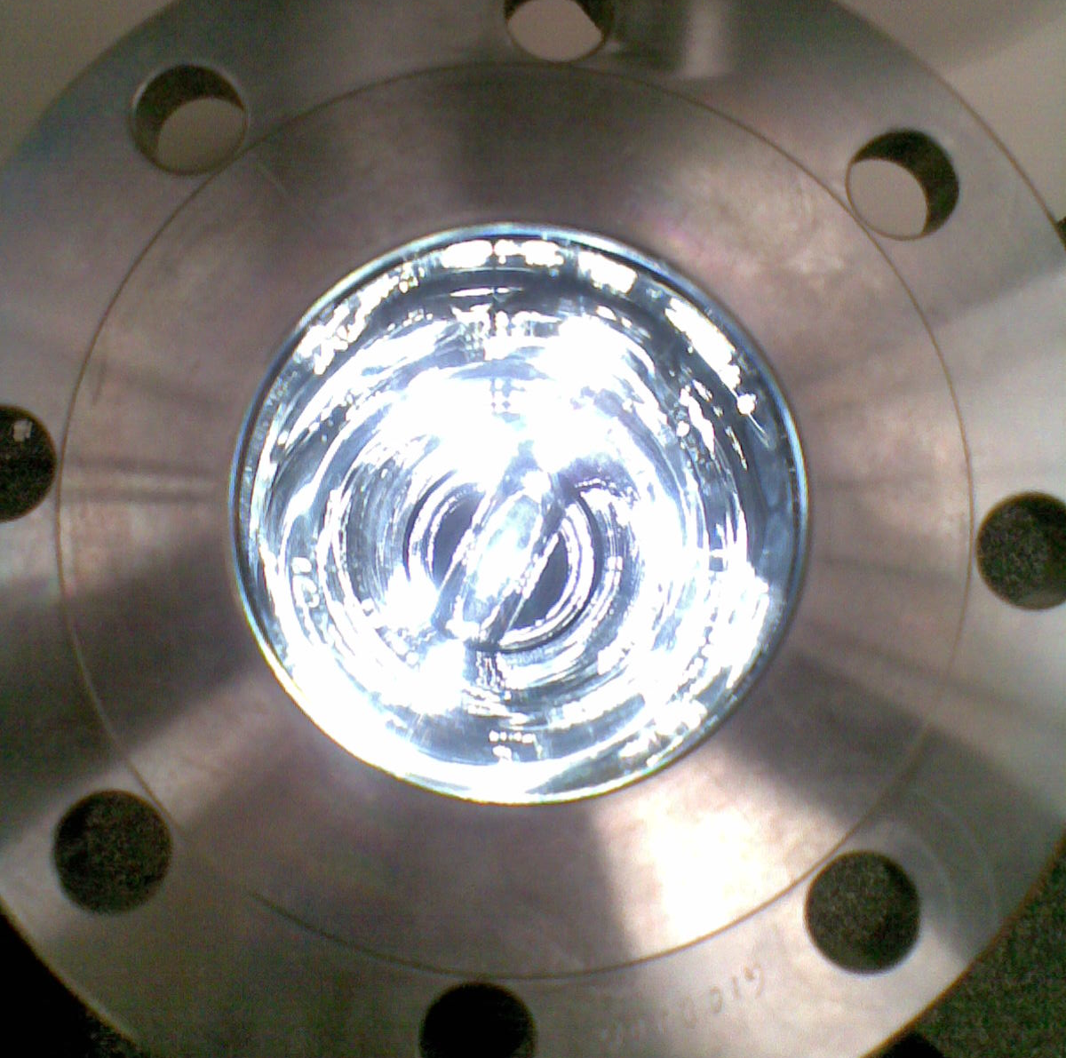
25

Slide 26
The HOD Systems
Robust Design

Slide 27
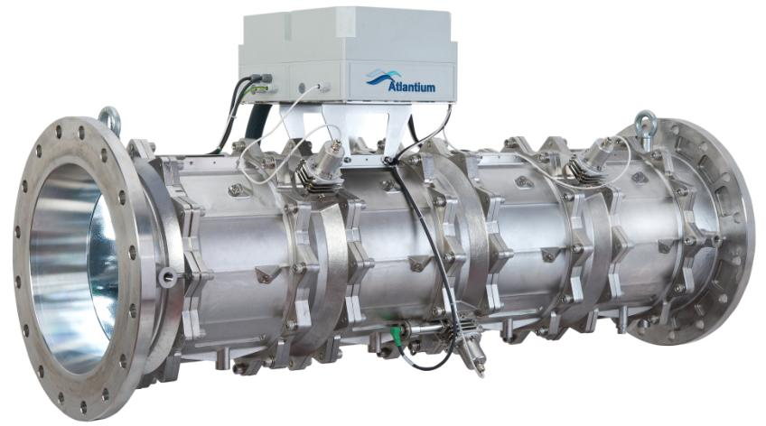
Hydro-Optic Technology – Inline Design
Over 60 Protected Patents
back

Slide 28
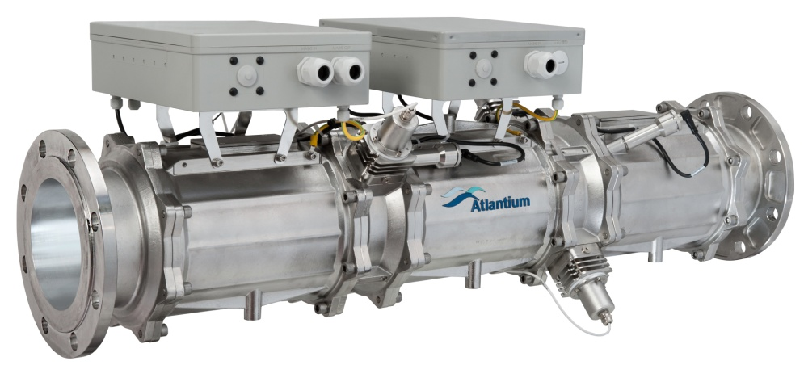
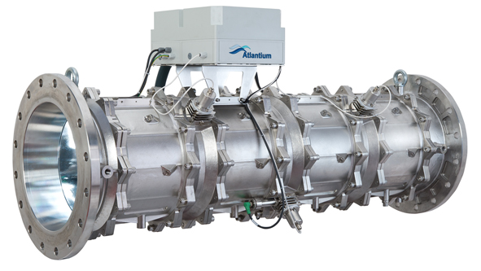
RZ Series HOD Systems
RZ104-11
RZ163-12
RZ300-13

Slide 29
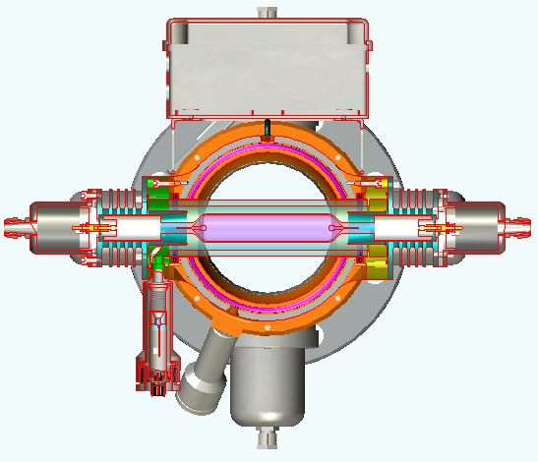
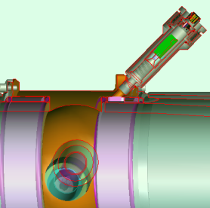
Sustained Performance - Dual sensors configuration provides actual dose measurement
Direct measurement of UV lamp efficiency
Built-in monitor for water Transmittance (UVT)
29

Slide 30
The HOD Systems
Advanced Monitoring

Slide 31
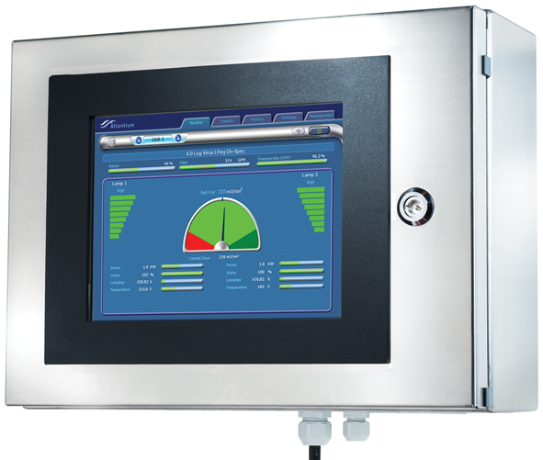

Slide 32
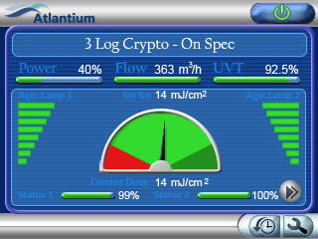
Lamp Power
Real Time UVT
Flow Rate
Lamp Hours
Minimum Allowed Dose
Validated RED
Maximum Allowed Dose
Lamp Performance

Slide 33
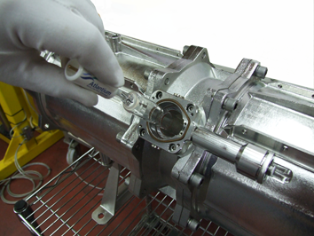
Low Cost Operation
  Inline system, easy to install, easy to maintain: 4-minute lamp replacement
  Fully automated system requires minimum manpower
  Easily integrated to plant controls
  Protects against breakthrough and reduces bio-fouling: less down-time
  Reduces frequency of CIP schedules
  Replaces heat for water pasteurization
  Can replace chemicals for certain applications: storage/disposal/worker health issues
33

Slide 34
True In-Line Configuration

Slide 35
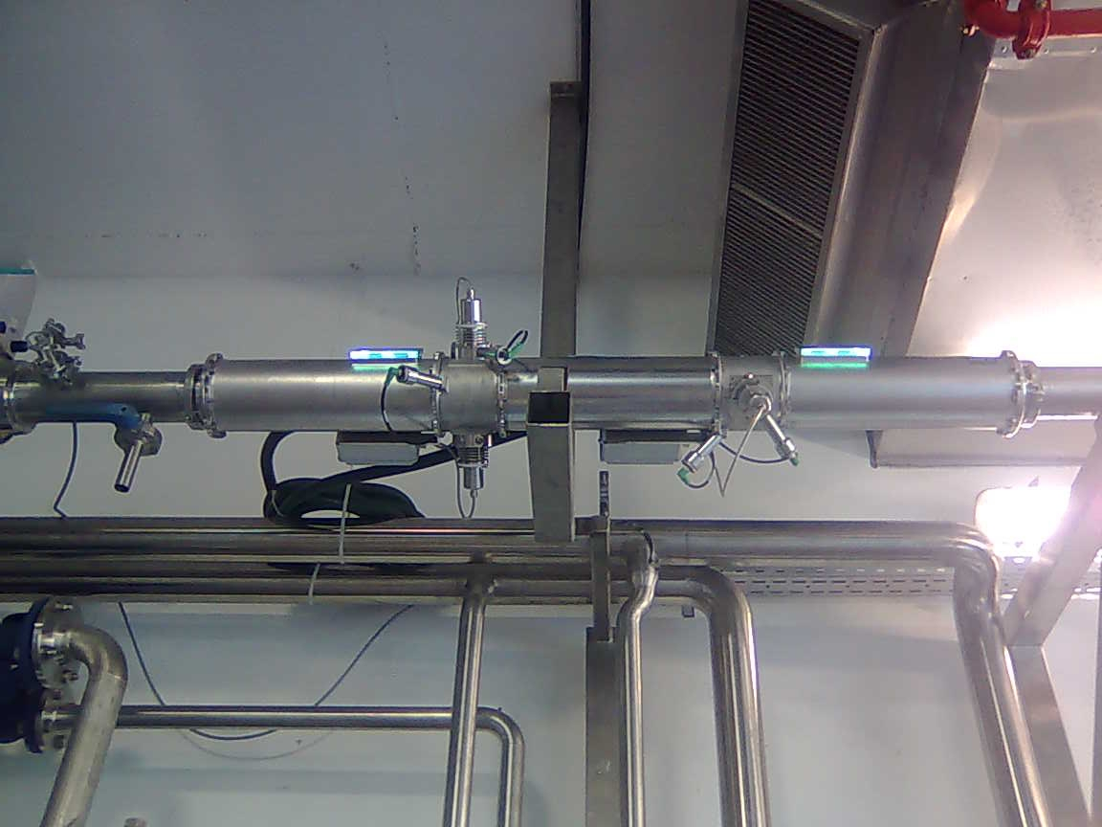
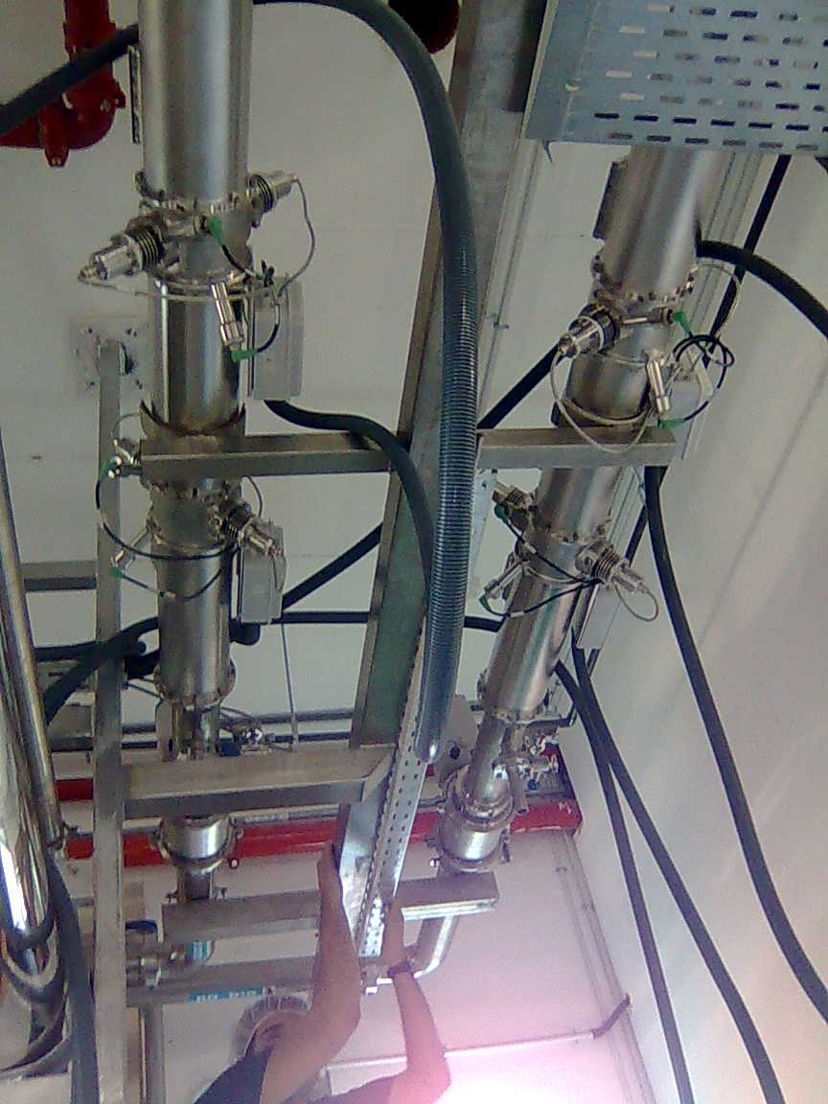
Hydro-Optic Disinfection - in-line solution

Slide 36
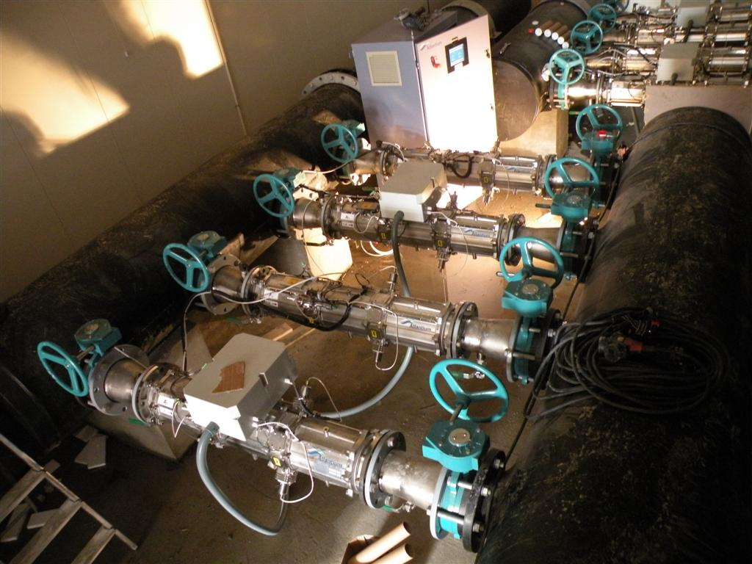
Installation of RZ163-12

Slide 37
The HOD Systems
Extremely Easy Lamp Replacement

Slide 38
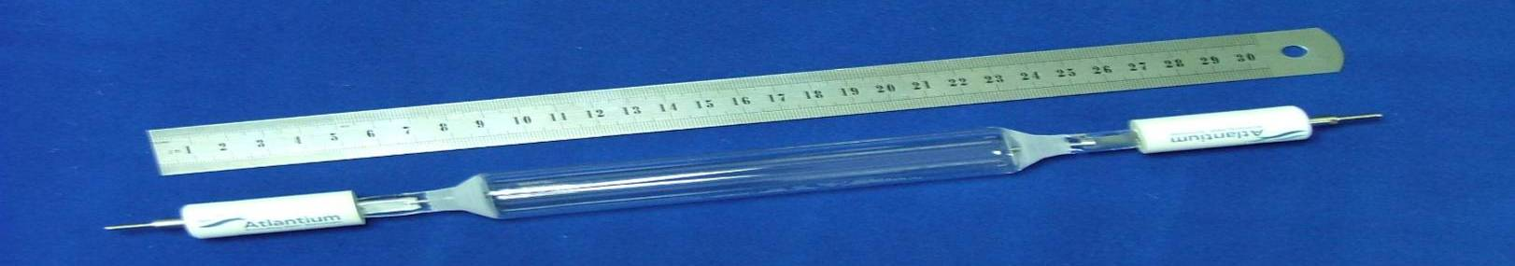
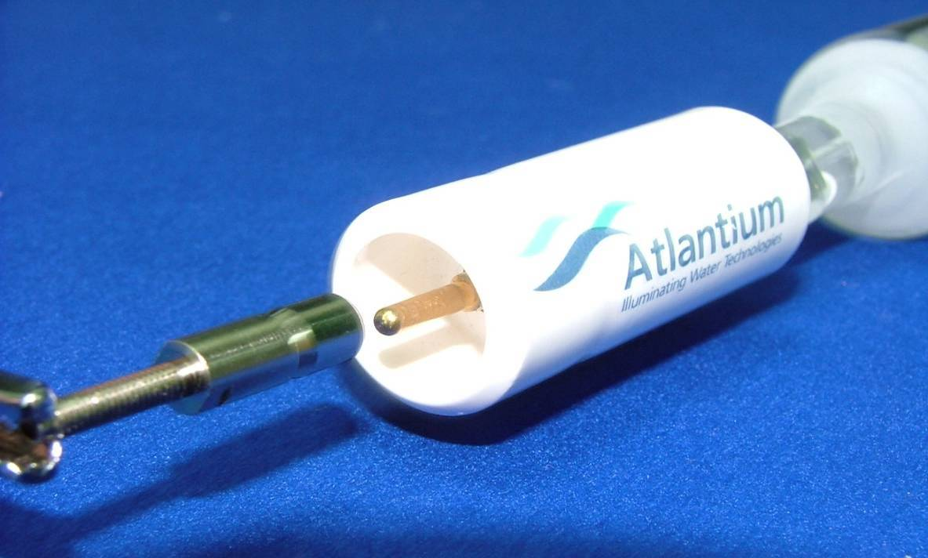
MPHI lamp – proprietary symmetric quick-connect

Slide 39
The HOD Systems
Comparison to others

Slide 40
HOD Applications

Slide 41
Value Proposition
Value | Application | Need
Saves energy Saves shut down time Increases product safety and shelf life | Post GAC Disinfection | Reduce maintenance and operation costs Product safety
Increases time between maintenance Extends membrane life | RO Protection | Reduce maintenance and operation Comply with company policy
Product safety and shelf life increase Maintains clean lines Avoids / reduces chemical usage Reduces maintenance expenses | Process Water Disinfection | Reduce chlorine usage Reduce pipe corrosion due to chemical usage Prevent contamination during production processes Increase process water safety
Notes:
41

Slide 42
Value Proposition
Value | Application | Need
Product safety and shelf life No risk of mercury in the water | Product Water Disinfection | Comply with corporate regulations Reduce M&O (“pasteurizers”) Eliminate risks Ozone destruction in production lines Product safety Increase shelf life
Product safety and shelf life | Firewall | All of the above
Green technology, fewer DBP’s | Chlorine replacement | Reduce chlorine usage Reduce pipe corrosion due to chemical usage Increase process water safety Comply with corporate regulations
Better efficiency (fewer lamps) Lamps out of the water | Ozone destruction | Comply with corporate regulations Eliminate risks Ozone destruction in production lines
Notes:
42

Slide 43
Water disinfection technologies today
Advantages
Issues
Chlorination
Relatively inexpensive;
Widely used and accepted
Disinfection by-products; Taste in food; Ineffective against Cryptosporidium & Giardia; Storage & handling; Creates issues for downstream processing - membranes
Ozonation
Effective;
Accepted in some industries
Disinfection by-products (Bromates); Hard to control with water quality flux; Difficult working environment; Many hidden costs
Membranes
Reliable;
Widely accepted
Not an absolute barrier; Sensitive to chlorine; Backwash treatment and biofilms contribute to high operational costs
Heat exchange (pasteurization)
Reliable;
Widely accepted
Extremely high operational cost; Intensive maintenance
Conventional UV
Environmentally friendly;
Widely accepted
Microbial Kill 1-3 log range; Deposits & fouling of quartz sleeves; High maintenance; Questionable reliability; Issues with monitoring and control
43
Notes:
43

Slide 44
Membrane Protection
Notes:
44

Slide 45
Atlantium Solution: RO Protection
Water safety
Less Chemicals, Energy & More product water
Less Down time
Maintain flux rate at lower Net Driving Pressure
Extend the period between consecutive CIPs
Reduce the risk of Microbial and Chemical contamination
Less Membrane replacement costs
Less Aggressive CIP required
Improved membrane recovery properties post CIP
Less Aggressive CIP required
45

Slide 46
HOD in Municipal

Slide 47
WHAT WE DO IN MUNICIPAL & HOTELS

Slide 48
Drinking water safe protection
Installation as “fire wall” at the entrance to the water tank
Installation to circulate the water in the storage water tank
Cooling tower protection
To protect the growth of alga in the cooling tower – to reduce the use of Chemicals and the running cost.
Heat Exchanger protection
To prevent Bio fouling that blocked the Heat Exchanger – Keep Efficiency of Temp transformation – reduce electrical consuming , maintenance , shout down time

Slide 49
COOLING TOWERS
Rapid growth of microorganism and creation of bio-fouling demands constant maintenance and down time.
  Bio-fouling formation and corrosion spells high operational costs and decrease in equipment’s operational life
  Product safety issues due to chemical and microbial contamination leakage into product
Issues springing from chemicals usage:
  Storage
  Environmental hazard
  Human risk
  Product risk
  Not effective against some pathogens
  In some cases needs to be bio-degradable or needs to be removed from water

Slide 50
Range of pH for Microbial Growth:
Bacteria | Fungi | Algae
pH 1 to 4 Few species (e.g., sulfur-oxidizing bacteria) | pH 1 to 5 Few species (e.g., molds) | pH 1 to 5 Very few species
Ph 4 to 8 Majority of species | pH 4 to 7 Majority of species (e.g., molds and yeasts) | pH 5 to 9 Majority of species
pH 8 to 11 Few species (spore-formers) | pH 7 to 8 Few species (e.g., molds) | pH 9 to 11 Few species

Slide 51
Range of Temperature for Microbial Growth:
Psychophilic | Mesophilic | Thermophilic
50-68 °F (10-20 °C) Few species, mainly bacteria and algae | 68-104 °F (20-40 °C) Majority of species | 104-167 °F (40-75 °C) Few species of bacteria and algae, very few fungi
Eliminating Bio-fouling and Organic needs a multi stage treatment process which might affects the scaling process

Slide 52
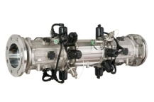
Aapplication
Cooling Tower
Make up water
Exit line to chillers
Hot water
Return line to cooling tower
Chillers
Cold water for production or general utilities

Slide 53
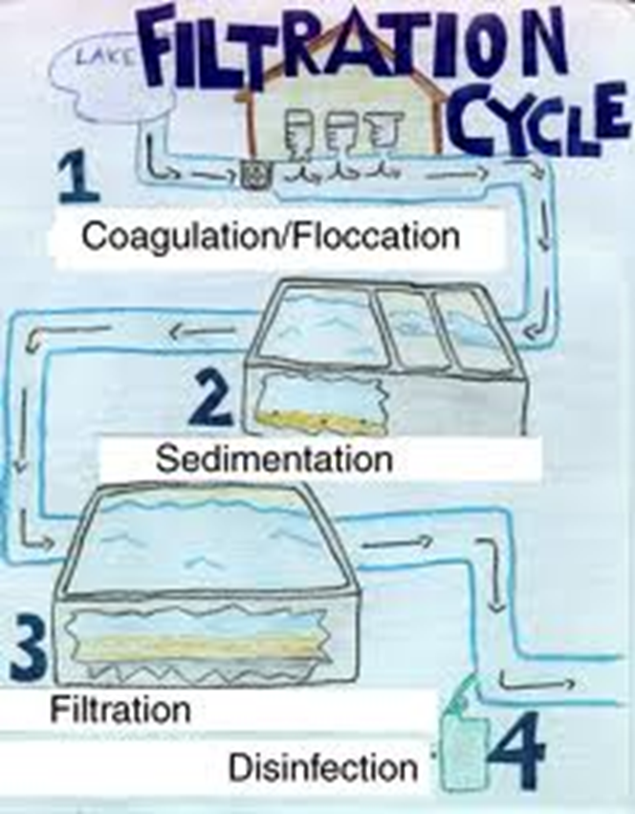
What do we do to keep the pathogens away and make drinking water safe?

Slide 54
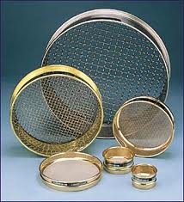
Keeping the pathogens away – cont.
We filter it:
Oops… many pathogens are capable of passing membrane filters of 1 µm pore size

Slide 55
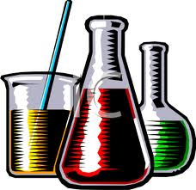
Keeping the pathogens away – cont.
We disinfect the water chemically: Chlorine, Chlorine Dioxide, Chloramine, Ozone…
Oops…
Notes:
Let’s poison them to death

Slide 56
Drawbacks of chemical disinfection
Taste, odor problems
Disinfection By-Products (DBPs) – may be carcinogenic.
Hazardous – dangerous to employees.
Large footprint (tanks for contact time).
Bad public relations – it’s NOT green.
… And in the end: it is not sufficient to make water safe.

Slide 57
Some Protozoa: hardly affected by Chlorine
Organism | Disinfectant | CT mg/l •min | Log-reduction | source | remarks
Crypto- sporidium | ClO₂ | 78 | 1 | Korich et al., 1990
 | Cl₂ | 15,300 | 3 | http://www.water-research.net/ | pH=7.5, T=25°C for swimming pools
 | Cl₂ | 7,800 | 1 | http://www.health.act.gov.au
Giardia | ClO₂ | 4.7–28 | 2 | Leahy, Rubin & Sproul, 1987; Rubin, 1988
 | ClO₂ | 180–530 | 4 | Hibler et al., 1987
 | Cl₂ | 45 | 3 | http://www.water-research.net/ | pH=7.5, T=25°C for swimming pools

Slide 58
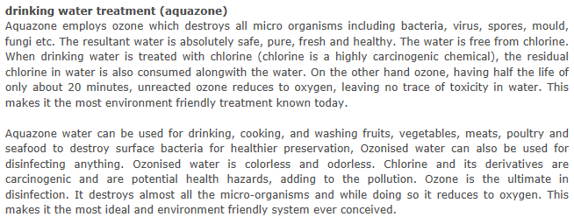
From a Mumbai 5-star hotel website:
Oops...

Slide 59
Cryptosporidium: A Chlorine-resistant pathogen
Milwaukee Cryptosporidium outbreak – 1996. ca. 400,000 sick, more than 100 dead.
Skellefteå, northern Sweden, 2010: 1,500 sick.
May 31, 2011, The Irish Times: “A boil water notice has been issued to residents in two areas of Co Roscommon after cryptosporidium was discovered in the water supply.”
Many other outbreaks.

Slide 60
Giardia: another Chlorine-resistant pathogen
the majority of reported incidents of waterborne giardiasis: surface waters which have only been treated with chlorine.
Treatment with Chlorine (or other strong oxidative agents only), should and is considered treatment deficiency!
American waterborne outbreaks of giardiasis include those of Rome, New York in 1974-75; Camas, Washington in 1976; Berlin, New Hampshire in 1977; Banff, Alberta in 1982; and Edmonton, Alberta in 1982-83.

Slide 61
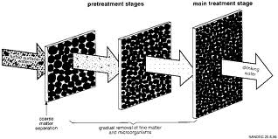
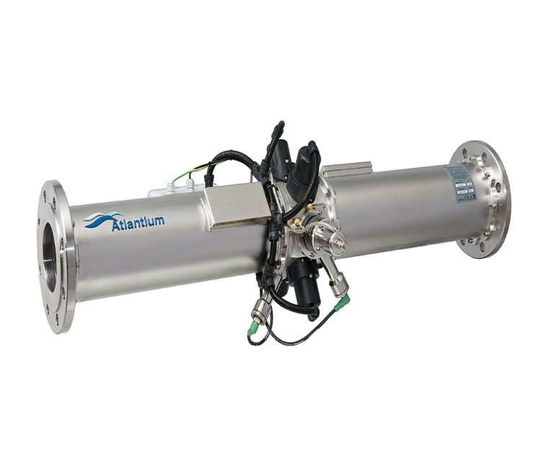
The Multi-Barrier Approach

Slide 62
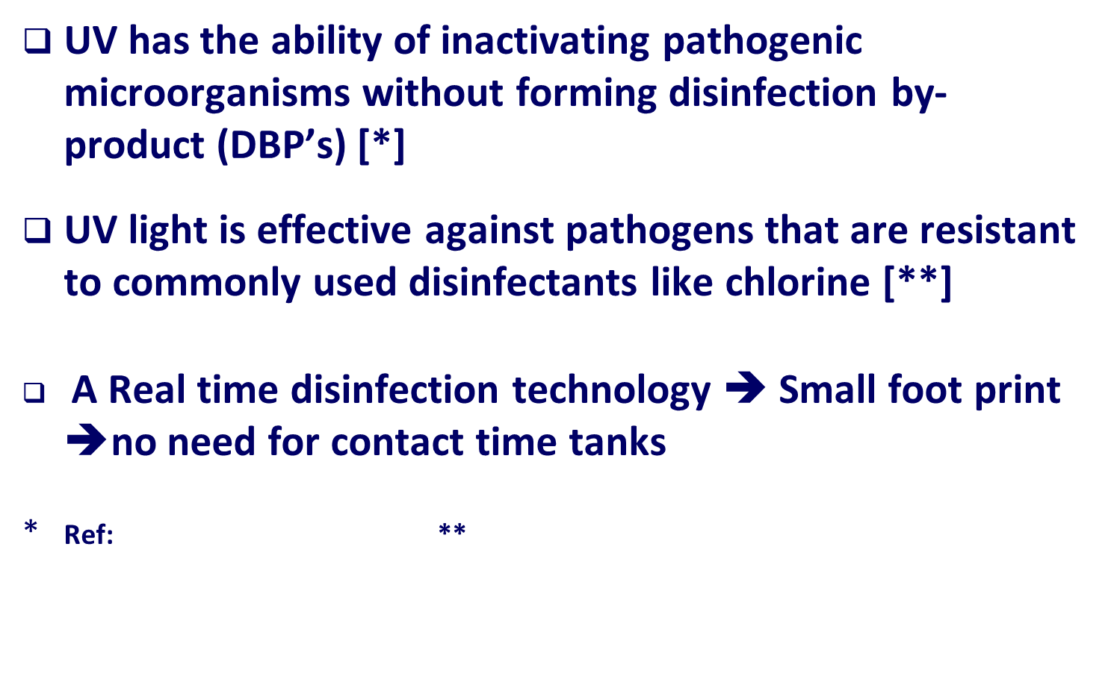
Why Using UV in a water security tool box?

Slide 63
WHY HOD SOLUTION?

Slide 64
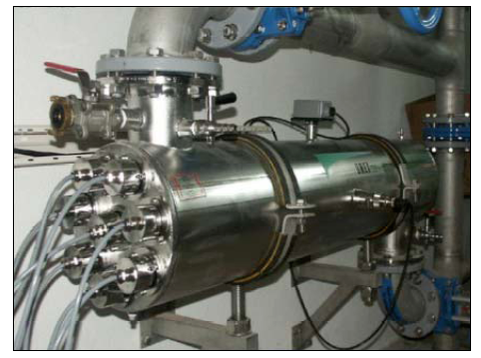
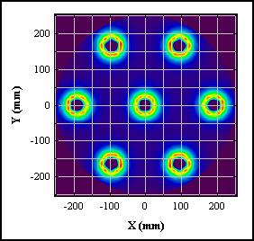

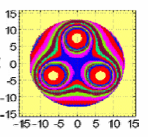
Conventional UV: Many lamps
Conventional LP UV
8 lamps but only one sensor!
Each lamp is treating part of the water
Microbes can escape!

Slide 65
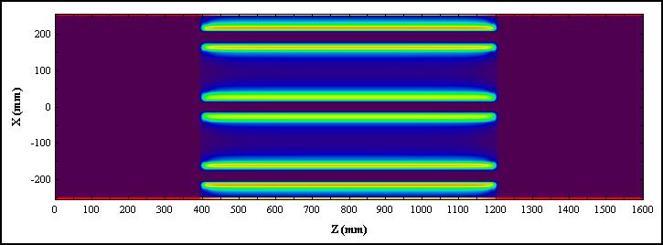
Dark Tracks: High Velocity Areas
Water velocity Between Lamps
Low light level
AND
High velocity Water
Low-dose tracks

Slide 66
The path of a particle
Conventional UV Reactors: sensors can measure intensity of UV light, but they cannot measure the dose delivered to the microorganisms as they pass through the reactor at different trajectories.

Slide 67
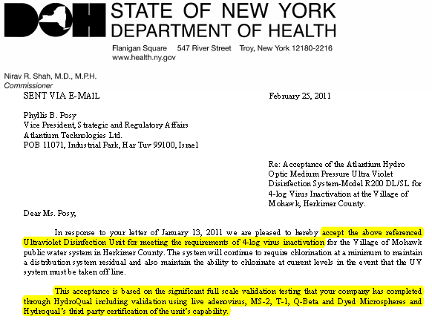
NY State DOH: 4-log virus credit for Atlantium

Slide 68
the municipal segment
Green and clean solution for drinkable water in prime residential projects
Municipal
Ground water
Surface water
Pre and post RO
Public institutions - govt. buildings , hospitals, etc.
Hotels
Up market residential projects
Provide drinking water and water security for clients in prime hotels
Lowest cost of ownership for small and medium drinking water plants
Reduce biofouling and cleaning cycles of membranes
Primer disinfection against 4 log viruses (GWR)
Provide security against biological threats

Slide 69
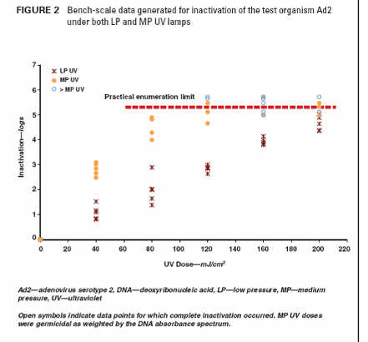
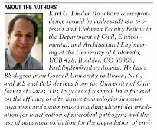

HOD - EPA Validation – Virus Validation
Atlantium is the only UV company that validated its system against viruses
4 Log Adenovirus disinfection can be achieved now
MP are more efficient then LP
-less dose is needed

Slide 70

Mohawk, NY
Mohawk village in NY.
Installed Sep. 2008
Purpose: set as a replacement for chlorine injection , since the previous system had no sufficient CT before 1st customer.
Achieve 4 log reduction in viruses- pending NY municipality approval.

Slide 71

Sofitel Plaza Saigon: promise safe drinking water

Slide 72
Application: Legionella prevention (multi-story buildings, mines)
Legionella thrives in water tanks (closed reservoirs). Growth range - 25 to 45 °C.
Water mist is sprayed into the air, for instance when irrigating gardens, inside and outside a hotel. Also in mines, water in tanks for dust-suppression.
Legionella transmission is via inhalation of mist droplets containing the bacteria.
Chlorine treatment: to achieve efficient results, up to 3 ppm free residual chlorine – taste, corrosion, carcinogenic byproducts.

Slide 73
Legionella prevention In a multi story building

Slide 74


Protection of Water Sources: Aquifers
All The Ministry of Health requires either removal of the sewage piping outside protection radii, or to sleeve it with double-cement layer ($, $, $...)
But MoH acknowledges Atlantium™ HOD technology as a barrier where sewage piping are within protection radii from a water source.

Slide 75

Applications: swimming pools, Mines Re-injection
Disinfection of swimming pool water: with Chlorine only – high concentration, odor problem. Combined with Atlantium HOD – low Chlorine concentration, clear and safe water.
Dewatering and Re-injection Bore Holes:

Slide 76
water protection in a multi-building compound
Circulation loops prevent stagnation and algae build-up

Slide 77
Consequences of Micro & Macro fouling
Increased overall costs
Ecologic:
  Additional emission water: Chemicals
  Additionla emission air: NO_{x,} SO_{2,} Co_{s}
Economic:
  Profit loss
  Increased operation expenditures
  Loss of unit availability
  Increased maintenance expenditures
  Increased depreciation requirements
Profit loss due to lost output
77

Slide 78

Micro fouling – Bio fouling
Micro fouling – Bio fouling

Slide 79
Cooling water prtoection
Cooling Tower
Make up water
Exit line to chillers
Hot water
Return line to cooling tower
Chillers
Cold water for production or general utilities
79

Slide 80


Slide 81
Reduce biocides usage
  Reduce overall chemicals intake
  Avoid safety and health hazards associated with chemicals usage
  Reduce corrosion
Improve product safety
  Prevent contamination of product water
  Avoid leakage of chemicals into product water
Reduce maintenance
  Save energy and water
  Gain more production time
  Lower overall operational costs

Slide 82

Macro fouling—Mussels & Algae
Enters cooling water circuit through the make-up cooling water
(sea water, rivers or lakes)
Develop inside the heat exchanger or water lines
Causes fouling of the surfaces of heat exchangers and may cause deterioration of the relevant heat transfer coefficient
May also create flow blockages, redistribute flow inside the components, or cause fretting damage.
HOD
Cl

Slide 83


Ground water present worth
Low flow
Medium flow
Centralized facility
Notes:
83

Slide 84
Product wáter after contaminated well
R-200 DL was installed after the GAC filters and before the production line
System included Remote monitoring and control
Criteria:
  Total Count: <100 UFC/100ml
  Fecal Coliforms: <1 UFC/100ml
  Streptococcus fecalis: <1 UFC/100ml
84

Slide 85




ATLANTIUM as an efficient burrier…
Increase your water safety
Reduce your Capital expenses
Reduce your Operational Expenses
Surface water – 25.3MGD / 4000 m³/hr -
14MGD / 2250 m³/hr

Slide 86
The special case of India
Buying power, high standard of living.
Good education and skilled manpower.
Growing GDP. IT industries “Bangalored”.
… No drinking water in the tap. “Close your mouth when you take a shower”.
???

Slide 87
The special reality of India
Some people have money – the state does not.
No confidence in public systems, particularly in public water systems (PWS). PWS are not trustworthy.
“Fear of the unknown”: PWS are unknown.
Packaged drinking water is a fashionable commodity.
Packaged drinking water is part of lifestyle.

Slide 88
The special case of India: solution providers
Water outlet solutions:
“Bisleri”: 60% market share in packaged drinking water in India. From 250 ml to 20 litres pack size.
“Eureka Forbes”: both home and institutional equipment. Coolers, hot & cold water facilities.
RO & other institutional-sized infrastructure solutions available for centralized facilities.

Slide 89
Case study: workplace
Ca. 3,000 consumers (mostly employees), mostly 08:00 through 18:00, Mon – Fri.
2.5 lit drinking water per person per day: 7.5 m³/day. 30-50 lit total water per person per day: 90-150 m³/day. Ca. 20 water outlets (1 outlet per 150 persons). Multi-use water bottles.
Tea & Coffee: vending machines.

Slide 90
Case study: water solutions
Central treatment facility: disinfection (with chlorination/ozone), water storage.
Hard water case: water softener and/or RO membrane plant are necessary.
Friday afternoon: empty & clean water tanks.
In some institutions: water re-cycling for irrigation of public spaces. Irrigation water (tertiary-treated) not disinfected. May pose health risks.

Slide 91
Common problems with all existing solutions
Reliability: where did bottled water come from?
E. F. is not a solution: everybody boils the water before drinking.
Environmental issue, Carbon footprint of bottled water (est. at 100 gr-carbon per liter): is bottled water moral practice?
Large footprint of central treatment facility.

Slide 92
Common problems – continued
RO product water should be mixed with raw water – where does that come from?
RO is costly in investment and operation – total $0.70 / m³.
Multi-Barrier approach – safe drinking water policy, all over the world.
“Wellness”: why not have drinking water quality all over the facility, 24/7, from every tap?

Slide 93
Atlantium UV solution
Field-proven with hundreds of installations world-wide. Working with the “big names”.
Validated and guaranteed, patented technology.
SWAN: Safe WAter Now. Drinking water quality 24/7, as part of quality of life.

Slide 94
Validation

Slide 95


UV Systems – EPA Validation
  EPA validation guidance is the most expensive, strict and
  hard to obtain validation process for assuring that the validated
  UV system will meet the requirements
  Actually acts as an entry barrier
All Atlantium’s Hydro-Optic Disinfection systems
were designed and tested according to Dose approach method
and utilized validated dose delivery algorithm
Assuring delivering the needed dose
for avoiding the risk of under and over dose
95

Slide 96


UV Systems – EPA Validation
96

Slide 97






Viruses disinfection and validation Atlantium’s activity
  Live virus validation by a 3rd party team of scientists used an Atlantium unit – in full scale flows -- proved that medium pressure UV can treat US EPA virus targets cost effectively. Useful particularly for groundwater disinfection because it is economical to get chlorine-level disinfection without chemicals.
  By now Atlantium has 3rd party validations for 4 log Adneovirus
  Atlantium’s pioneering activity conducted with EPA and States regulators, researchers, virologists and with validators, will enable the industry to validate and clear their UV systems for 4 Log Adeno virus

Slide 98
Business case comparison
(Total Cost of Ownership)
Why
Atlantium?
back
Notes:
98

Slide 99
Comparison HOD Vs. 3 different competitors
Flow | Competitor A | # of lamps | Atlantium | # of lamps | Power ratio Atlantium / Competitor
95%, 90mJ/cm² 474m³/hr | 18kW | 3 | 8.4kW | 2 | 1:2.1
Flow | Competitor B | # of lamps | Atlantium | # of lamps | Power ratio Atlantium / Competitor
95%, 60mJ/cm² 350m³/hr | 3.6kW | 2 | 1.7kW | 1 | 1:2.1
Flow | Competitor C | # of lamps | Atlantium | # of lamps | Power ratio Atlantium / Competitor
98%, 60mJ/cm² 230m³/hr | 4.0kW | 1 | 2.4kW | 1 | 1:1.7
Notes:
The above data is from the bidding!!!
All HOD dose indications are EPA validated RED,

Slide 100
CAPEX & OPEX– 3 Log Crypto –
Atlantium Vs competitor
Lamp type | Number of lamps | Lamps Electrical power [kW] | Flow for 3 log Crypto credit according to the EPA guidelines [gpm] | UVT | System | Company
MP | 1 | 2.29 | 1513 | 94% | RZ300-11 | Atlantium
LP | 12 | 3.96 | 1513 | 94% | xxxxx | xxxxx
Atlantium - MP based technology ➔ Less Lamps 1 Vs. 12 ➔ significantly less maintenance ➔ Less OPEX

Slide 101

ULU PANDAN
Ulu Pandan
Systems is BX32000

Slide 102


Wedeco BX 32 lamps
System type – BX3200
Technical specification:
  Flange DN500
  No of lamps 32
  1 UV sensor
  Power consumption (approx) 11.6kW
  Dose pacing – optional

Slide 103


Atlantium Vs Wedeco
Atlantium | Wedeco
RZ300-13 | BX3200 | System type
4+1 | 4+1 | No of unites
Lamps
MP | LPHI | Type
3 | 32 | No of lamps per unit
15 – series configuration | 160 - parallel configuration | Total No of lamps
Control
1 per 1 lamp | 1 per 32 lamps | No of sensors per unit
Built in | - | UVT monitoring
Included | Optional | Dose pacing
Operation
Low | High * | Maintenance
Atlantium unit is 10%-30% lower than Wedeco |  | Power consumption
Atlantium unit designed to minimize maintenance activities
Lamp replacement while the unit is ON
Series configuration & Sensor per lamp ➔ only the needed lamp will be replaced
No need for external equipment such as additional in line UVT device
Dose pacing - included ➔ providing the needed dose at the minimal electrical power
Sensor per lamp ➔ no need for lamp rotation once a quarter
No need for sleeve replacement

Slide 104
Comparison HOD Vs. UVLogic series
Flow | Trojan | # of lamps | Atlantium | # of lamps
95%, 30mJ/cm² 110m³/hr | 0.7kW | 4 | 1kW | 1
99%, 30mJ/cm², 229m³/hr | 1.3kW | 8 | 1.3kW | 1
99%, 30mJ/cm², 517m³/hr | 1.6kW | 6 | 2kW | 2
99%, 40mJ/cm², 636m³/hr | 3.2kW | 12 | 3.4kW | 2
Notes:
All HOD dose indications are EPA validated RED, UVLogic dose indications are average non-validated dose [data taken from Trojan UVLogic brochure]

Slide 105
Comparison HOD Vs. UV SWIFT series
Flow | Trojan | # of lamps | Atlantium | # of lamps
98%, 40mJ/cm² 75m³/hr | 0.96kW | 6 | 0.75kW | 1
98%, 40mJ/cm², 131m³/hr | 1.26kW | 8 | 1.3kW | 2
98%, 40mJ/cm², 270m³/hr | 1.56kW | 6 | 1.6kW | 1
98%, 40mJ/cm², 580m³/hr | 3kW | 12 | 3.2kW | 2
Notes:
All HOD dose indications are EPA validated RED, UVSWIFT dose indications are DVGW validated RED [data taken from Trojan UVSWIFT brochure]

Slide 106
Atlantium Ltd.
Har Tuv Industrial Park
POB 11071, Bet Shemesh 99100, Israel
Tel : + 972 2 992 5001 Fax : + 972 2 992 5005
info@atlantium.com www.atlantium.com

