Slide 1
We Put Your Fish Bio-security at the Heart of our Technology…
April 2012

Slide 2
Bio Security: the concern of fish-growers
Atlantium’s Hydro Optic Disinfection technology is based on an advanced new-generation of Medium-Pressure High-Intensity UV lamps that deliver consistent and accurate UV dose designed to guarantee aquaculture facility’s bio-security.
With vast experience in the Chilean and Norwegian Salmon market, combating viruses, fungus, algae and a wide variety of bacteria, the Atlantium technology has proven itself to provide effective and invaluable protection for fish producers.
The HOD technology is applied as primary disinfection barrier eliminating the use of ozone or chemicals to provide controlled growth environment in the fish tanks.

Slide 3
Bio Security: the concern of fish-growers
Atlantium is working with major industry players around the globe designing solutions for complete sustained microbial inactivation, safeguarding complete facilities from otherwise detrimental losses.
Atlantium Technologies is one of the only UV providers in the aquaculture industry that delivers a third-party validation for 5-log germicidal reduction and 4-log virus reduction as per EPA criteria (US Environmental Protection Agency) ensuring full compliance with the most stringent present and future regulations.

Slide 4
Global Aquaculture Operation
AquaChile, Chile
Aguas Claras, Chile
Aqua Farm, Chile
Aland, Sweden
Astilleros Calbuco, La Peninsula, Chile
Australian Institute of Marine Science, Australia
Beauty Fish, Israel
Camanchaca, Chile
Colors, Israel
CPF, Thailand
Danziger Discus, Israel
Gold Coast , Australia
Golden Tiger, Australia
Grieg Sea Food, Norway
Insuina Pescanova, Spain
Maabarot, Israel
Marine Harvest, Chile
Marine Harvest, Norway
Marine Farm, Chile
Michmoret, Israel
Monash University, Australia
Naviera El Navegante, Chile
Naviera Frasal, Chile
Naviera Montero
Naviera Patagonia, Chile
Naviera Ulloa, Chile
Norsk Marine Fisk, Norway
Palma Aquarium, Spain
Pescanova, Spain
Pinar, Turkey
RWS, Singapore
Scantz, Australia
Sagro, Cyprus
Salmones Magallanes, Chile
Selonda, Greece
Smolten, Norway
Solvtrans, Chile
Tafi, Australia
Tjeldbergodden Settefisk AS, Norway

Slide 5
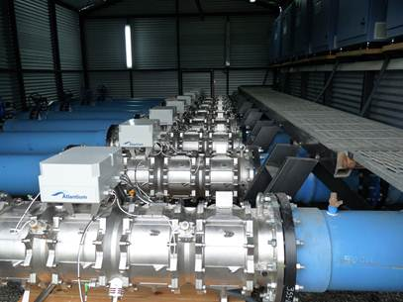
HOD technology in land-based facilities

Slide 6
Competitive Position
Field-proven, reliable solution to industry’s microbiological threats:
Water Bio-security improves yield, reduces production loss, reduces hindering of growth treatment,
  Effective water disinfection significantly reduces risk of batch contamination mainly in sensitive growth stages of the fish
  Wide experience (both lab and in-field) in overcoming the microbiological challenges of the industry:
    IPN, ISA, Saprognelia, MNV, VNN, Vibrio, Francecela etc
  Competitive price
  Regulations compliant system

Slide 7
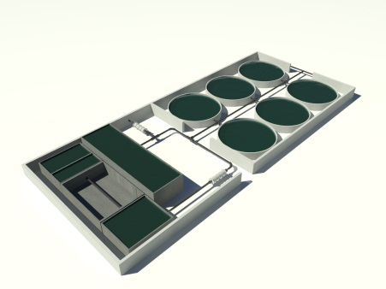
RAS and Flow Through Facilities
Intensive production of marine species inevitably leads to invasion and proliferation of harmful diseases into the growth environment.
Ensuring production bio-security is a crucial component to providing production stability.
In flow-through facilities the Atlantium’s Hydro-Optic technology is used as primary disinfection barrier for all intake water (“Firewall”).
In RAS facilities it is used to ensure the microbiological safety of all recirculating water for controlled growth environment.

Slide 8
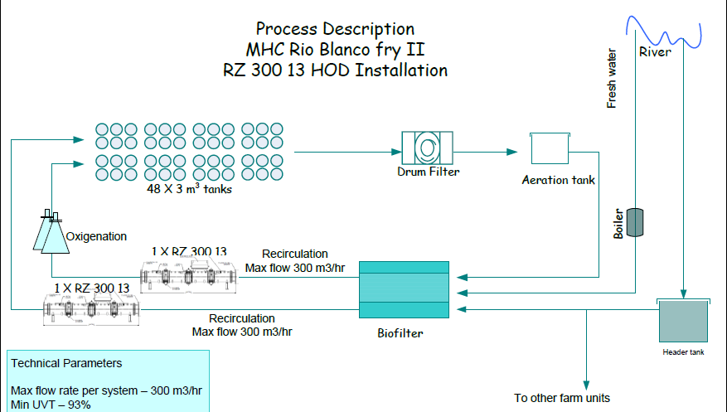
IPN Protection at a RAS site in Chile

Slide 9
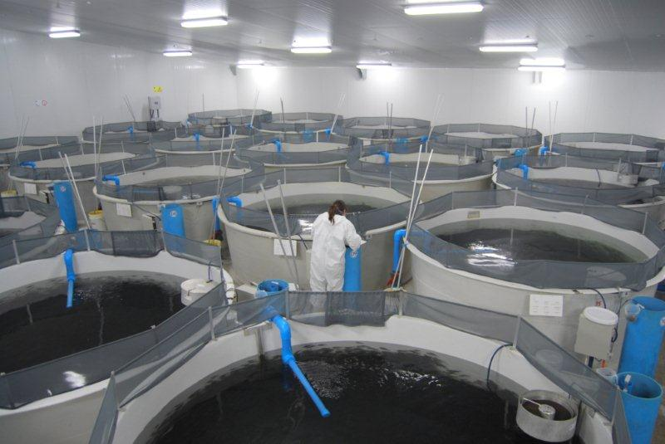
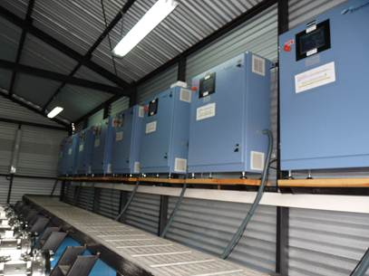
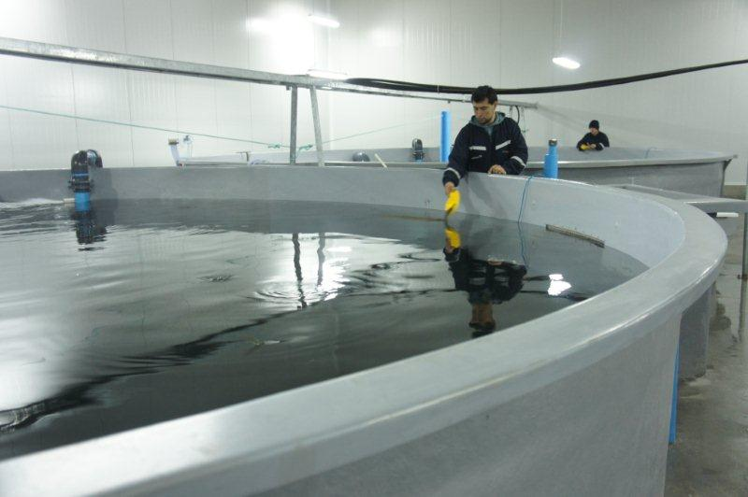
HOD technology in land-based facilities

Slide 10
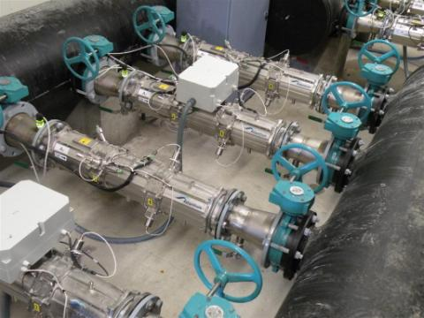
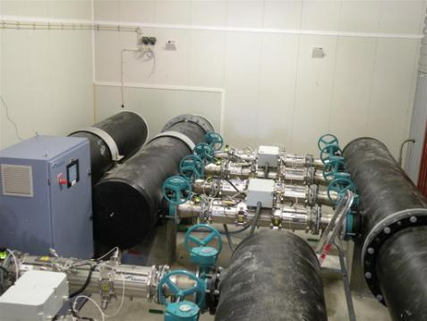
HOD technology in land-based facilities

Slide 11
Data logging information from site
Stabilizing period
Flow Vs. UV dose and fry weight
Final 19 days: dose maintained above 150 mJ/cm²
Critical stage.
Initial 67 days: dose maintained above 250 mJ/cm²
Weight
Days of cultivation

Slide 12
Data logging information from site: UV Dose Vs. UVT
UV dose Vs. UV Transmittance
UV Transmittance
Days of cultivation
UV dose levers are kept above the required dose levels in spite of UVT changes

Slide 13
Data logging information from site: Flow Vs. UV Dose
Flow Vs. UV dose

Slide 14
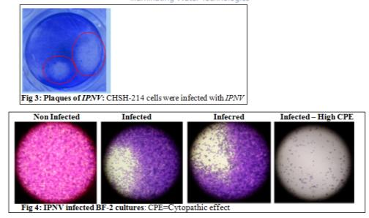
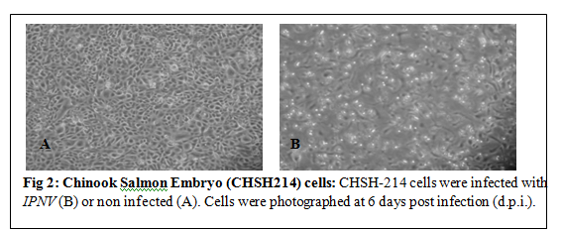
HOD Systems – IPN Resistivity tests in Atlantium

Slide 15


Slide 16
Well-boats
With ever-growing regulations on inlet and outlet water due to the gradual contamination of the ports and major sea-transportation hubs, your fish are exposed to a variety of threats while being transported to in-land or off-shore facilities.
A proven retrofit-friendly disinfection solution
Fully complies with the most stringent regulations
Truly committed to your fish welfare on-board.
Our unique control and monitoring system data-logs and generates detailed compliance reports of flow, water-quality and delivered dose throughout the entire voyage.
Whether you are a boat owner, fish grower or a regulator, Atlantium’s Hydro-Optic technology enables you to sleep better at night.

Slide 17
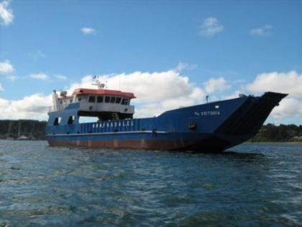
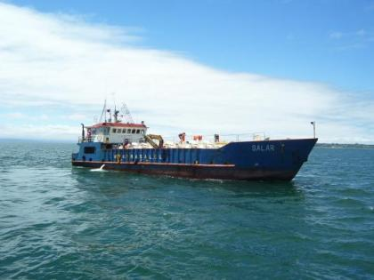
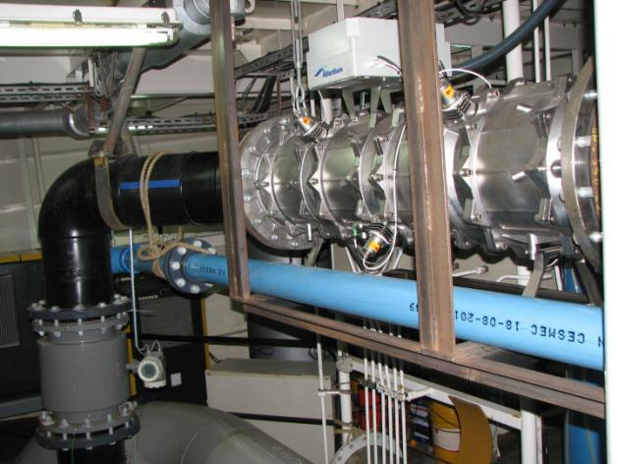
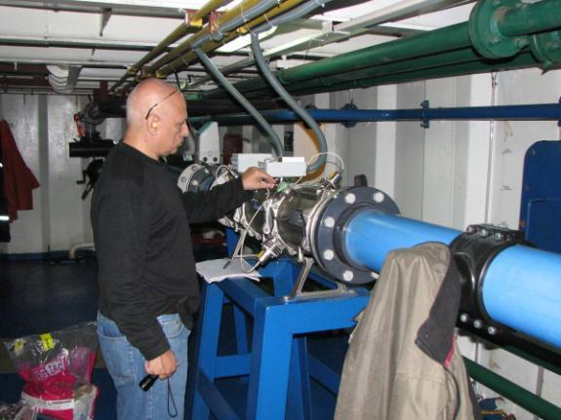
HOD technology aboard well-boats

Slide 18
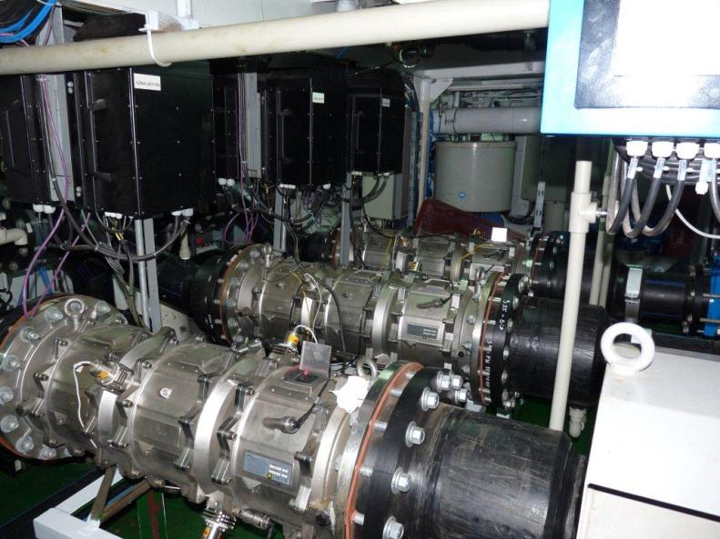
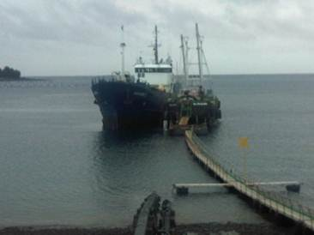
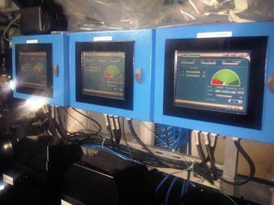
HOD technology aboard well-boats

Slide 19
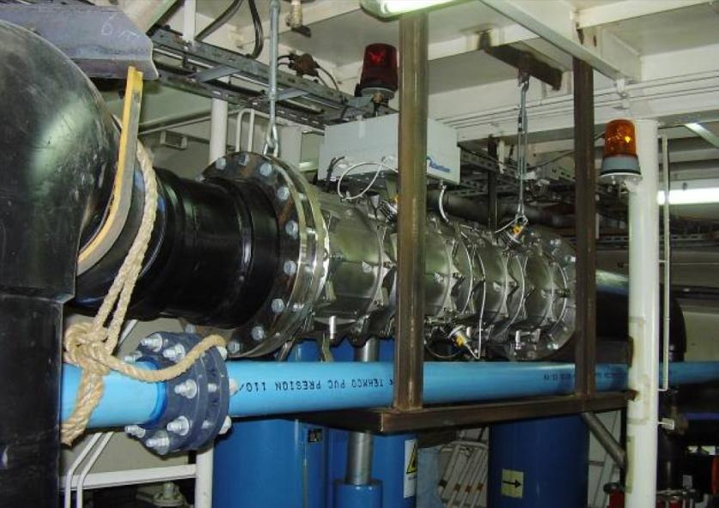
HOD technology aboard well-boats

Slide 20
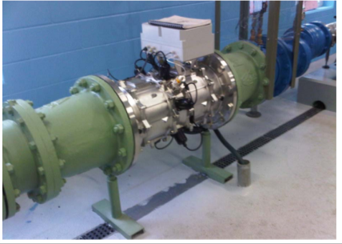
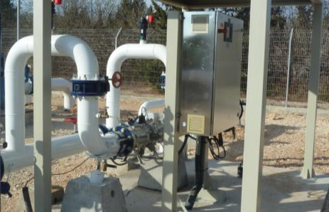
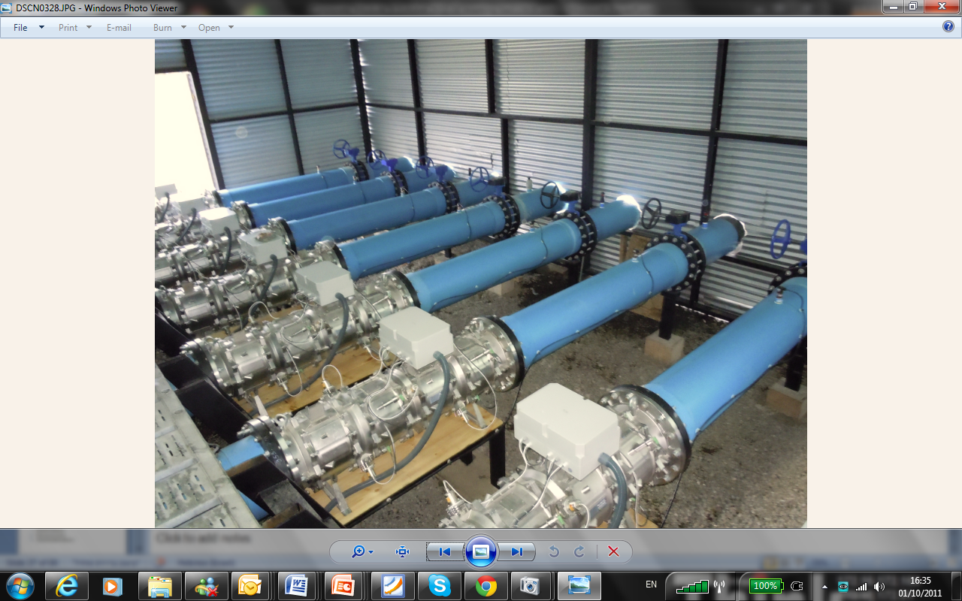
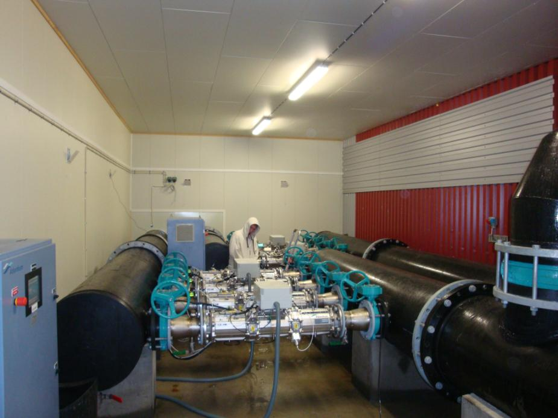
ATLANTIUM as an efficient burrier…
Increase your water safety
Reduce your Capital expenses
Reduce your Operational Expenses
Surface water – 25.3MGD / 4000 m³/hr -
14MGD / 2250 m³/hr

Slide 21
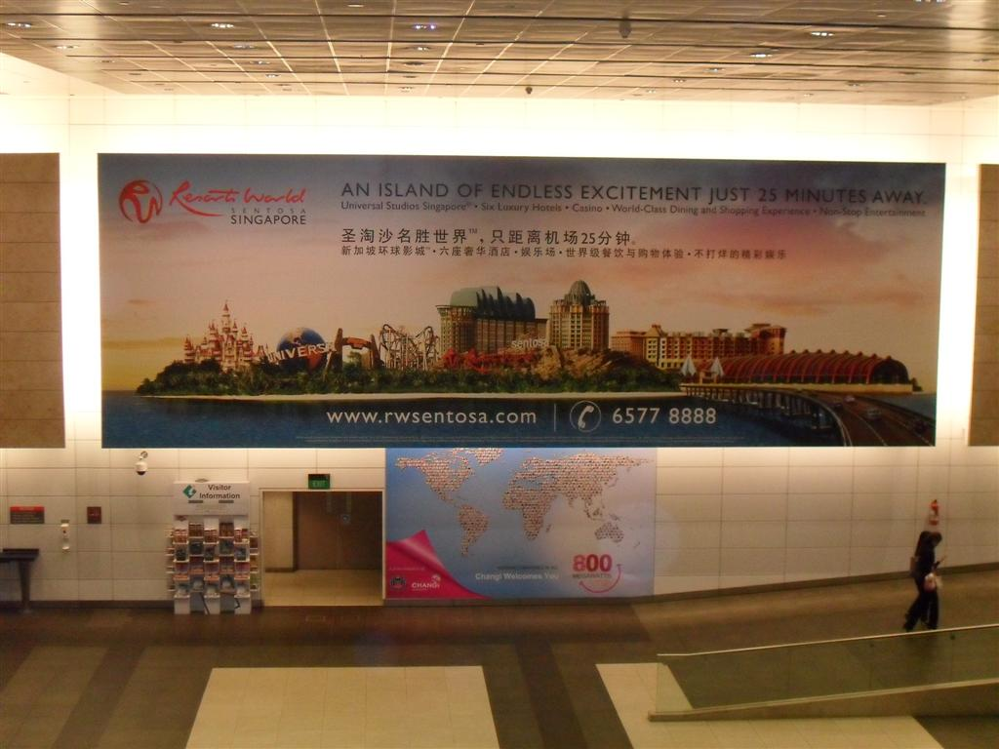
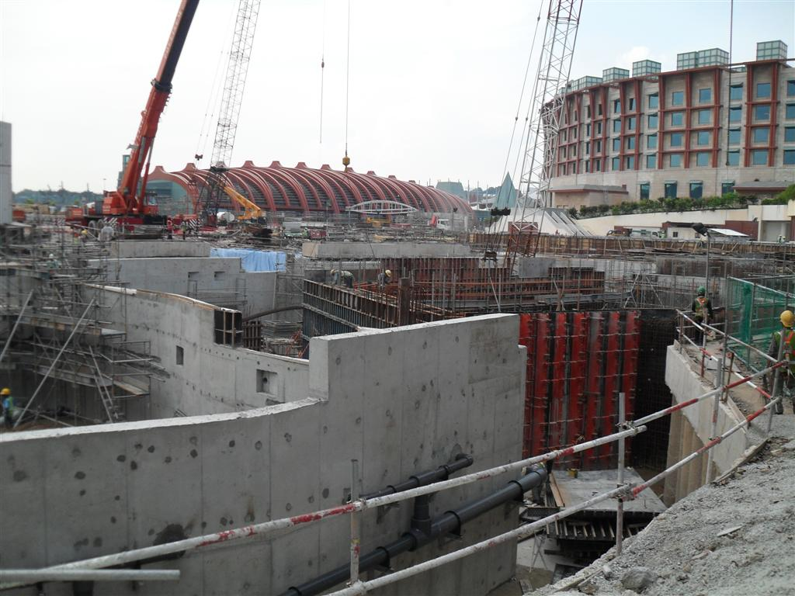
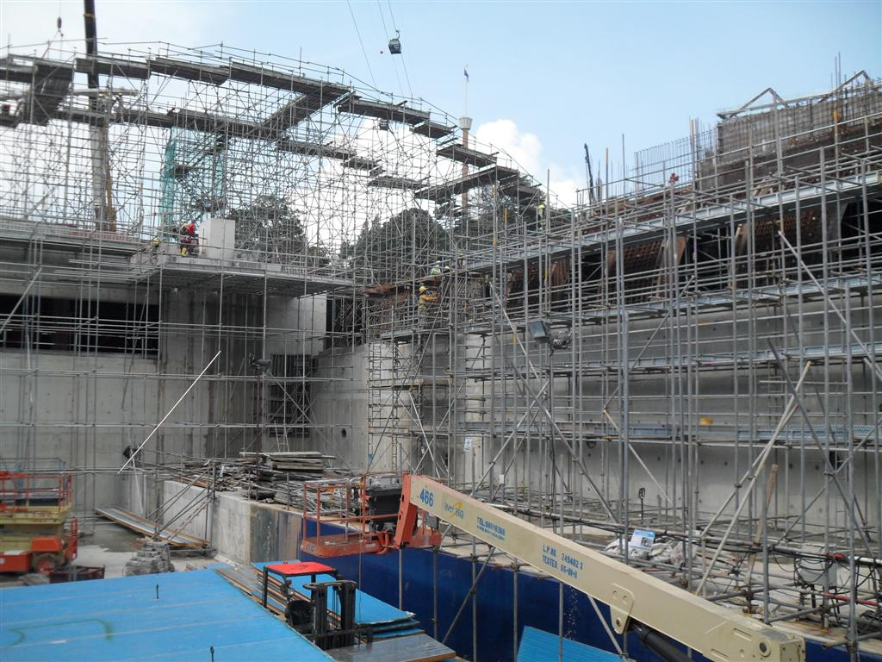
Santosa Aquarium choose Atlantium…
14MGD / 2250 m³/hr

Slide 22
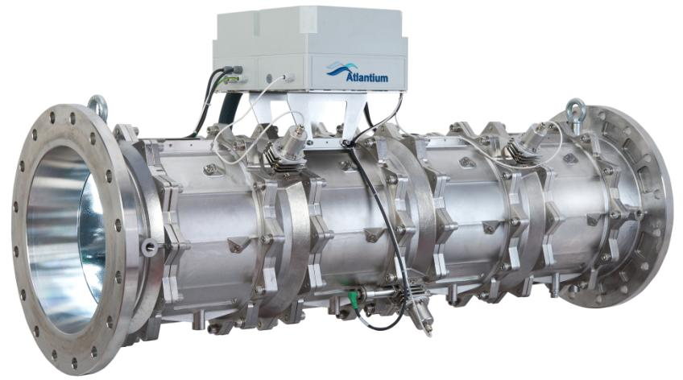
HOD Technology: Over 60 Protected Patents

Slide 23
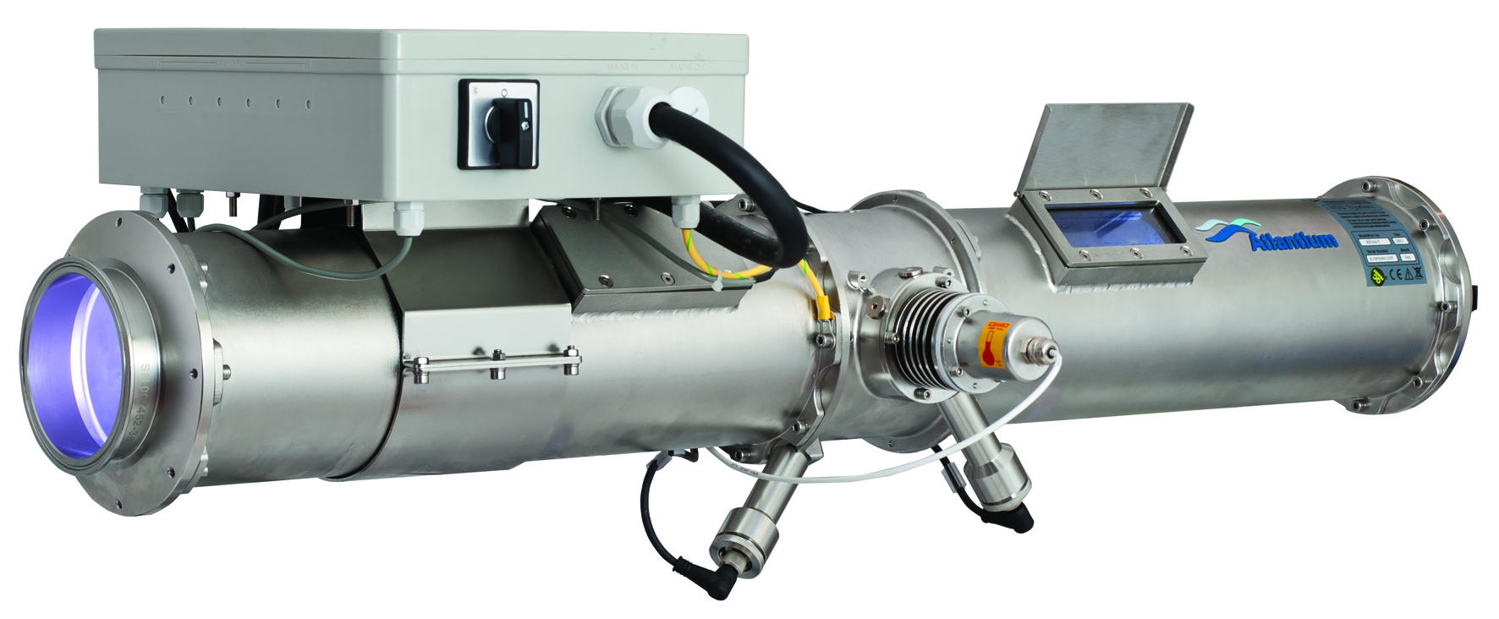
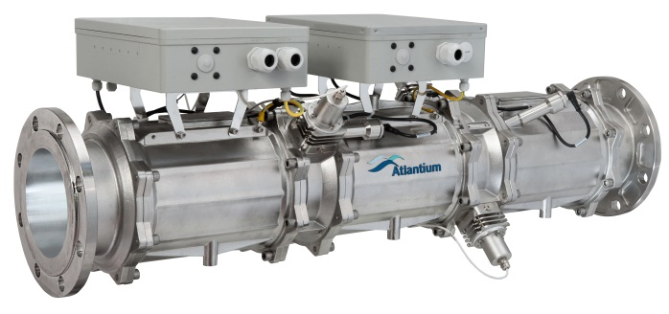
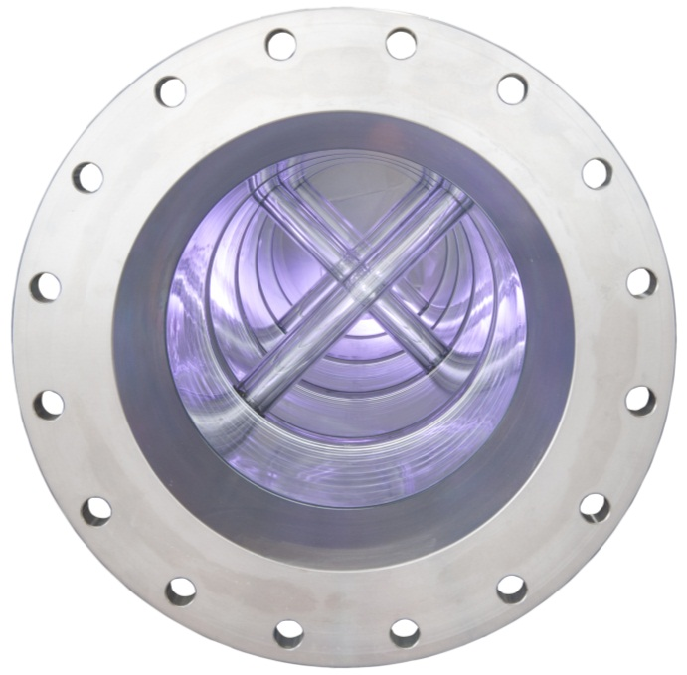
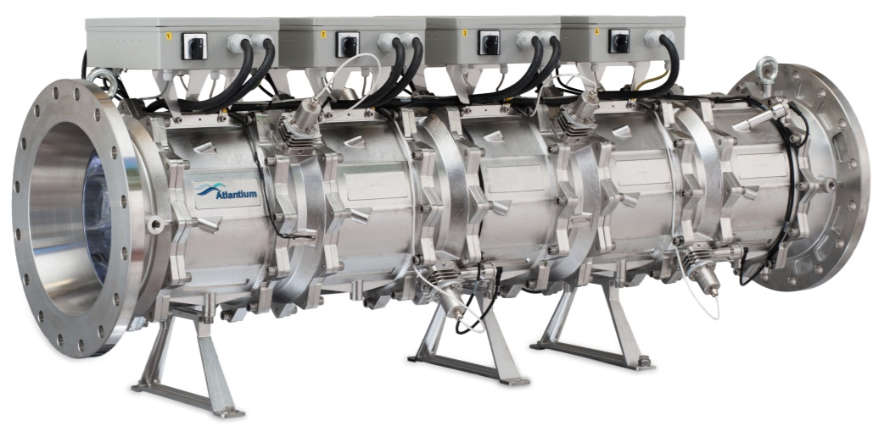
Hydro-Optic Disinfection – Product Lines
Modular Systems
RZ104-11
RZ163-12
RZ300-14

Slide 24
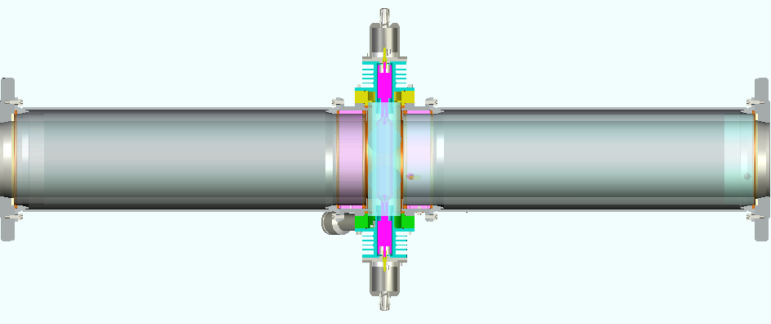
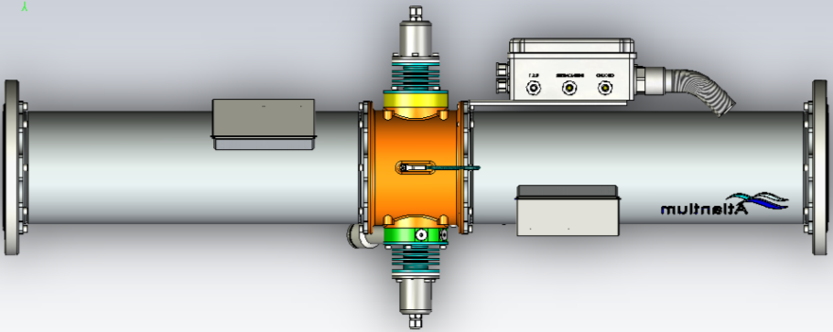
Operation principles: HOD system cross section
RZ104-11 a member of RZ series HOD system
Stainless
Air Block
Quartz Tube
HOD
Conventional

Slide 25
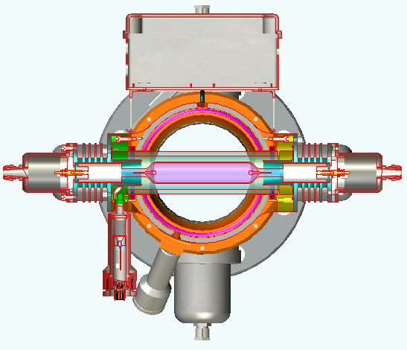
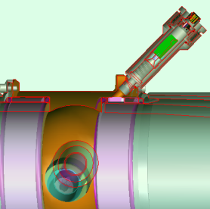
Sustained Performance
Dual sensors configuration provides actual dose measurement
Direct measurement of UV lamp efficiency
Built-in monitor for water Transmittance (UVT)

Slide 26
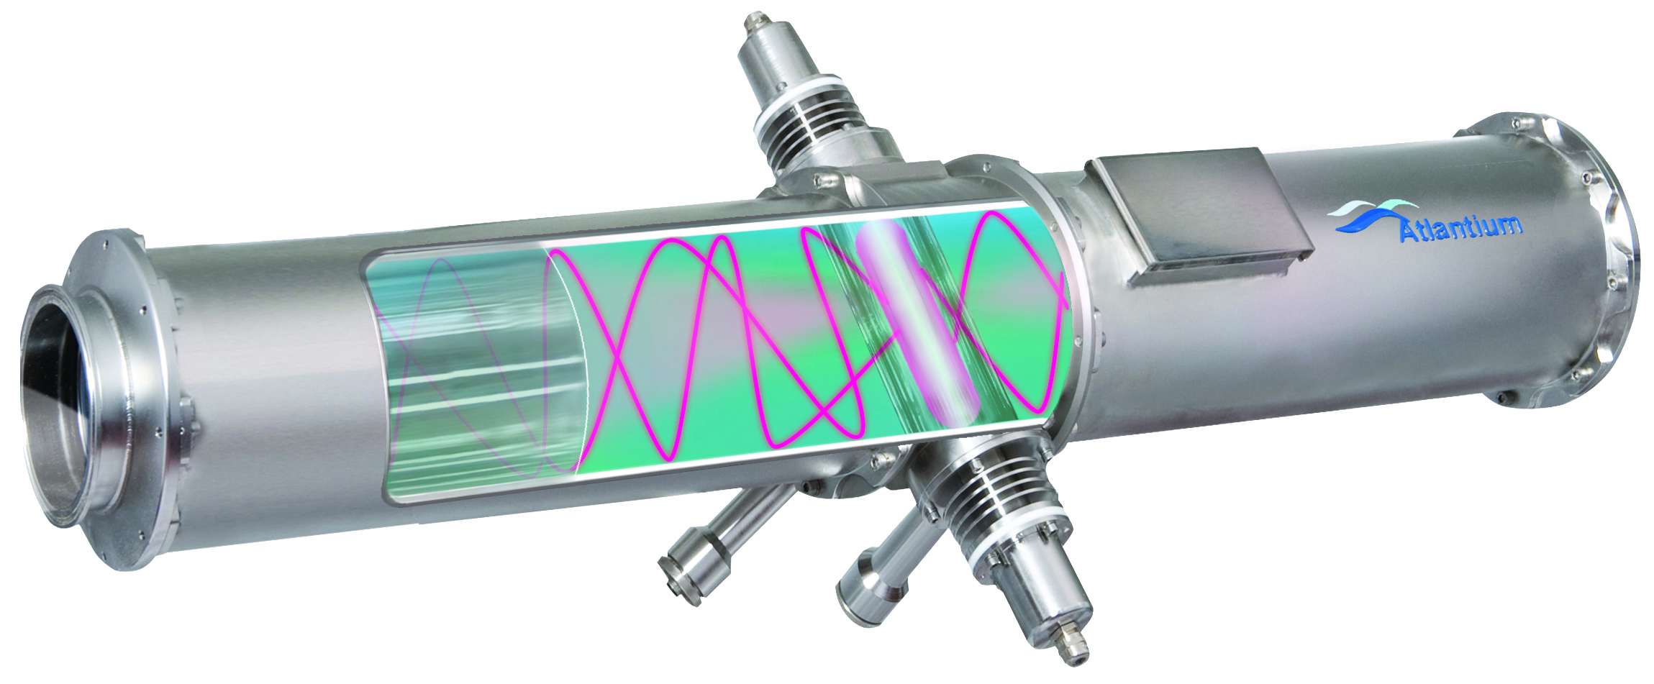
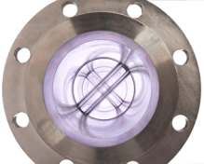
Hydro-Optic Optimization
1
  Fiber-Optic and Hydraulic principles applied to UV system design change the way that UV is delivered
  Quartz disinfection chamber surrounded by an air block
  Traps germicidal UV light rays and reflects them back into the water
  Longer light paths (more inactivation opportunities per UV photon)
  Attacks microorganisms from all directions
  Uniform dose

Slide 27
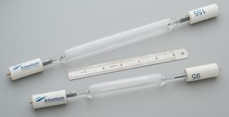
Optimized UV Lamp Efficiency
3
  Fiber-Optic and Hydraulic principles applied to UV system design
  lamp
  Medium Pressure high-intensity polychromatic lamps
  1x Medium Pressure High-Intensity Atlantium lamp generates more UV than
  16x LP lamps or 2x MP lamps
  Fewer lamps needed: fewer replacements, fewer ballasts: lower costs
  Polychromatic light leverages entire germicidal spectrum
  Inactivates even highly resistant microorganisms and their repair mechanism
  Short lamps much easier to handle

Slide 28
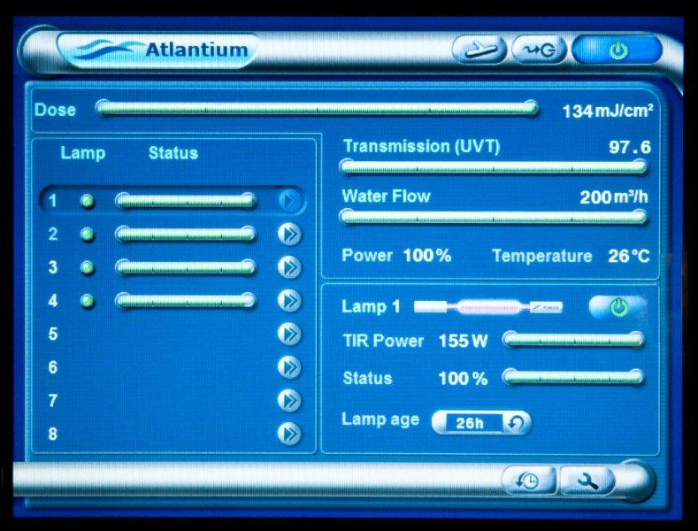
Premium Controller:
Main-screen information

Slide 29
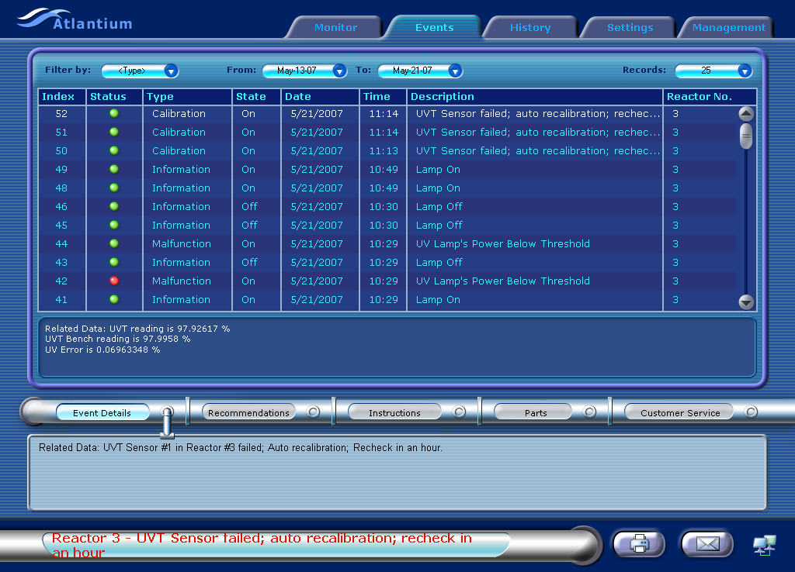
Atlantium PC software:
Data-logging and events

Slide 30
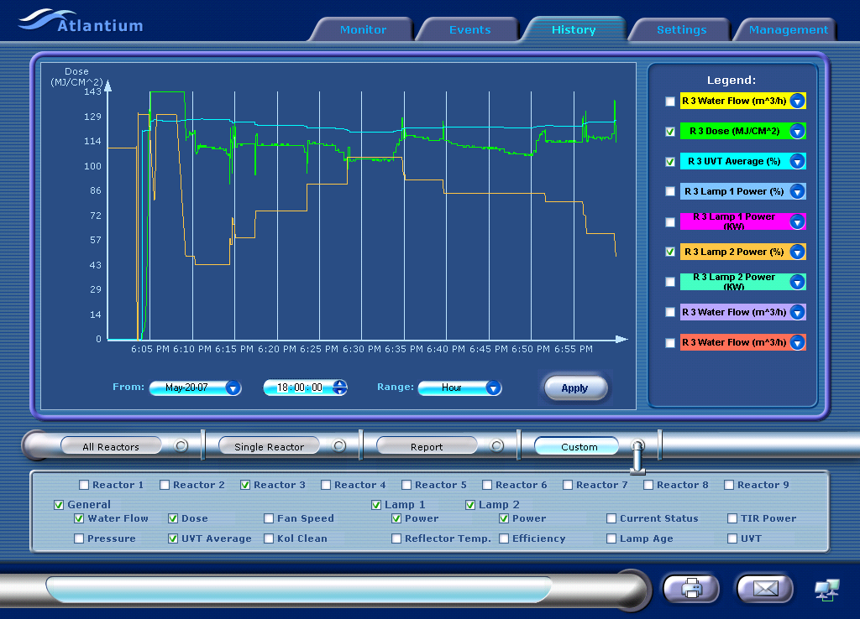
Atlantium PC Software:
Remote monitoring, control and report generation

Slide 31
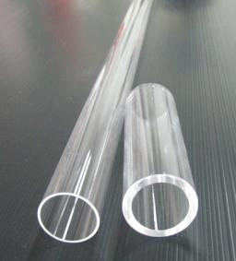
4-minute UV Lamp Replacement
  Fiber-Optic and Hydraulic principles applied to UV system design
  lamp
  Thick quartz tube separates UV lamp from water chamber
  Thick quartz tube separates UV lamp from water chamber
  Quick and easy lamp replacement – only 4 minutes
  Avoids risk of broken glass and mercury in water
  No thin Quartz sleeves to replace or break
4

Slide 32
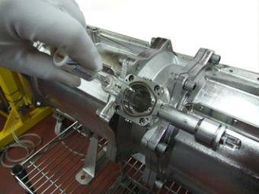
Low Total Cost of Operation
  Inline system, easy to install, easy to maintain: 4-minute lamp replacement
  Fully automated system requires minimum manpower
  Easily integrated to plant controls
  Protects against breakthrough and reduces bio-fouling: less down-time
  Reduces frequency of CIP schedules
  Can replace chemicals for certain applications: storage/disposal/worker health issues

Slide 33
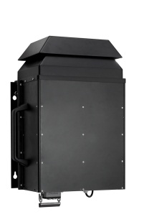
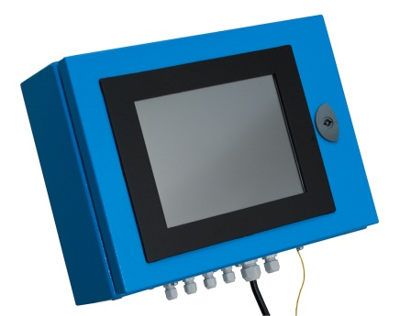
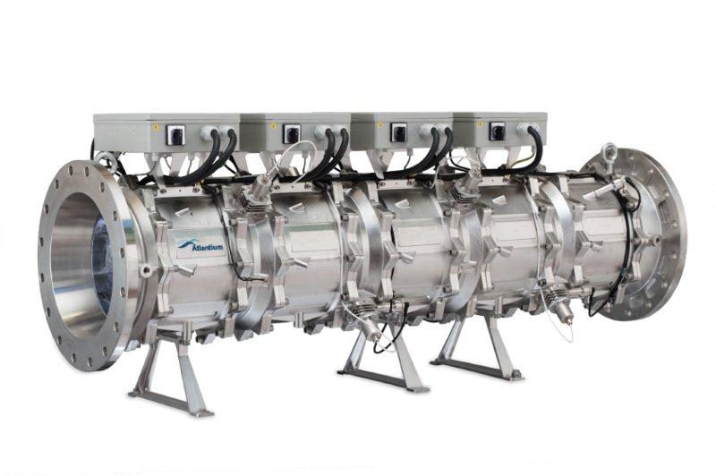
HOD System Components
Unique modular ballast unit for maximum design, installation and maintenance flexibility.
Simultaneous monitoring & recording in real time of mission-critical parameters including actual UV dose, UVT, water flow and lamp power.
Detailed reports enable the user to keep track over time on key disinfection parameters as well as ensure compliance with the most stringent regulations.
Complete modular structure of individual pipe and lamp sections allows for maximum design and installation flexibility. Flow and dose capacities can be increased by adding additional sections in-place without the need to replace the entire system.

Slide 34
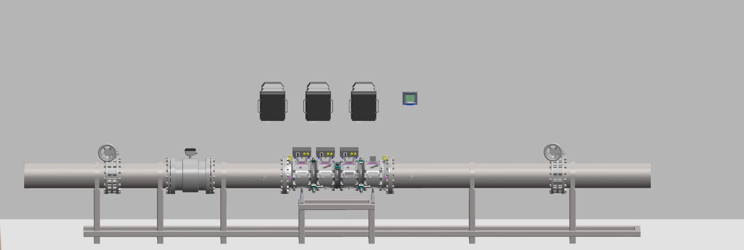
HOD Installation set-up
Ballasts
Controller
Isolating valve
Flow Meter
Isolating valve
HOD system

Slide 35
Bio-security through real design
There are several key factors which must be taken into consideration when designing the right UV disinfection solution for your fish farm, well-boat or aquarium. Make sure your UV system accounts for these factors!
❶Validation—the only acceptable performance certification
❷Minimum dose—the only true disinfection indicator
❸Medium pressure lamps—the only real protection against viruses
❹A dedicated sensor per lamp—the only way to ensure transparency of ))))operation

Slide 36
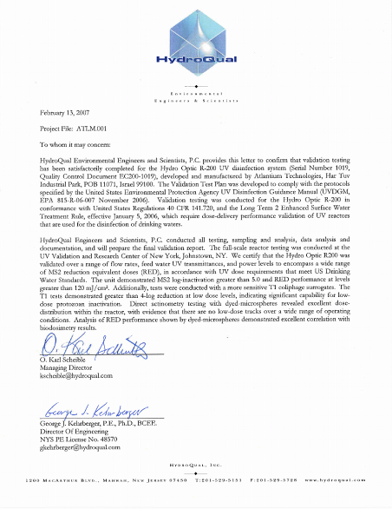
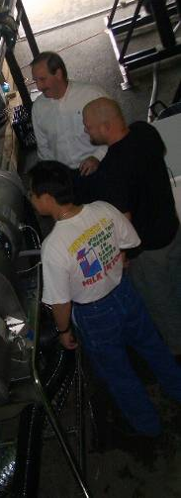
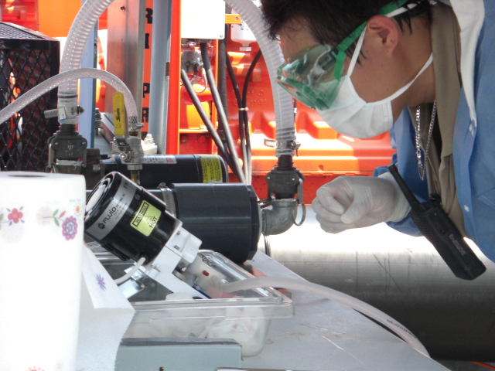
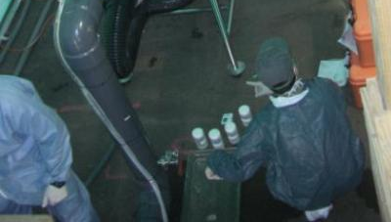
HOD Systems – EPA Validation
36
Notes:
36

Slide 37
Medium pressure lamps:
The only real protection against viruses
Atlantium’s unique Medium Pressure High Intensity [MPHI] lamps provide a wide variety of operational benefits while overcoming the setbacks of conventional UV lamps.
To begin with, Atlantium’s MPHI are highly efficient for virus inactivation as they deploy a wide germicidal wavelength which attack viruses and other microorganisms on a wide front.
The Atlantium Hydro-Optic systems are validated for 4 log Adeno virus inactivation which ensures their success where low pressure lamps fail to deliver the required protection.

Slide 38
  Designing for the right DOSE
120 mJ/cm² RED
FDA –
Pasteurized equivalent
HOD solution is 120 mJ/cm²
~16mJ/cm² RED – this is the actual min. dose that you get from conventional UV lamps suppliers
Atlantium’s Microbial Commitment
40mJ/cm² Average – All other UV lamp suppliers

Slide 39

Medium Pressure vs Low Pressure UV Lamps
Low Pressure (LP UV)
Mercury vapor
Monochromatic (253.7 nm)
Inactivates pathogens by damaging their DNA/RNA
Medium Pressure (MP UV)
Mercury vapor - Polychromatic
Inactivates pathogens by damaging DNA and additional macromolecules (proteins) via polychromatic
Bolton Photosciences Inc.

Slide 40

Medium Pressure Lamp:
No bacteria re-generation
40

Slide 41

Medium Pressure Lamp:
No bacteria re-generation
Bacteria re-generates in the tanks which are exposed to day light

Slide 42
Many important regulations* distinguish between LP and MP dose!
Medium Pressure UV: the UV unit must provide a Reduction Equivalent Dose of at least 120,000 μWs/cm² (120 mJ/ cm²) as measured by a germicidal sensor (250-280 nm wavelengths) at the end of its life; or
Low Pressure UV: the UV unit must provide a Reduction Equivalent Dose of at least 186,000 μWs/cm² (186 mJ/cm²) as measured by a germicidal sensor (250-280 nm wavelengths) at the end of its life; or
*Example taken from a UV regulation manual of one of an international soft drink producer

Slide 43
Key points for HOD bio-security
No “low-dose” tracks within the HOD disinfection systems = no pathogen escapes the required UV dose.
Design according to Minimum dose and not Average dose as in conventional UV.
Medium Pressure lamps which a wide range of germicidal wavelength.
Dedicated sensor per lamp to ensure optimal and correct lamp operation.
Extensive laboratory and in-field testing of various industry-related micro organisms to ensure adequate dose is used in design.
Maximum utilization of UV photons ensures low electrical consumption.

Slide 44
Thank You
Atlantium Technologies Ltd.
Har Tuv Industrial Park
POB 11071, Israel 99100
Tel: +972-2-992 5001
Fax: +972-2-992 5005
info@atlantium.com
www.atlantium.com

