Slide 1
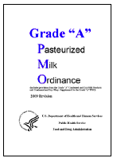
The Next-Generation UV Technology
Hydro-Optic Dechlorination & Disinfection
Technology (HOD):
Achieve PMO Pasteurized Equivalent Water from UV HOD – A Bright Idea to cost effectively protect your Brand
Dairy industry – 2012
Bob English

Slide 2
Who’s Atlantium UV
  A cutting edge UV technology company formed in Israel in 2003 by PhD’s in Microbiology, Optical Physics, Software Engineering, Hydrology, and Environmental Science. Atlantium was borne out of the absence and need for a Regulatory Agency approved primary line of disinfecting UV systems that could produce 3rd party validated FDA- PMO Pasteurized Equivalent Water and EPA drinking water with 4 log adenovirus and 5 log bacteria reduction. This was a industry paradigm shift from a good idea to include to a FDA & EPA approved best practice for water disinfection and pasteurization.
  Atlantium expanded that vision to now include feed and process water dechlorination for food and beverage applications to complement our pharmaceutical application achievement.

Slide 3
Presentation Design:
  Identify Specific Problem
  Define cause of problem
  Present the Best Solution.

Slide 4
#1 Identify the Current Problem:
  Aseptic rinse line
  Frequent process interruptions and maintenance attention required to change very expensive 0.2 um bacteria reduction filter cartridges (“sterilization” filters)

Slide 5
#2 Cause of the current problem:
  Even with the frequent Carbon Filter and Sand Filter backwashes, the fine microbial matter and bacteria that are innately associated with ALL carbon filters contaminate the water lines and plug your filters.

Slide 6
#3 Best solution for your problem
  Replace the root cause of your problem with a full flow inline Atlantium HOD UV Dechlorination and Sanitization system.
  Get significantly higher quality water with less cost, less water use, less time, less attention, and less effort.

Slide 7
What Dechlorination with UV means for you ?
  Eliminates the need for frequent replacement of the expensive 0.2 um
  Atlantium HOD UV treats water beyond PMO pasteurized equivalent water quality – which exceeds your cartridge filters performance!!
Save water, time and money.
Cartridges
Backwash Water
Carbon Rebeds
Excellent
ROI
Maintenance time and attention
Process interruption
Increase in reliability and quality

Slide 8
Important Benefits of UV replacing Carbon(GAC) Filters used in Dechlorination
    Light-based De-Chlorination – Very clean no chemical or particulate additions (carbon and sand fines)
    Extreme Disinfection – bonus
    4 log +++ elimination on all microbiology!!
    No other technology or vendor can meet this performance guarantee!

Slide 9
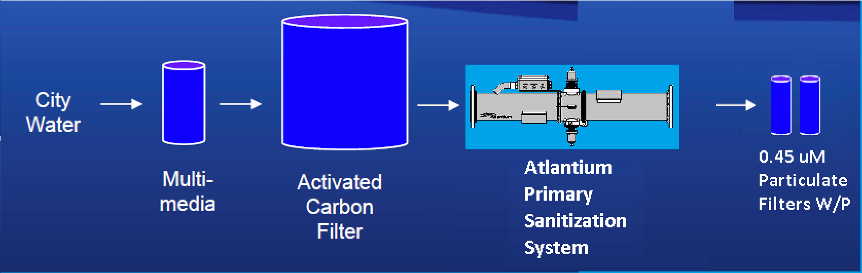
Design #1
PMO quality disinfection of your Carbon filtered water
    This system configuration eliminates the need for the 0.2 absolute bacteria filter since it sanitizes the water to a higher quality standard than that filter.
    For extreme conservatism a 0.45 nominal filter could be left in place but is not necessary. (28.9)

Slide 10
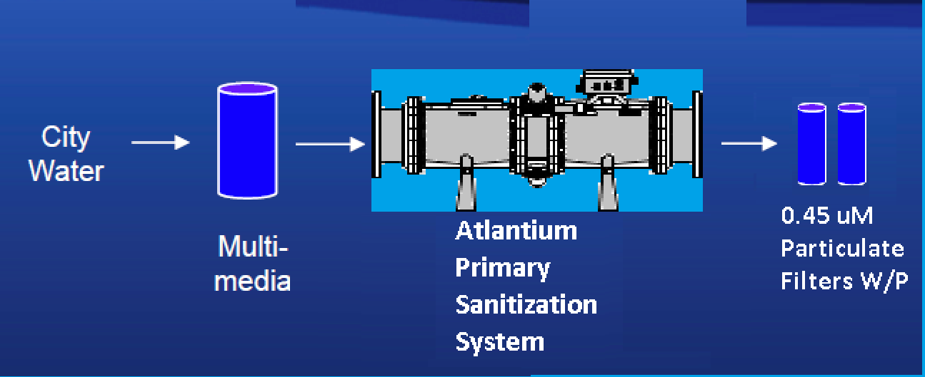
Design #2 Cost Effective, Elegant, Reliable and Robust
Dechlorinate and Produce PMO quality Water
    This system configuration eliminates the carbon filter, the 0.2 absolute bacteria filter from the aseptic cap rinse line while producing PMO Pasteurized Equivalent water up to a max flow of 250 GPM for all other Dairy water uses. The ROI these pasteurized equivalent water push, rinse, or CIP make up water applications can be as short a 4 months! For extreme conservatism a 0.45 nominal filter could be left in place but is not necessary. ((35.1))

Slide 11
Why is Atlantium MP HOD the most efficient UV system for your Dechlorination and disinfection?
Total Internal Reflectance™
High Efficiency and Output Medium Pressure Lamps that are powered to maintain the user set UV dose even as flow rate and UV transmittance change.

Slide 12
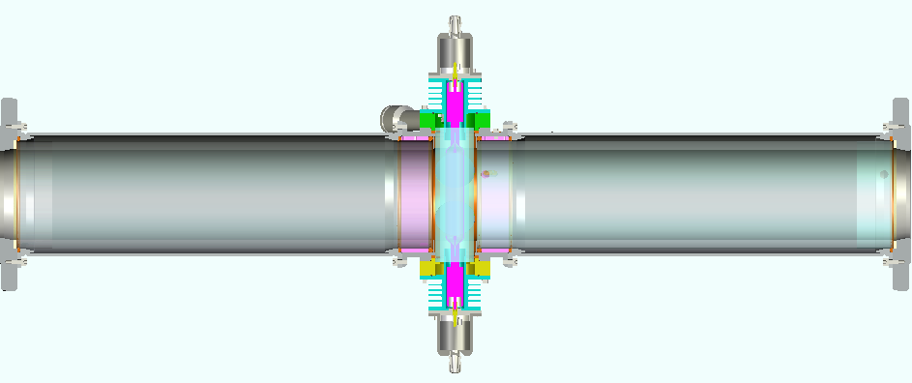
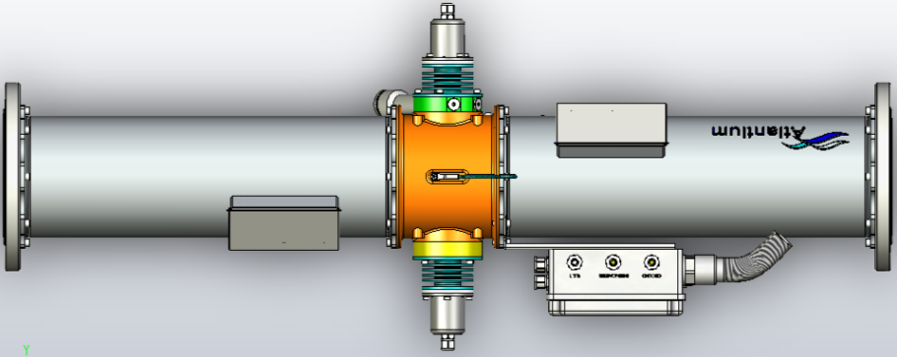
Operation principles:
RZ series HOD system cross section
Total Internal Reflectance™
Stainless
Air Block
Quartz Tube
HOD
Conventional UV Light Paths

Slide 13
HOD- Changing the UV DISINFECTION Paradigm
HOD
Product
Safety
Better
Product/Water
ratio
Less waste
water
Less
Manpower
Brand
Security
Less Energy
Less
Chemicals
Less Down
Time
Product
Safety
Brand
Security
Notes:
13

Slide 14













Where else has this been done?
Atlantium HOD Worldwide UV Dechlorination/Disinfectant Installations & Pending Applications: Wawa Dairy – Publix Dairy – Kruger Dairy - Coca Cola Jacksonville
Notes:
14

Slide 15
More information
For Greater Detail the following subjects continue on :
Why did we Dechlorinate with Carbon in the first place?
Basic Chemistry associated with Chlorine in water
Why Medium-Pressure Lamps Target Dechlorination
The HOD Advantage – Why HOD MP is better than LP or conventional MP
Pasteurized-Equivalent Water Application
UV that really works – Promises that are kept
Robust and Elegantly simple Application Attributes

Slide 16
Why did we Dechlorinate with Carbon in the first place?
One of the greatest success stories in that past 5 years in water treatment is how very effectively UV energy is at used to Dechlorinate - chlorinated feed and process waters.
The proven practice of dechlorination with UV incorporates an unrivaled level of disinfection but due to the extremely high UV dose (at 270-300 nm) that is required to actually break the free chlorine bonds, all UV reactors that where properly sized and effectively used for this application have been very large and extremely expensive for all but the most critical pharmaceutical and high tech applications.
Atlantium Medium Pressure HOD makes this application a cost effective alternative carbon filtration in the Dairy Industry through Total Internal Reflectance™

Slide 17
Why did we Dechlorinate with Carbon in the first place? Continued
Problems with the early UV dechlorination applications:
Water pH dependent
Water temperature dependent
Excess Heat from the LP lamps
Excess energy draw LP lamps
UV system very large and VERY expensive
Low Pressure Lamps are very inefficient at Dechlorination as they produce 254 nm light while the ideal dechlorination wavelength are 270-300nm!

Slide 18
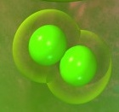
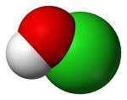
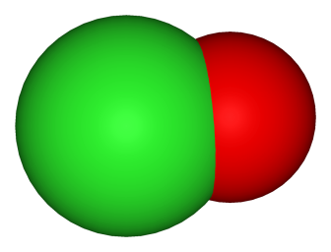
Basic Chemistry associated with Chlorine in water
The three Free-Chlorine components
  Hypochlorous Acid [HOCl]
  Chlorine (“Dichlorine”) [Cl₂]
  Hypochlorite ion [OClˉ]
Cl
Cl
O
H
Cl
O
Cl

Slide 19
Basic Chemistry associated with Chlorine in water
Basic Chemistry associated with Chlorine in water
UV Photon “Bullet” breaks the chlorine based molecule
Bond Potential
Molecule
Photo-dissociation
hν
HCl
O
Dissociation Coordinate (R)

Slide 20
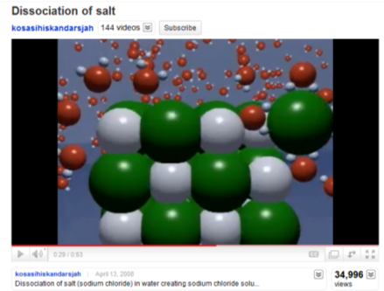
Basic Chemistry associated with Chlorine in water
All three methods: Free Chlorine to Chloride ions
Carbon – GAC
→ Chloride ions (Cl⁻)
Bisulfite(chem feed)
MP UV Photons
Na⁺
Cl⁻

Slide 21
Free Chlorine reduction alternatives
Basic Chemistry associated with Chlorine in water
 | Activated Carbon Filter | Sodium Bisulfite | PharmaGuard UV system
Bacteria proliferation | Yes. Intensive. | Anaerobic, including sulfur-reducing bacteria. | No. The very high UV-Dose "kills" ALL micro-organisms.
Chemicals into the water | No | Yes. Must be removed. | No – chemical-free.
Maintenance burden | Yes. Ongoing routine. | Yes. Ongoing routine. | No. Easy maintenance.
Effect on RO membranes | Bio- fouling. | Bio- fouling and scaling. | Greatly reduces any bio-fouling and scaling.
On-Demand | Not always. Intensive maintenance, risk of breakthrough. | Yes | Yes

Slide 22
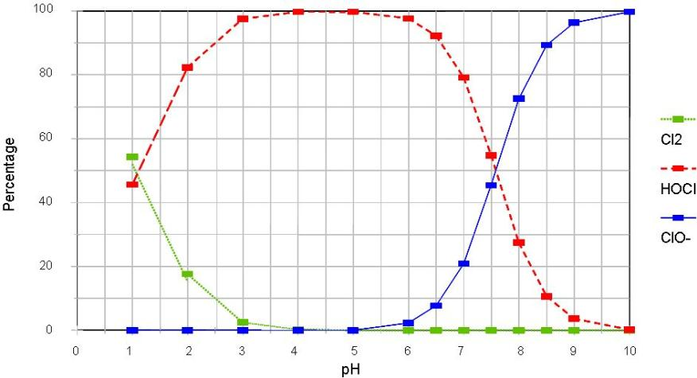
Basic Chemistry associated with Chlorine in water
Free active Cl components vs. water acidity (pH)
HOCl
OCl⁻
Cl₂

Slide 23
Why Medium-Pressure Lamps Target Dechlorination?
Medium
Pressure Lamp
OCl⁻
Low
Pressure Lamp
HOCl
Figure 2: Absorption spectra of HOCl and OCl⁻ measured respectively at pH 5 and pH 10

Slide 24
Atlantium HOD Operation principles:
Atlantium MP HOD system cross section
Total Internal Reflectance™
Stainless
Air Block
Quartz Tube
HOD
Conventional UV Light Paths

Slide 25
The HOD Advantage – Why HOD MP is better than LP or conventional MP
Uniform dose distribution
HOD System
Non-uniform dose distribution
‘Light in a steel tube’
Conventional UV
304 or 316 SS Absorbs > 90% of the UV energy on impact
304 or 316 SS Absorbs > 90% of the UV energy on impact
Notes:
What are the HOD advantages?
Performance and reliability.
Because of the total internal reflection the HOD has a uniform dose distribution.
On the other hand, conventional UV systems has non-uniform dose distribution. In the figure we see a conventional UV system where the UV lamp is inside the water. The light in side the water decay as a function of distance from the lamp.

Slide 26
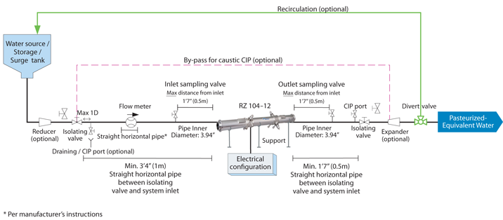
Pasteurized-Equivalent Water Application

Slide 27
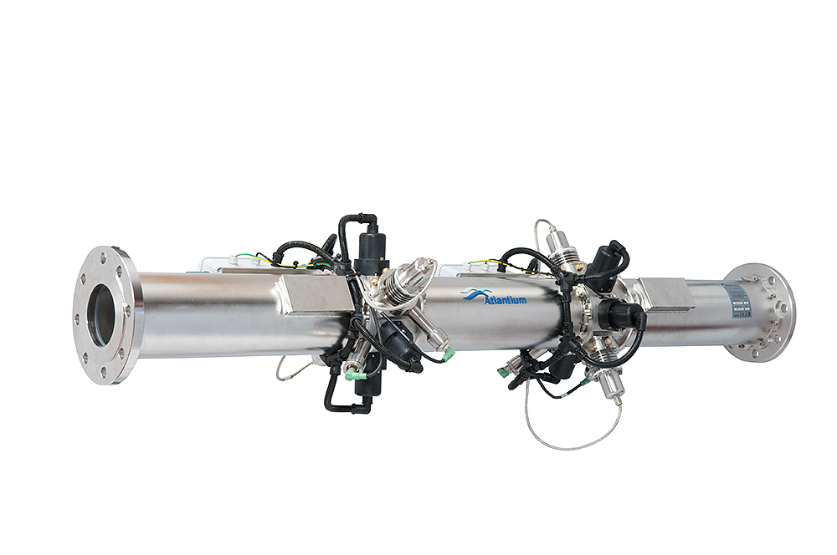
UV that really works – Promises Kept
FDA, EPA Regulatory compliance
3rd party validated
It is the Primary disinfectant
Control pseudomonas, Algae, and other microbes that resist chlorine
Fight biofilms and its causes and reduce CIP costs
Assure quality: monitor, track; searchable records for disinfection verification
Meets the PMO 2011 for Appendix H (Pasteurized Equivalent Water) and Appendix D (Disinfected Water) for:
Notes:
What you are doing for Coliform and E. coli today may not be enough to virus and yeast; we all need to look ahead and do the best we can to make sure not to compromise the brand – don’t want to be the subject of some research project that will find you have some virus or creature sticking to the sides of your bottles

Slide 28
UV that really works – Promises Kept
It is the Primary disinfectant :
  Sustainability, cost and chemical reduction
  chemical resistant organisms
  Alternative solutions are needed
  Disinfectant by products alter the taste and quality
Notes:
What you are doing for Coliform and E. coli today may not be enough to virus and yeast; we all need to look ahead and do the best we can to make sure not to compromise the brand – don’t want to be the subject of some research project that will find you have some virus or creature sticking to the sides of your bottles

Slide 29
UV that really works– Promises Kept
Meets the PMO 2011 for Appendix H (Pasteurized Equivalent Water) and Appendix D (Disinfected Water) for:
  Push Water
  Final Rinse
  CIP
  Water reuse such as “Cow Water”
Notes:
What you are doing for Coliform and E. coli today may not be enough to virus and yeast; we all need to look ahead and do the best we can to make sure not to compromise the brand – don’t want to be the subject of some research project that will find you have some virus or creature sticking to the sides of your bottles

Slide 30
Robust and Elegantly simple Application Attributes
  Atlantium Dechlorination UV System solves the problem of reducing free chlorine without the biofouling associated with carbon filters.
  Ideal for Low foul rates associated with Pharm and Biopharm applications
  Very high UV-Dose levels required to address free chlorine and other oxidizers guarantees a very effective bio-reduction

Slide 31
Transforming
Free Available Chlorine
to
Chloride Ions

Slide 32
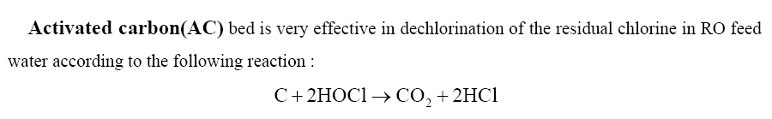

Activated Carbon Filter and Free-Chlorine
HCl + H₂O → H₃O⁺ + Cl⁻
Hydronium Ion
Chloride Ion

Slide 33
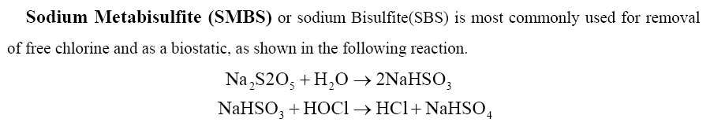


Sodium bisulfite / Sodium metabisulfite
Sodium metabisulfite or sodium pyrosulfite [SMBS]: Na₂S₂O₅
Sodium bisulfite (sodium hydrogen sulfite) [SBS]: NaHSO₃
Sodium bisulfate
OR:
2NaHSO₃ + 2HOCl --> H₂SO₄ + 2HCl + Na₂SO₄
Sodium sulfate
http://en.wikipedia.org/wiki/Sodium_bisulfite
http://en.wikipedia.org/wiki/Sodium_metabisulfite

Slide 34
Ultraviolet Photon Bullets

Slide 35
Free-Cl concentration vs. time
UV-on
UV-off

Slide 36
Out-in Ratio vs. UV-Dose

Slide 37
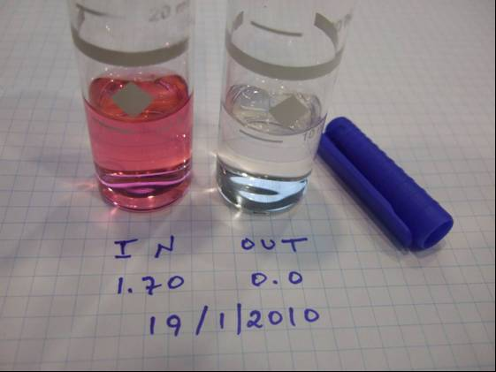
HACH DR/890

Slide 38
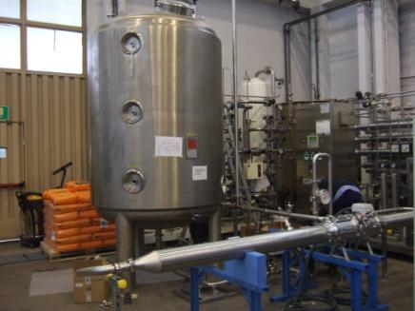
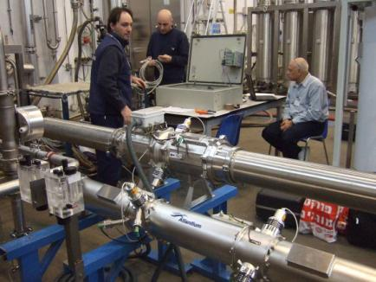
Validation with third party De-Chlorination

Slide 39
Summary
  Light-based De-Chlorination – Very clean
  Extreme disinfection – bonus

Slide 40
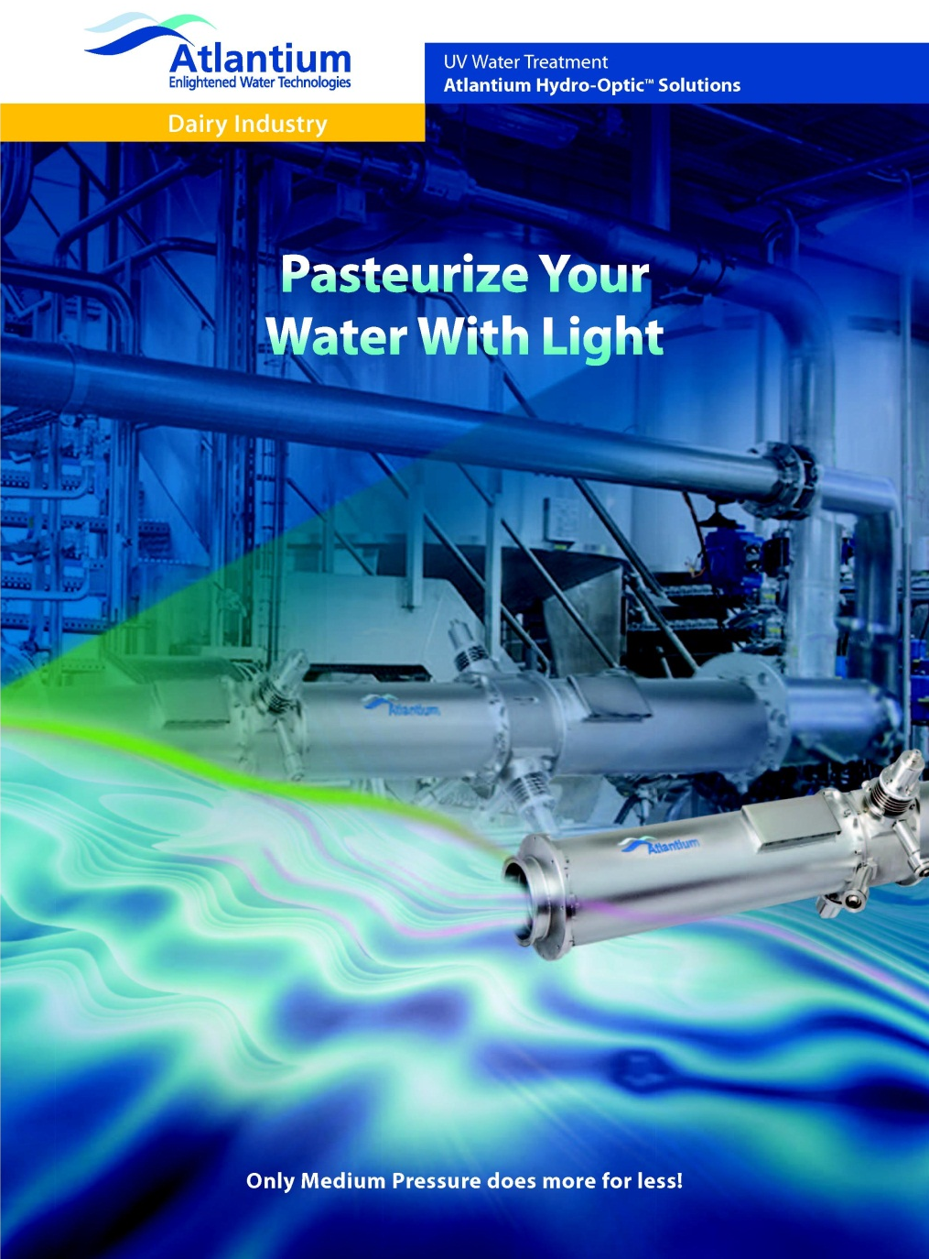
Thank You
Bob English
bobe@atlantium.com
508-596-7410
Dechlorinate and
Atlantium Technologies Ltd.
Har Tuv Industrial Park
POB 11071, Israel 99100
Tel: +972-2-992 5001
Fax: +972-2-992 5005
office@atlantium.com
www.atlantium.com

