Slide 1
Hydro-Optic UV Disinfection:
New Concepts in Water Disinfection

Slide 2
Company Profile
Headquarters in Israel – home to renowned innovations in both high-tech and water technologies
  USA Office – dedicated sales force for Municipal market and for F&B market
  West Europe Office – Located in France
  Latin America (Argentina, Brazil, & Chile)
IP- Comprehensive intellectual property portfolio
Major shareholders –
  Challenger Ltd.
  Elron Electronic Industries Ltd.
Field-proven technology

Slide 3
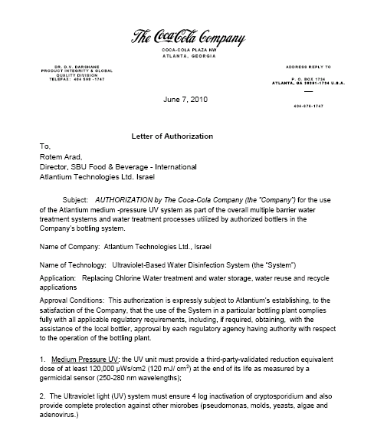
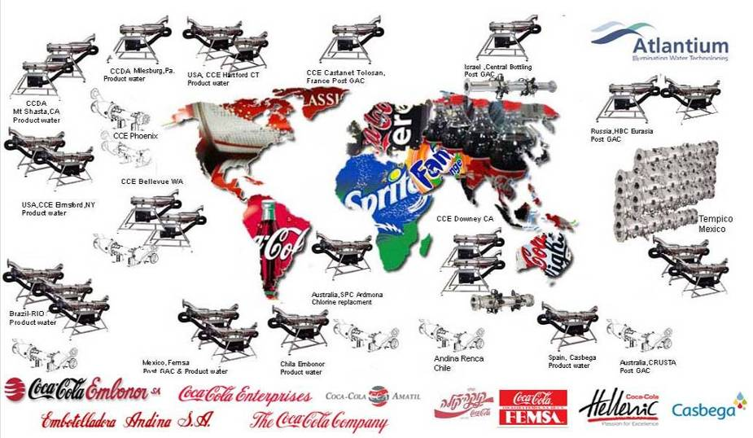
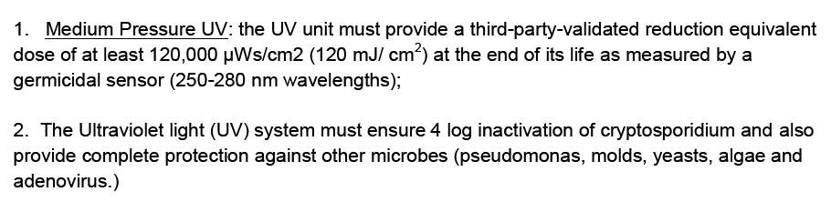
More than 120 systems sold to Coca Cola

Slide 4
Next Generation Hydro Optic UV Disinfection Technology
Notes:
4
4

Slide 5
Higher Performance at Lower Cost
Performance (log)
Atlantium
Hydro Optic
UV
Pasteurizers
Membranes
Ozone
Conventional
UV
Chemical
Treatments
Total Cost
Notes:
5

Slide 6
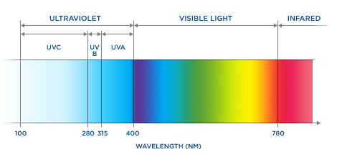
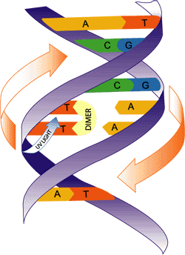
General principles of UV operation
Germicidal light spectrum – 200-300nm
UV light inactivates cells by damaging their DNA
Creates Thymine Dimers
Inhibits DNA replication
6

Slide 7
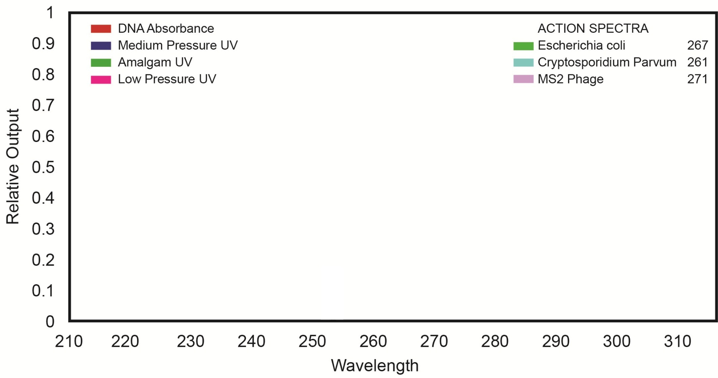
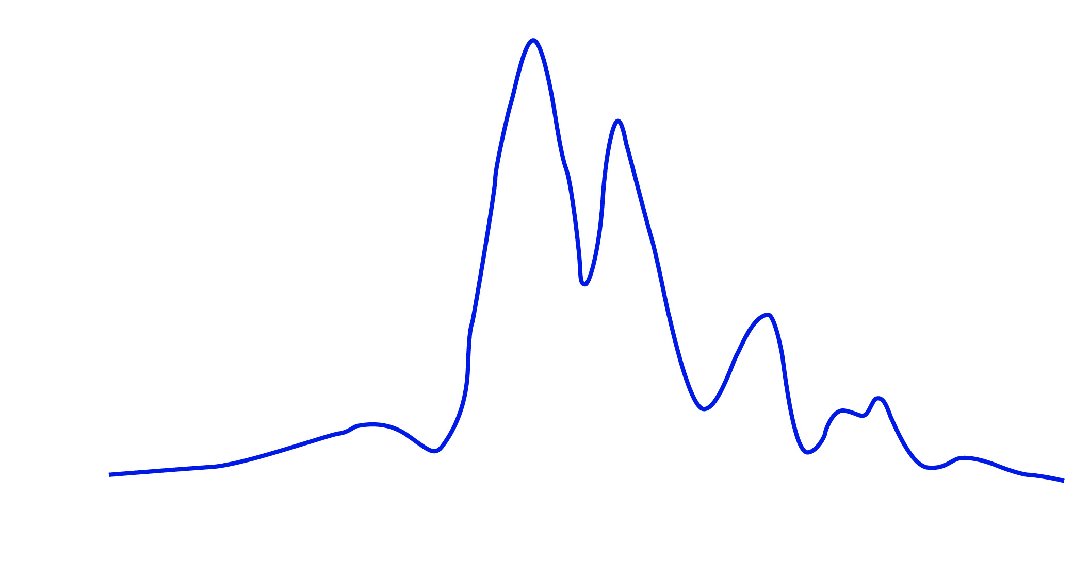





Low pressure (LP) vs. Medium Pressure (MP)
Low output, one wavelength vs. High output, multi wavelength
Medium Pressure
Low Pressure

Slide 8
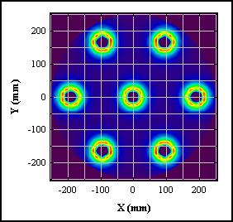
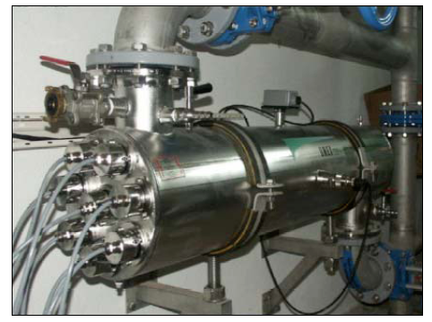
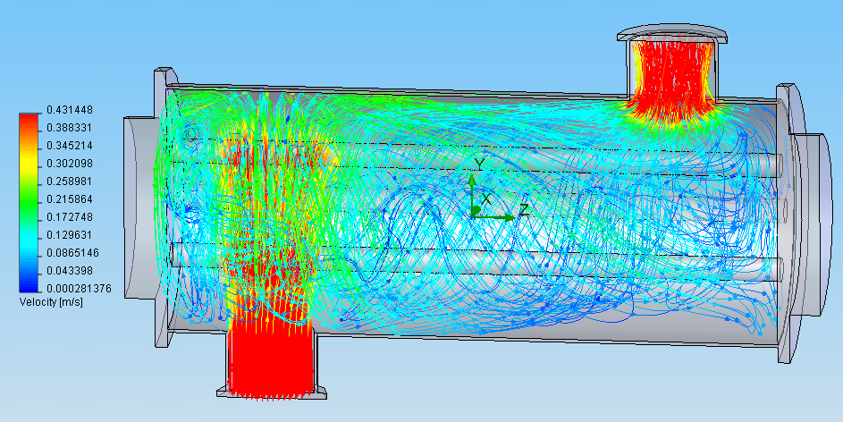
Conventional UV systems:
High velocity AND low UV-intensity and distribution
Each lamp treats a FRACTION of the crossing water volume
“Tired” lamp → escape routes

Slide 9
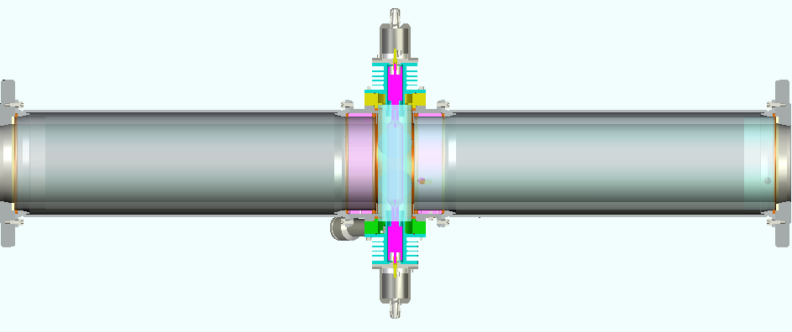
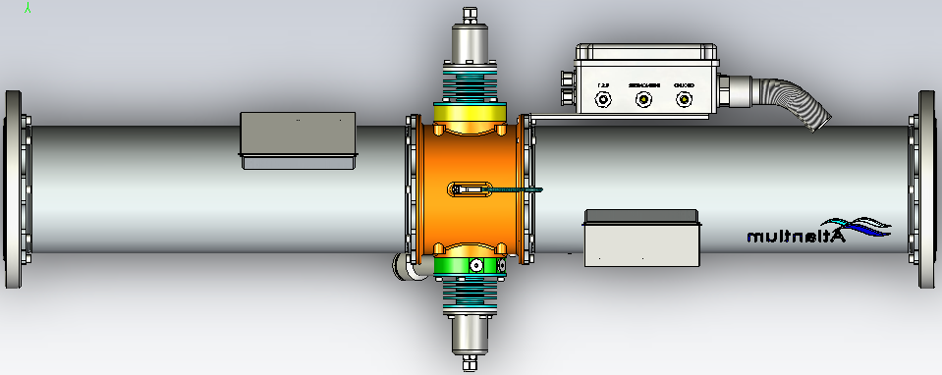
Operation principles:
Stainless
Air Block
Quartz Tube

Slide 10
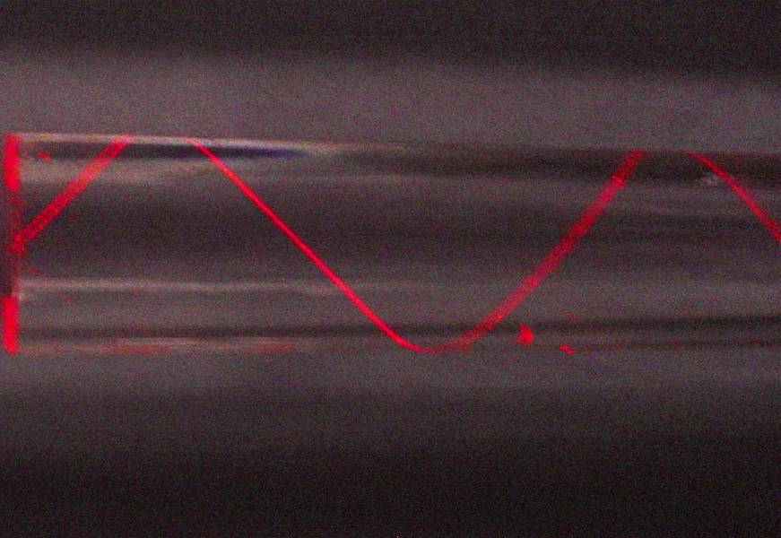
Total Internal Reflection - The hunt goes on…

Slide 11
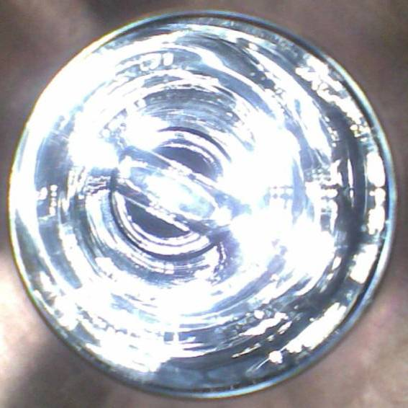
Total Internal Reflection - The hunt goes on…

Slide 12

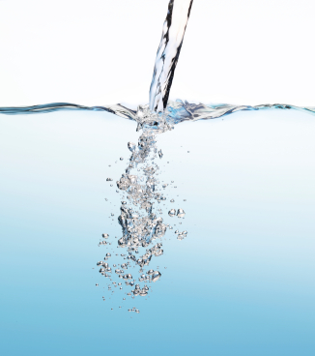

The Dose Function
UV DOSE
[mJ/cm²]
UVT [%]
FLOW
[m³/hr]
LAMP POWER [%]

Slide 13
Dose Distribution and RED Effect
Average dose is not the REAL dose
Average Dose
Minimal Dose-
RED
3 LOG
Bacilus Subtillis
5 LOG
Escherichia. coli
5 LOG
Pseudomonas Aeuriginosa
5 LOG
Cryptosporidium hominis

Slide 14
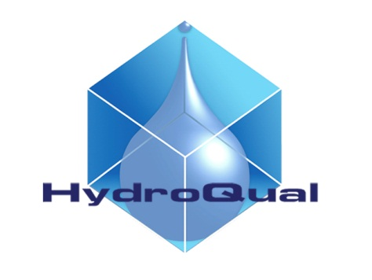
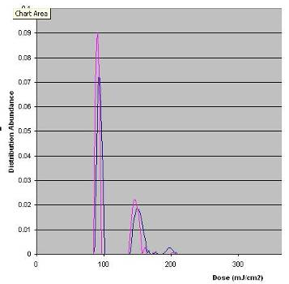
Dose Distribution and RED Effect
NO Low dose tracks

Slide 15
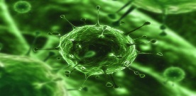
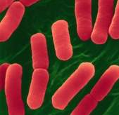
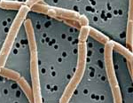
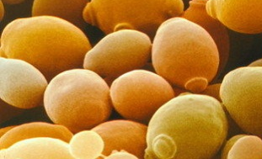
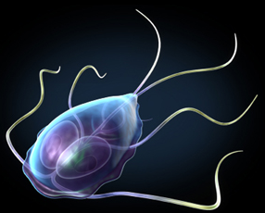
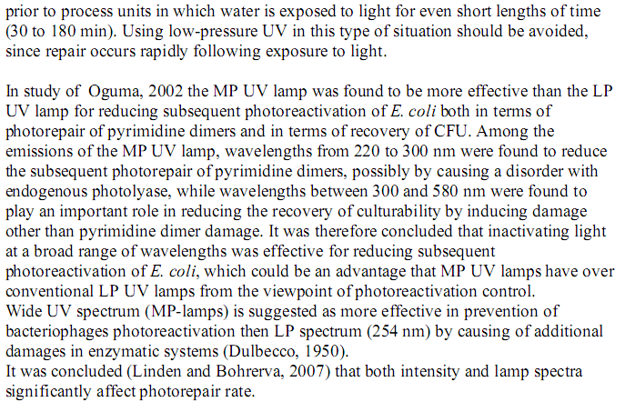
Microorganisms
Adenovirus
(100Å)
E. Coli
(1µm)
LactoBacilus
(1µm)
Saccharomyces (5µm)
No repair Effect in MP
Giardia (10 µm)

Slide 16
  Designing for the right DOSE
120 mJ/cm² RED
FDA –
Pasteurized equivalent
Atlantium’s Microbial Commitment
40mJ/cm² Average
~16mJ/cm² RED

Slide 17
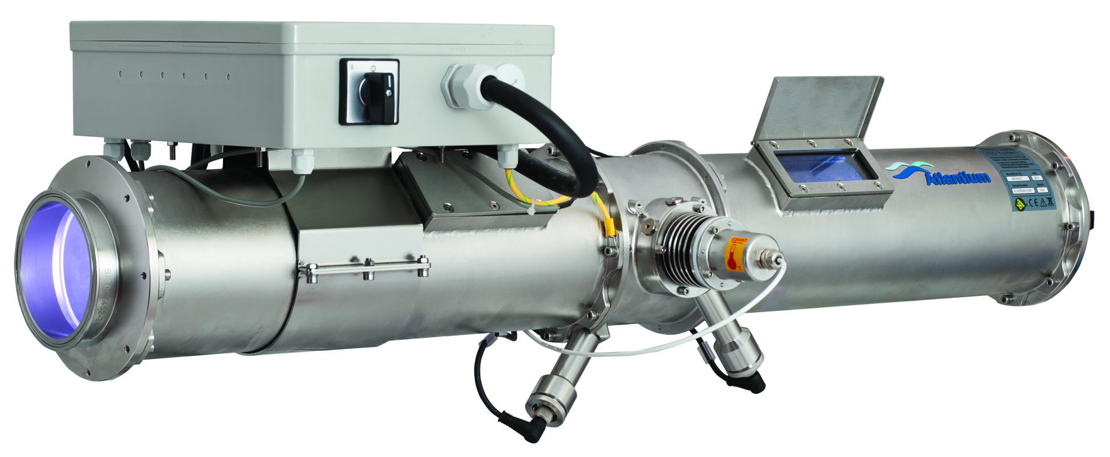
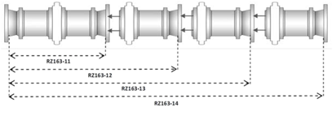
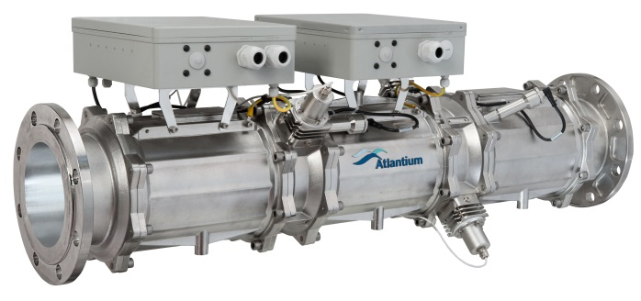
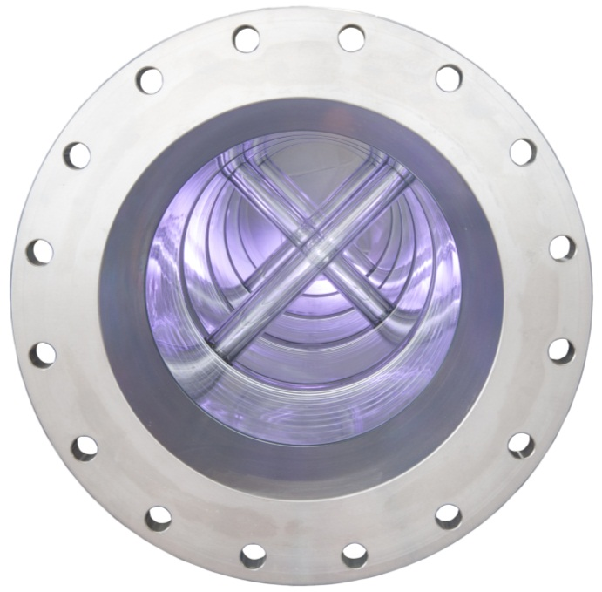
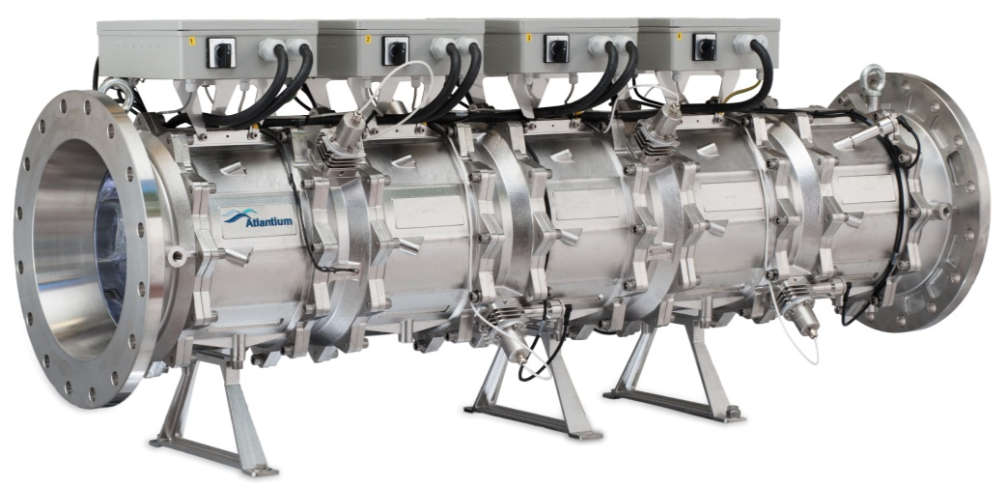
Hydro-Optic Disinfection – Product Lines
Modular Systems
RZ104-11
RZ163-12
RZ300-14

Slide 18
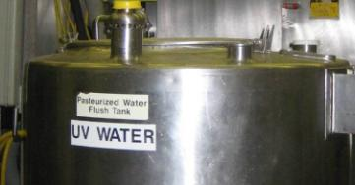
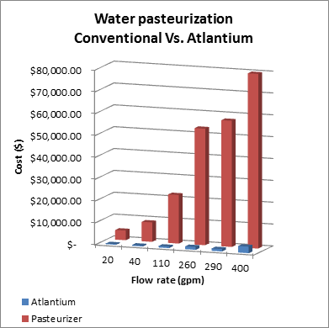
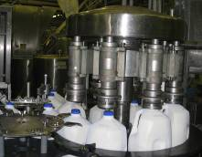
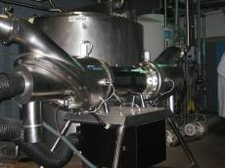
Pasteurized Equivalent Water
In 2009 FDA has defined on its PMO rule, how to make water treatment with UV:
“Medium pressure UV at 120,000 microwatt-seconds per square centimeter or a 4 log adenovirus equivalent“ along with several other conditions.
Atlantium’s systems comply with all of the terms set by the FDA.

Slide 19
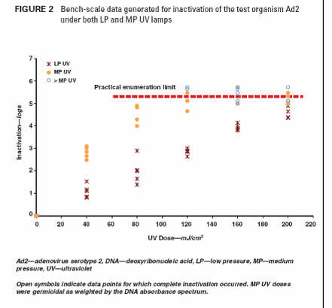
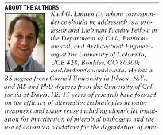
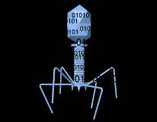

The Only REAL Validated Virus Protection
Atlantium is the only UV company that validated its system against viruses with live Adenovirus
4 Log Adenovirus disinfection can be achieved now
MP are more efficient than LP -
lower dose needed
RNA viruses

Slide 20
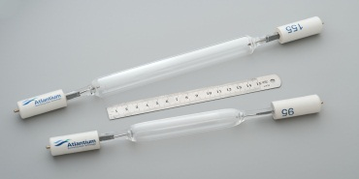
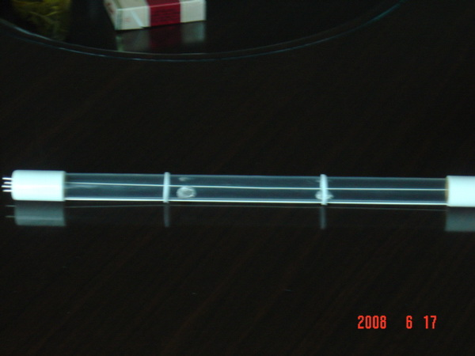
Low pressure (LP) vs Medium Pressure (MP)
Many long low intensity LP lamps Vs. Fewer Atlantium short high intensity MP lamp
Medium pressure UV advantages
Broader wave length
Higher output per lamp (less lamps)
Not sensitive to water temperature
No repair effect of the microbes
Variable output (LP is ON/OFF)
Atlantium’s 10cm High intensity MP lamp
Long LP Lamps LPHO ; 1.5W/cm

Slide 21
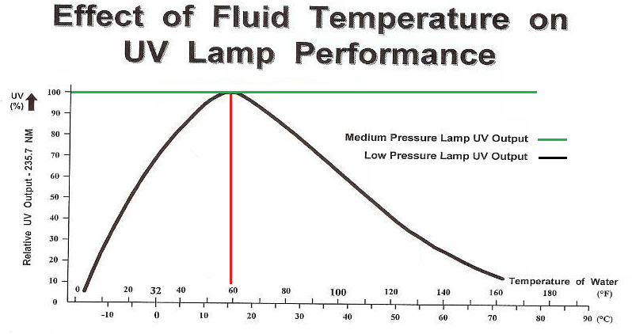
LP Not Effective in Cold Water

Slide 22
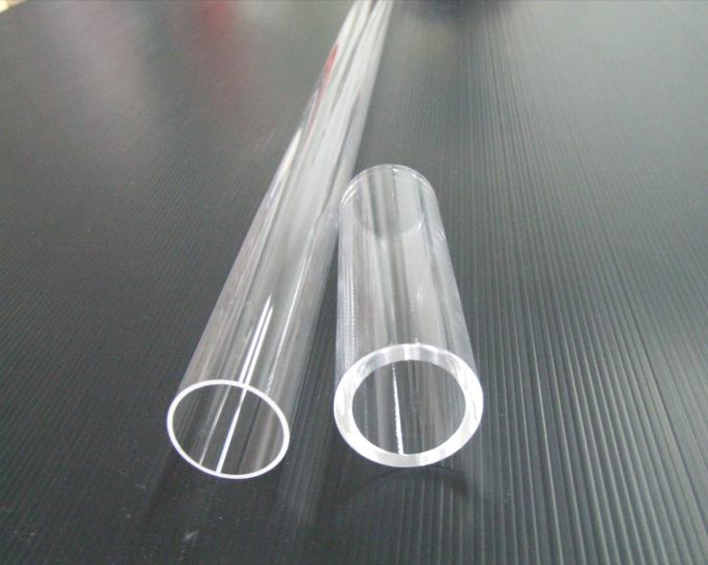
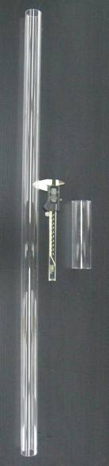
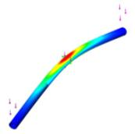



RZ-series – Short & Robust Lamp Tubes
Conventional
Max: 18
HOD-RZ
Atlantium RZ-series tube
Commonly-used tube
Notes:
22

Slide 23
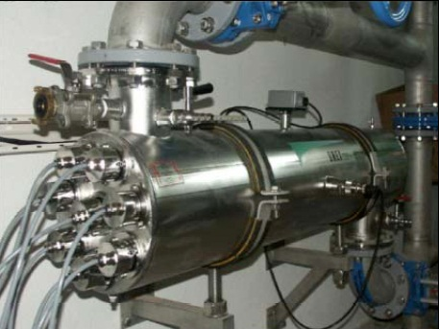
Conventional UV Systems Monitoring
Only one sensor for entire disinfection chamber

Slide 24
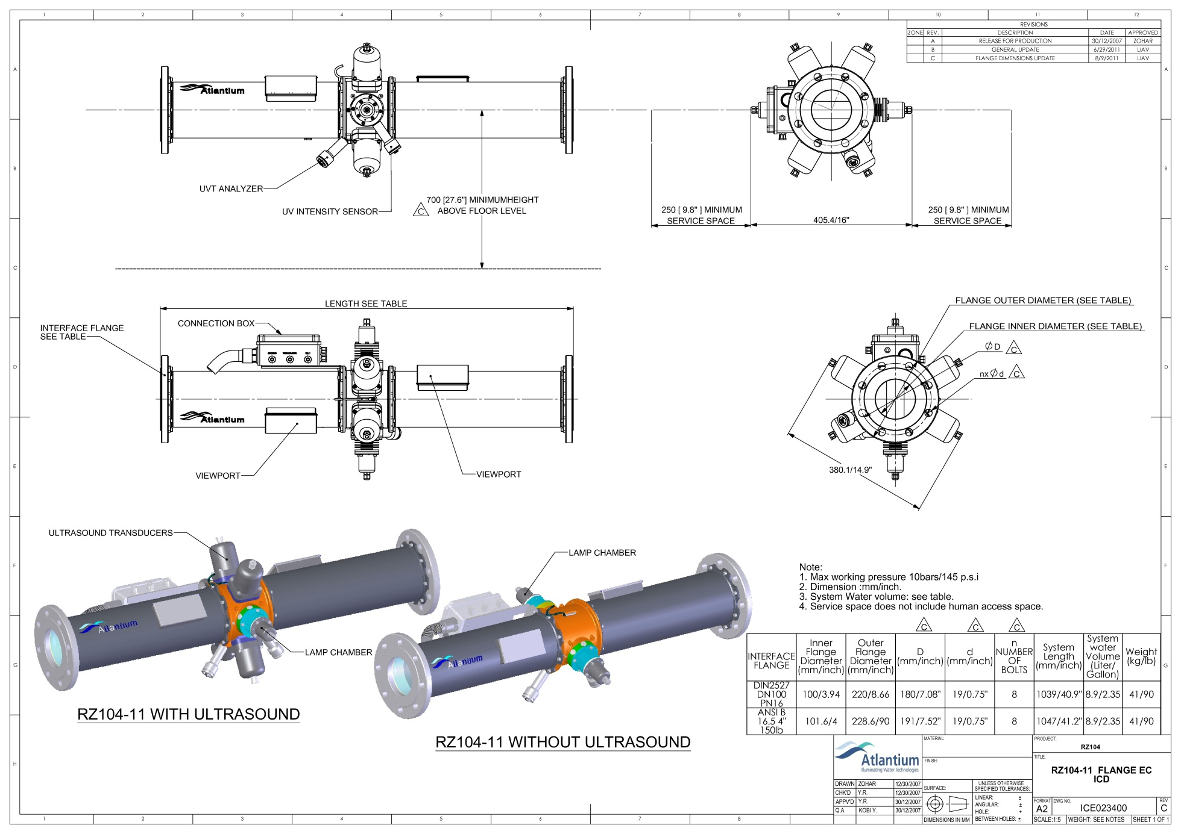
Atlantium - Dual sensors configuration

Slide 25
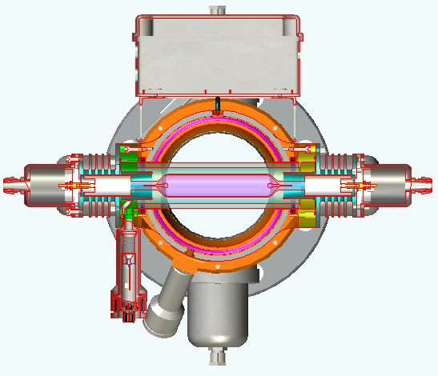
Atlantium - Dual sensors configuration
Dual sensors configuration provides actual dose measurement
Direct measurement of UV lamp efficiency
Built-in monitor for water Transmittance (UVT)
Ultrasonic cleaning
Notes:
לעשות בקליקים

Slide 26
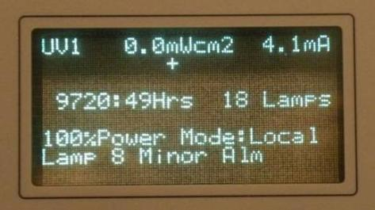
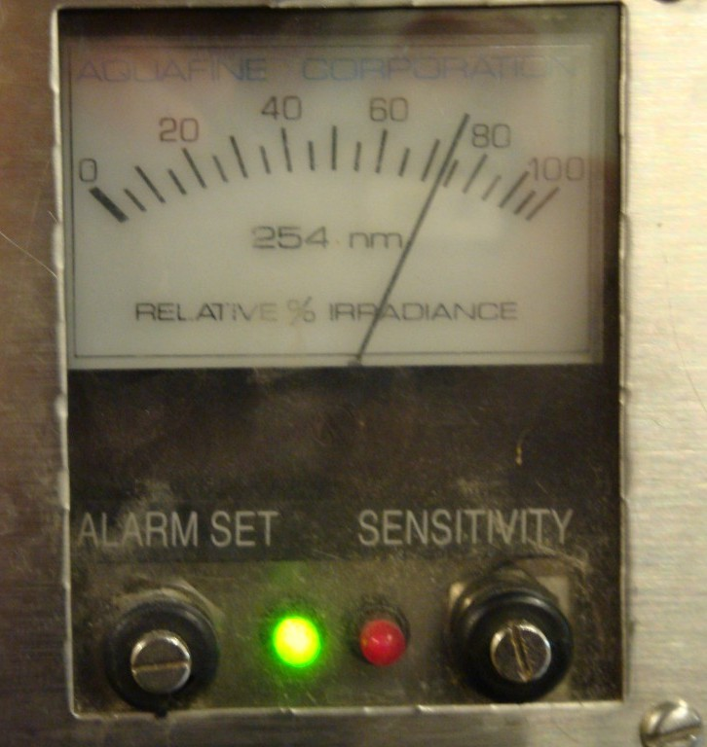
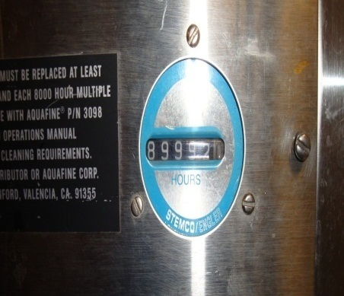
UV measurement : Conventional UV

Slide 27
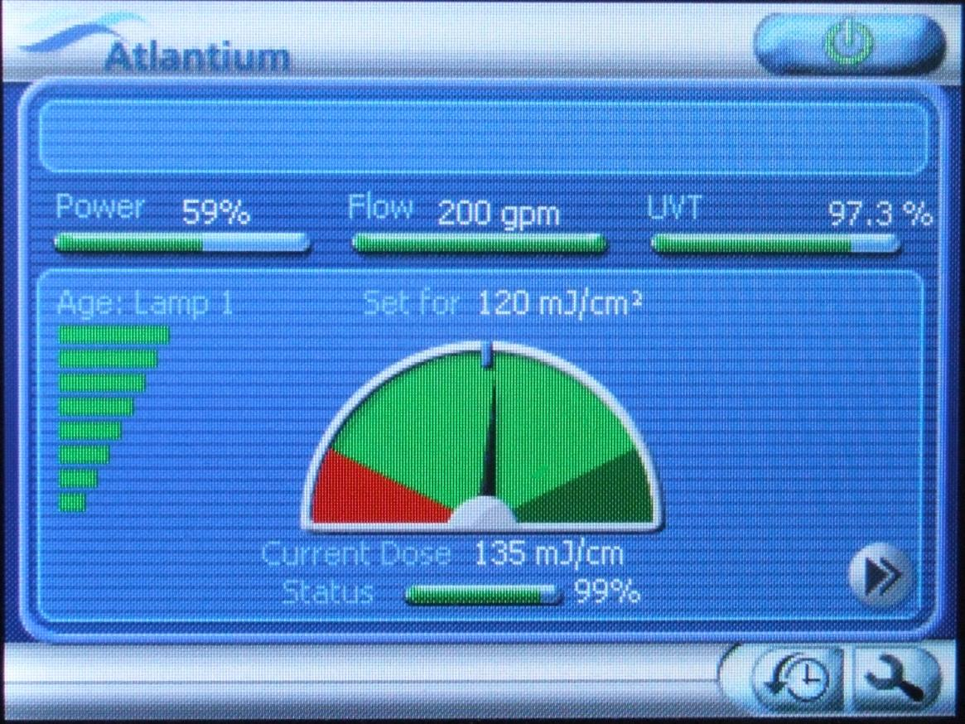
Atlantium - Advanced Monitoring Capabilities
► Accurate monitoring and real-time control - Cruise control

Slide 28
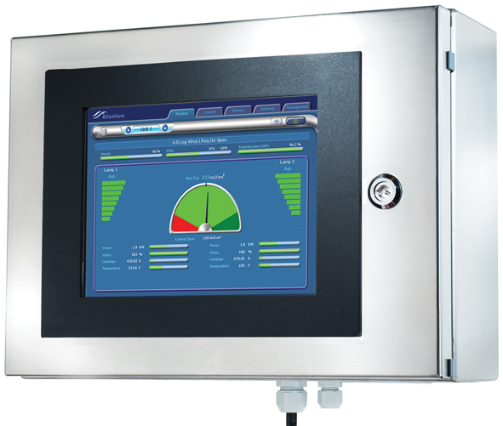
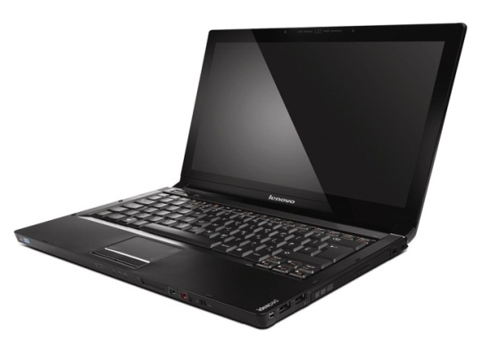






Comprehensive I/O Abilities
Computer
PLC
SMS
Alarm
Siren
Internet
Valve

Slide 29





Applications
Safe
Save
Green
ROI
Quality
Notes:
29

Slide 30

Main Applications in The Beverage Industry
Beverage
Chlorine replacement
Post Active Carbon
Product water disinfection
Membrane protection
Ozone destruction

Slide 31

Atlantium’s Applications – Beverage plant
Firewall
X
Chlorine replacement
Process water disinfection
Membrane Protection
Ozone Destruction
Product Water Disinfection
Post Active Carbon
Product Water Disinfection

Slide 32
No Chlorine
Notes:
32

Slide 33
Chlorination Disadvantages
Resistive bacteria
  Among others - photogenic species such as cryptosporidium and Giardia, and biofilm forming bacteria such as Pseudomonas.
Disinfection by-products formation
  Risks human health.
  Known DBPs: THM’s, HAA’s, NDMA and other unknown chloro-Organic compounds.
Safety hazard
  Chlorination area must be kept cool and ventilated
  Chlorine gas is very poisonous.
Overall costs
  Contact tank ,Footprint ,GAC sizing
Reduced corrosion potential
Membranes damage potential
Chlorine is not a sustainable GREEN method

Slide 34


PBG DoMo plant –Moscow
Entire plant complies with No-Chlorine approach obliged in Russia
2 Atlantium systems for disinfection and 2 for Ozone destruction

Slide 35
Membrane Protection
Notes:
35

Slide 36

Application Example
The system disinfects water before going into RO membrane filtration
Membrane protection application reduces biofauling phenomenon and thus decreases pressure on membranes, extends membrane lifetime and reduces energy consumption

Slide 37

Higher quality
Less Activated Carbon steaming
Less Unexpected CIP
Controlled CIP
Product Water Disinfection
Non Preservatives
37
Notes:
37
37

Slide 38

Coca-Cola Castanet Tolosan
Plant suffered from contamination in their product water after Active Carbon filters
Customer installed R200 SL ATL system on 2008 to protect its product water

Slide 39
Coca-Cola Castanet Tolosan
Since the 11/08/08 installation Atlantium used as a microbial barrier
GAC & Filters Steaming reduced to as needed basis:
From 1 per week
on both GAC (not enough in the summer)
0 in 6 months
Total count
Regulation
<250 CFU/10ml
No Steaming
11.08.08 Last weekly GAC CIP
Sunday GAC CIP

Slide 40
Coca-Cola Castanet Tolosan
Sampling at far away points (Blender & syrup room) were also significantly improved
Using the same standards in revising pipe CIP schedule from
1 per week
2 per year
Estimated Savings to the plant – over 100,000€ a year
Before installing HOD
After installing HOD
pipe CIP - twice a year
CIP Once/week
2.11.08 Last weekly pipe CIP

Slide 41


Femsa Veracruz, Mexico
Post Active Carbon & Product Water Disinfection
Filtro de carbon activado
Cisterna
Pozo
Osmosis inversa
Filtros de Arena Verde
8 UV reactors (18 lamps)
7 with 1 lamp each
1 with 11 lamps
1 HOD (2 Lamps)
8 UV reactors (18 lamps)
7 with 1 lamp each
1 with 11 lamps
Chlorination (7-8 ppm) for CIP
Tanque de
mezcla
Filtro de lecho profundo
Filtro de 1µ
UV battery
Cisterna
Red municipal
Filtros de Arena Verde
Filtro de carbon activado
Filtro de 5µ
To production
Flow rate: 60 m3/hr
Torre de Ozono

Slide 42


Femsa, Coatepec
6 months after installation: follow-up for 30 days
➔ QA and plant engineers have reported that during this period they did not have any unexpected CIP events and the site is operating according to FEMSA standards
Notes:
42

Slide 43
Rainmaker – Reused Water Disinfection
Notes:
43

Slide 44


Process Stages
Equalization tanks
Sedimentation Basin
Aeration Basin
Post MBR
Post RO

Slide 45






Process Steps
Stabilizing the inlet flow
Flocculation
Aeration Basin
MBR
Reverse Osmosis
Evaporation and Crystallization
Atlantium Disinfection

Slide 46


Atlantium Disinfection
Permeate water is going through the Atlantium system for the only water disinfection in the entire recycling process
After the Atlantium system, water goes back to the plant as CIP water and bottle washing water
Water recycling yield in the process – 70-80%

Slide 47
Atlantium Disinfection

Slide 48

The Atlantium Difference
Next-Generation UV technology
Reduced chemicals, reduced carbon footprint
Clean and Green
Unprecedented UV power efficiency
Validated to EPA criteria for 5-log bacteria reduction and 4-log virus reduction.
Proven ROI

Slide 49

Thank You
Bob English – NA Regional Manager
Atlantium Technologies Ltd.
Har Tuv Industrial Park
POB 11071, Israel 99100
Tel: +972-2-992 5001
Fax: +972-2-992 5005
office@atlantium.com
www.atlantium.com

