Slide 1
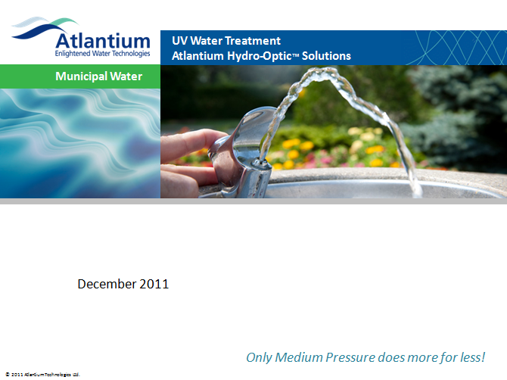
Introduction
Introduction to Atlantium’s Hydro-Optic Disinfection Technology (HOD)
January 2013
Notes:
1
This are conventional UV systems, in all cases the lamps are inside the water.
The key issues of such systems are:
Reliably
Problematic maintenance
And almost no monitoring.
I will elaborate on this issues in the next slids

Slide 2
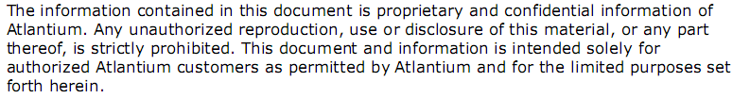
Notes:
2
This are conventional UV systems, in all cases the lamps are inside the water.
The key issues of such systems are:
Reliably
Problematic maintenance
And almost no monitoring.
I will elaborate on this issues in the next slids

Slide 3
Conventional UV Systems
UV History in a Nutshell
In 1801, UV light was discovered by Johann Ritter, who was able to decompose silver chloride using light beyond the violet part of the visible spectrum.
The germicidal properties of UV were recognized in 1904 with the award of the Nobel Prize in Physiology to Niels Finsen for his work in treating Lupus vulgaris (skin tuberculosis).
By 1910, a drinking water facility using a basic UV lamp system was commissioned in Marseilles, France.
Notes:
3
This are conventional UV systems, in all cases the lamps are inside the water.
The key issues of such systems are:
Reliably
Problematic maintenance
And almost no monitoring.
I will elaborate on this issues in the next slids

Slide 4
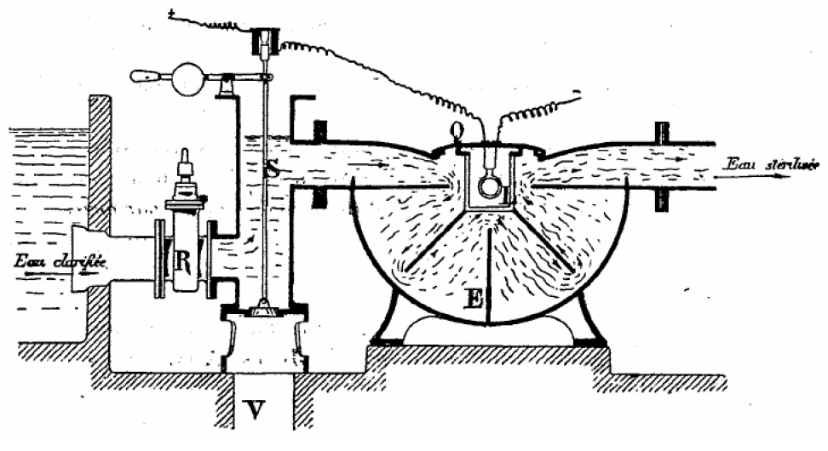
Conventional UV Systems
Early patent for Ultraviolet water disinfection reactor
Illustration of the first UV System, 1910, Marseilles, France
4
Notes:
4

Slide 5
Water disinfection technologies today
Conventional water disinfection methods
Advantages
Disadvantages
Chlorination
Relatively cheap; Widely used and accepted
Disinfection by-products; Taste in food; Ineffective against Cryptosporidium & Giardia; Creates issues for downstream processing - membranes
Ozonisation
Effective;
Accepted in some industries
Disinfection by-products (Bromates); Hard to control with water quality flux; Difficult working environment; Lots of hidden costs
Membranes
Reliable;
Widely accepted
Not an absolute barrier; Sensitive to chlorine; Backwash treatment and biofilms contribute to high operational costs
Heat exchange (pasteurization)
Reliable;
Widely accepted
Extremely high operational cost; Intensive maintenance
Conventional UV
Environmentally Friendly;
Widely accepted
Microbial Kill 1-3 log range; Deposits & fouling of quartz sleeves; High maintenance; Questionable reliability; Issues with monitoring and control
Notes:
5
This are conventional UV systems, in all cases the lamps are inside the water.
The key issues of such systems are:
Reliably
Problematic maintenance
And almost no monitoring.
I will elaborate on this issues in the next slids

Slide 6
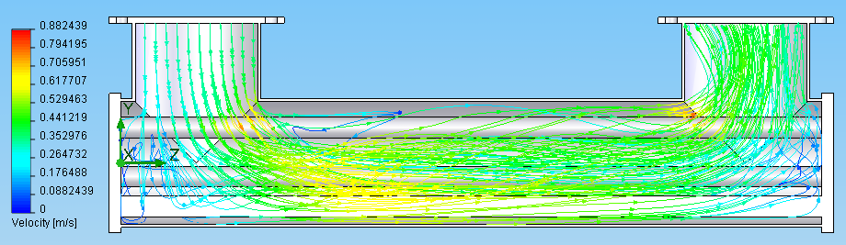
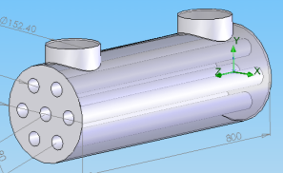
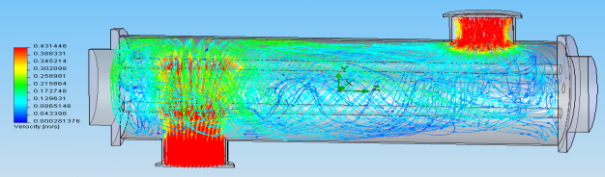
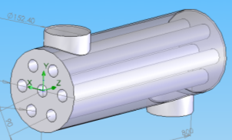
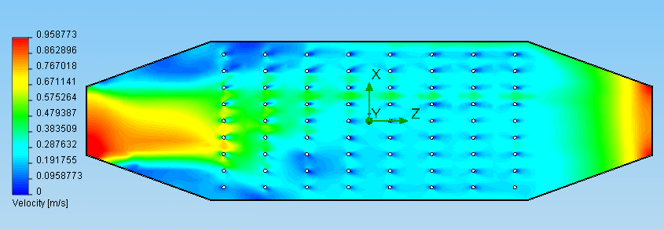
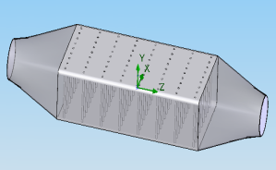
Conventional UV Systems - concept
U-type - B120 WEDECO
N-type - LD320 by Hanovia
E-type - K3000 by Wedeco

Slide 7
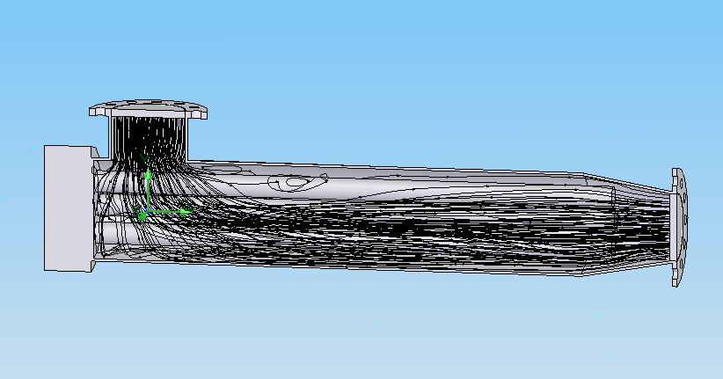
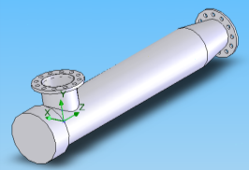
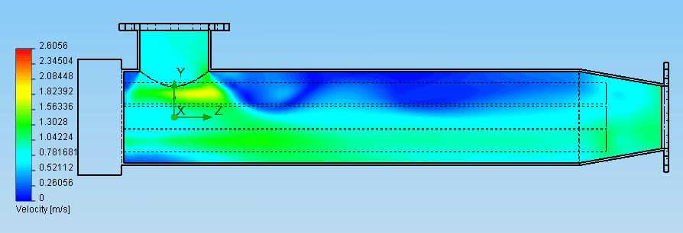
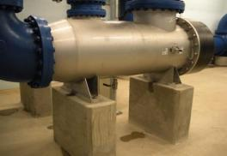
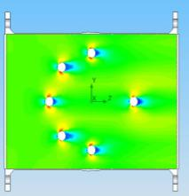
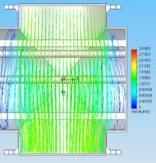
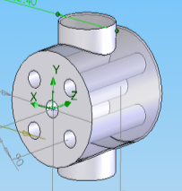
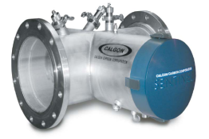
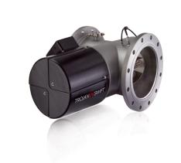
Conventional UV Systems - concept
L-type - UVSwift-B06 by Trojan
T-type - 6L24 by Trojan

Slide 8
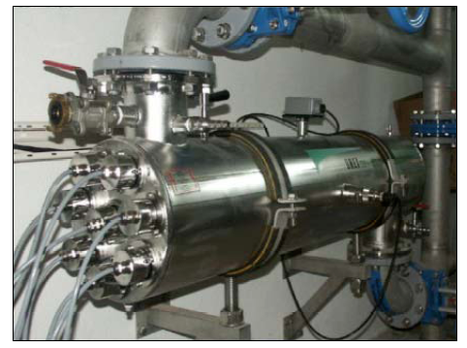
Conventional UV Systems - concept
A typical (non Atlantium) conventional UV reactor
Stainless enclosure with several lamps along or across its longitudinal axis
Many lamp in parallel
8 in this model
The weakest lamp controls the disinfection level
Some of the UV light is lost due to absorption by the metal enclosure
Waste of Light
Typically one sensor measures the UV light emitted from one of the lamps through the water
Limited control
Notes:
8
This are conventional UV systems, in all cases the lamps are inside the water.
The key issues of such systems are:
Reliably
Problematic maintenance
And almost no monitoring.

Slide 9
Conventional UV Systems – key issues
Conventional UV Systems Key Issues:
non-uniformity light distribution
High maintenance
Weak monitoring
Reliability
Notes:
9
This are conventional UV systems, in all cases the lamps are inside the water.
The key issues of such systems are:
Reliably
Problematic maintenance
And almost no monitoring.
I will elaborate on this issues in the next slids

Slide 10
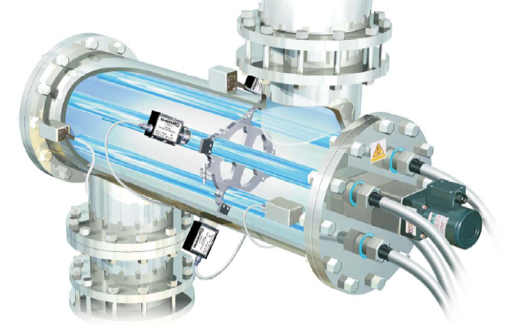
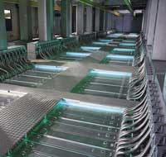
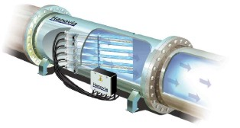
Conventional UV Systems – key issues
Lamps immersed in the water
Open Channel
Immersed lamps
Immersed lamps
Immersed lamps
Notes:
10
This are conventional UV systems, in all cases the lamps are inside the water.
The key issues of such systems are:
Reliably
Problematic maintenance
And almost no monitoring.

Slide 11
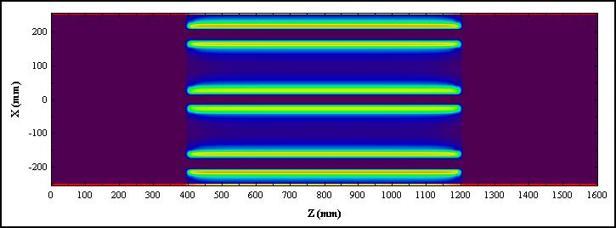
Conventional UV Systems – key issues
Dark tracks overlap the water high velocity areas
Water velocity Between Lamps
Low light level
AND
High velocity Water
Low-dose tracks
Notes:
11
This are conventional UV systems, in all cases the lamps are inside the water.
The key issues of such systems are:
Reliably
Problematic maintenance
And almost no monitoring.

Slide 12
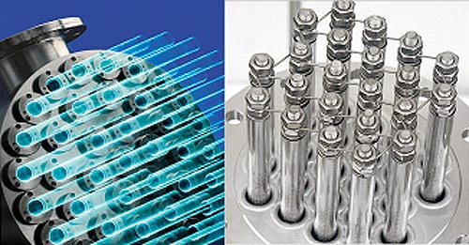
Conventional UV Systems – key issues
High maintenance
Many lamps and many screws = a lot of maintenance
Notes:
12
Lamp fouling due to heat
Require fouling treatment such as wipers
When replacing need to unscrew many screws
Quartz sleeve and UV lamp may break – may cause mercury contamination, the broken glass can reach process water.

Slide 13
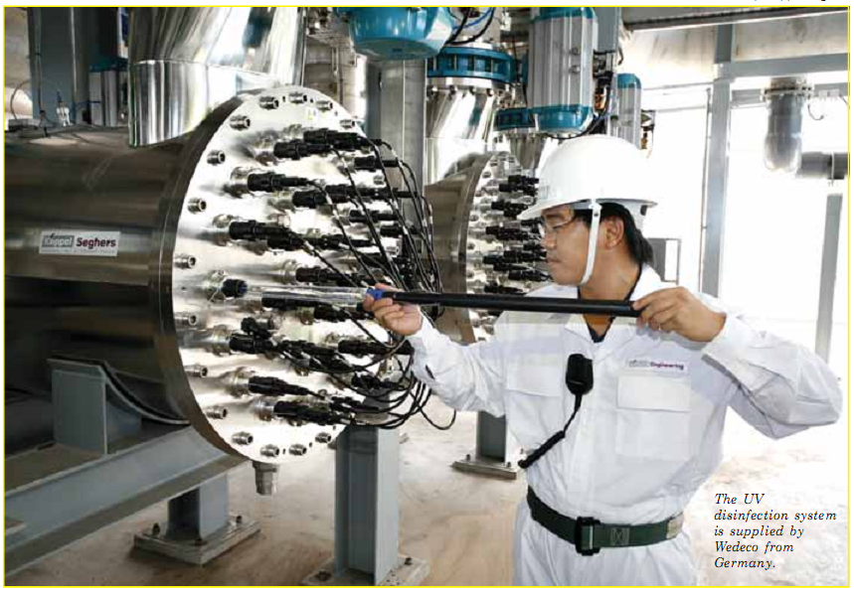
Conventional UV Systems – key issues
High maintenance
Many lamps and many screws = a lot of maintenance
Notes:
13
Lamp fouling due to heat
Require fouling treatment such as wipers
When replacing need to unscrew many screws
Quartz sleeve and UV lamp may break – may cause mercury contamination, the broken glass can reach process water.

Slide 14
Conventional UV Systems – key issues
One sensor for UV light transmission
Notes:
14
Lamp fouling due to heat
Require fouling treatment such as wipers
When replacing need to unscrew many screws
Quartz sleeve (about 11-15 mm appose to our HOD window 50mm) and UV lamp may break – may cause mercury contamination, the broken glass can reach process water.
One sensor that measure UV light through the water : can’t determine: lamp aging , which lamp , fouling , lower water quality -→ need to un screw all the lamp in risk of breaking them and the quartz sleeve check and clean then screw back.

Slide 15
HOD Technology: Over 60 Protected Patents
Atlantium’s HOD advantages over conventional UV
Atlantium's Hydro-Optic Disinfection technology overcomes main obstacles encountered in the use of conventional reactors:
Reliability
Dose management and Monitoring
Uniform dose distribution
  Automatic Monitoring & Control
  Low Total Cost of Operation
  4-minute UV Lamp Replacement
  Optimized UV Lamp Efficiency
Notes:
15
This are conventional UV systems, in all cases the lamps are inside the water.
The key issues of such systems are:
Reliably
Problematic maintenance
And almost no monitoring.
I will elaborate on this issues in the next slids

Slide 16
Atlantium’s HOD advantages
UV Dose
the amount of UV light energy that the microorganism was exposed to while crossing the reactor, Measured in mj/cm²
It is a calculated function of the following parameters:
UVT - transmission of the water to the UV light (in wavelength of 254nm).
UVI - Intensity of the light illuminating from the UV lamp
Power - the amount of power transferred from the PS to the lamp
Flow – the flow rate of the water trough the System

Slide 17
Uniform Dose Distribution
Uniform Dose Distribution
Inactivating water-borne microorganisms using UV disinfection requires distribution of the UV light so that all microbes are exposed to a uniform dose, ensures microbes cannot avoid being confronted by the UV light
Achieving this aim requires a system design and structure that promotes optimal synchronization of UV light and hydraulic flow patterns in the disinfection zone.
Atlantium's invention, the Hydro-Optic Disinfection™ system, has achieved the goal of uniform dose distribution by implementing solutions for both of the key elements; UV light and hydraulic.
Notes:
17
This are conventional UV systems, in all cases the lamps are inside the water.
The key issues of such systems are:
Reliably
Problematic maintenance
And almost no monitoring.
I will elaborate on this issues in the next slids

Slide 18
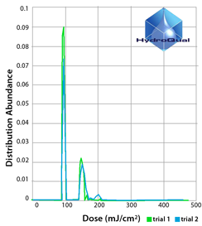

Uniform Dose Distribution
Validation
Validation tests by Hydroqual tested true UV dose distribution of different UV systems
The Atlantium system consistently delivered a uniformly-distributed UV dose throughout the water (more than any other UV system)
All water receives at least the
minimum regulated dose all the time
All target pathogens inactivated
UV energy used most efficiently
Notes:
18
This are conventional UV systems, in all cases the lamps are inside the water.
The key issues of such systems are:
Reliably
Problematic maintenance
And almost no monitoring.
I will elaborate on this issues in the next slids

Slide 19
Uniform Dose Distribution
Uniform Dose Distribution
Uniform dose distribution
HOD System
Non-uniform dose distribution
Conventional UV
19
Notes:
19

Slide 20
Uniform Dose Distribution
Hydraulics - controlling the water flow
Atlantium has effectively engineered the Hydro-Optic Disinfection system so that water flows in a controlled, defined pattern into the system's disinfection tube.
The water flow, synchronized to match the pattern of UV light distribution, runs unimpeded as there are no parts, baffles or brushes to block UV photons from hitting and inactivating microorganisms
Notes:
20
This are conventional UV systems, in all cases the lamps are inside the water.
The key issues of such systems are:
Reliably
Problematic maintenance
And almost no monitoring.
I will elaborate on this issues in the next slids

Slide 21
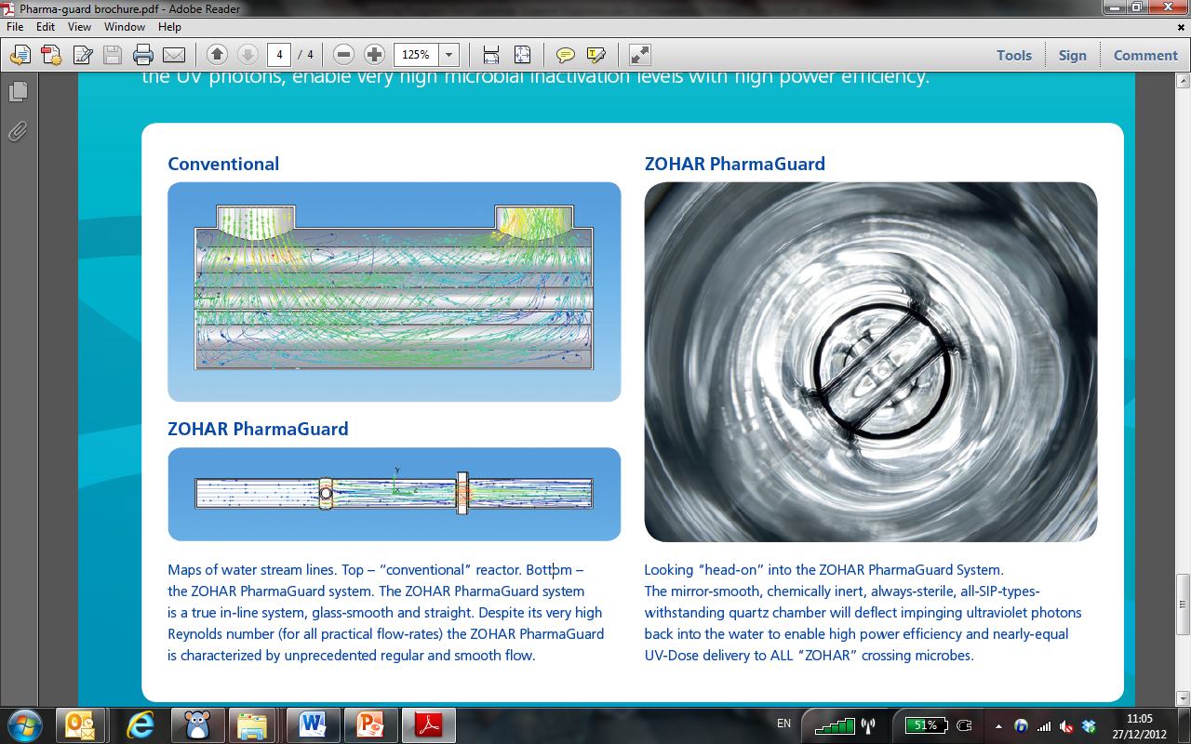
Uniform Dose Distribution
Hydraulics - controlling the water flow
Maps of water stream lines. Top – “Conventional” reactor. Bottom – Atlantium’s RZ system. The RZ system is a true in-line system, glass-smooth and straight. Despite its very high Reynolds number (for all particle flow-rates) the RZ system is characterized by unprecedented regular and smooth flow
Conventional UV System
Atlantium’s RZ UV System
Notes:
21
This are conventional UV systems, in all cases the lamps are inside the water.
The key issues of such systems are:
Reliably
Problematic maintenance
And almost no monitoring.
I will elaborate on this issues in the next slids

Slide 22
Uniform Dose Distribution
UV Light
Inspired by the physics of fiber-optics, Atlantium adapted the principle of Total Internal Reflection (TIR) to water disinfection.
Implementing the principle using a thick quartz tube surrounded by an air block, lengthens the effective path of the ultraviolet (UV) rays forces them to repeatedly bounce back from the quartz tube wall at different angles throughout the entire water volume.
The water flowing through the quartz tube acts as a waveguide for the UV light, ensuring that the disinfecting photons continually propagate throughout the entire volume of water.
Notes:
22
This are conventional UV systems, in all cases the lamps are inside the water.
The key issues of such systems are:
Reliably
Problematic maintenance
And almost no monitoring.
I will elaborate on this issues in the next slids

Slide 23
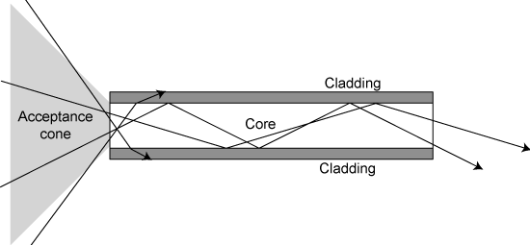
Uniform Dose Distribution
Total Internal Reflection
The natural phenomenon that carries waves over long distances in quartz tubes surrounded by air
Notes:
23
This are conventional UV systems, in all cases the lamps are inside the water.
The key issues of such systems are:
Reliably
Problematic maintenance
And almost no monitoring.
I will elaborate on this issues in the next slids

Slide 24
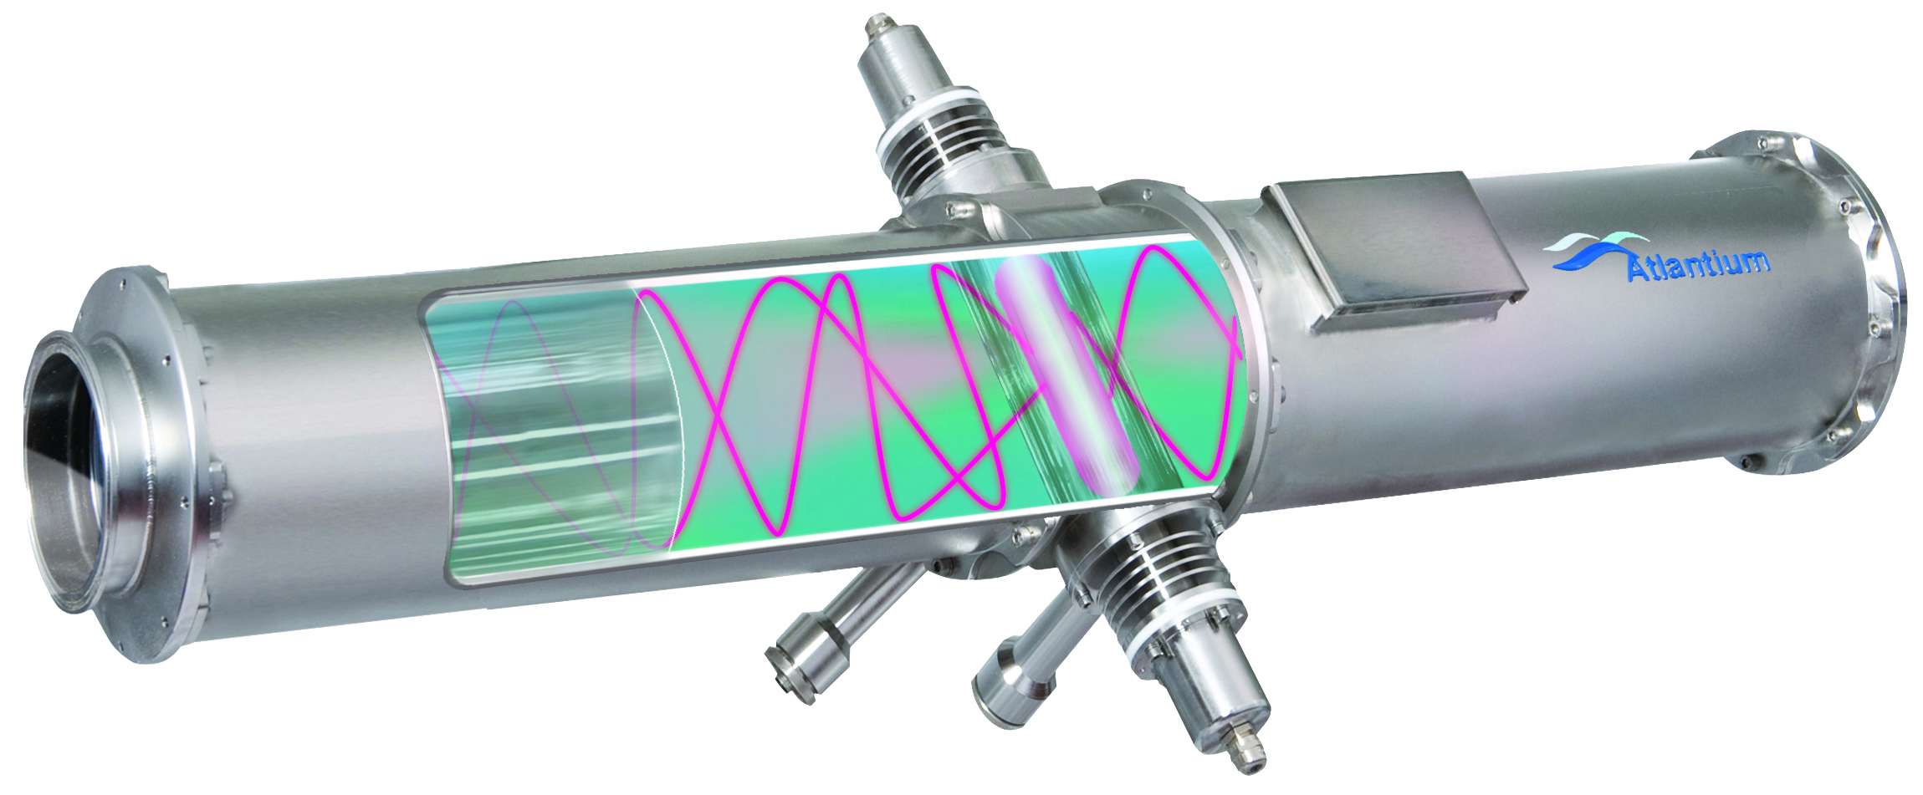
Uniform Dose Distribution
Total Internal Reflection
Fiber-Optic and Hydraulic principles applied to UV system design change the way that UV is delivered
Quartz disinfection chamber surrounded by an air block
Traps germicidal UV light rays and reflects them back into the water
Longer light paths (more inactivation opportunities per UV photon)
Attacks microorganisms from all directions
Uniform dose

Slide 25
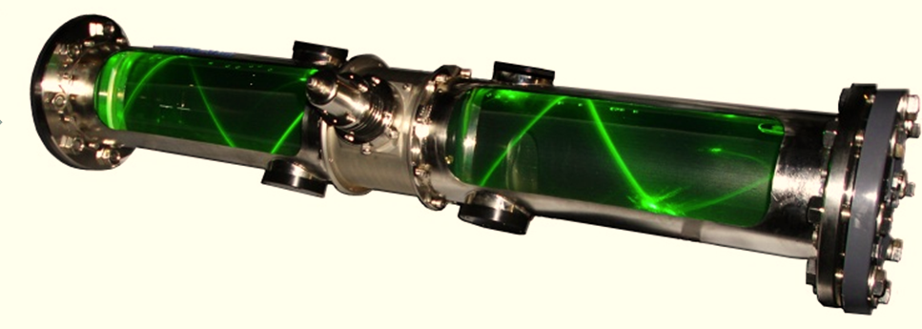
Uniform Dose Distribution
Total Internal Reflection
Simulation of the Total Internal Refection (TIR) phenomenon, as real light reflect inside Atlantium’s RZ104 model quartz tube

Slide 26
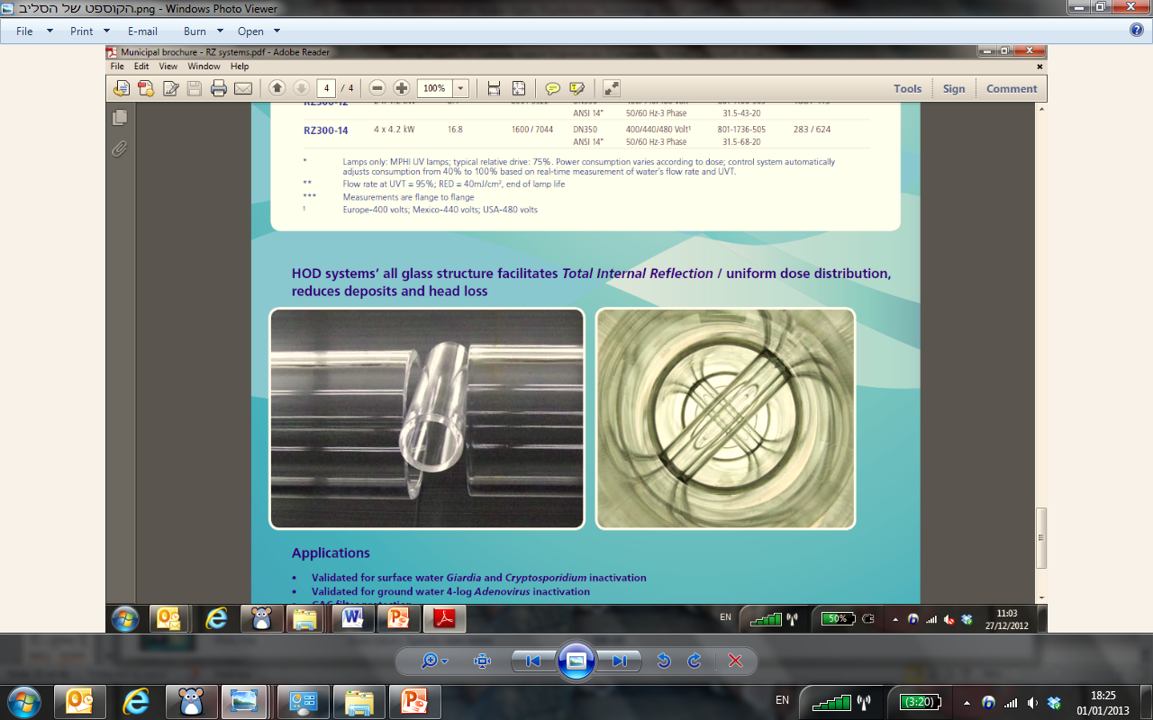
Uniform Dose Distribution
Sleeve’s structure
HOD system’s all glass structure facilitate Total Internal Reflection, reduces deposits and head loss. The mirror-smooth, chemical inert, always-sterile. Withstanding quartz chamber will deflect impinging ultraviolet photons back into the water enable high power efficiency and nearly-equal UV-Dose delivery to all crossing microbes.

Slide 27
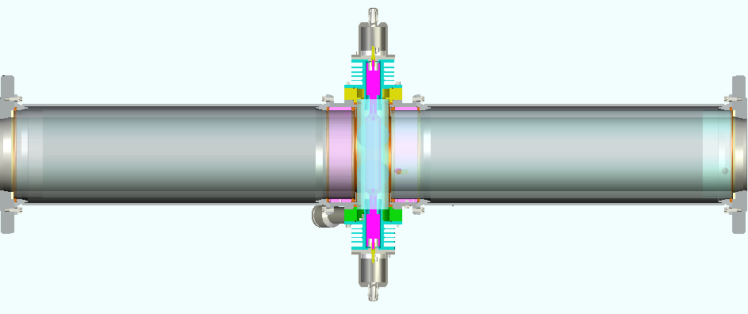
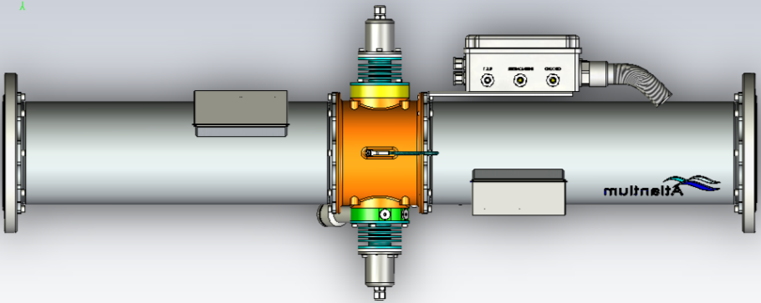
Uniform Dose Distribution
HOD System Cross section
RZ104-11 a member of RZ series HOD system
Stainless
Air Block
Quartz Tube
HOD
Conventional

Slide 28
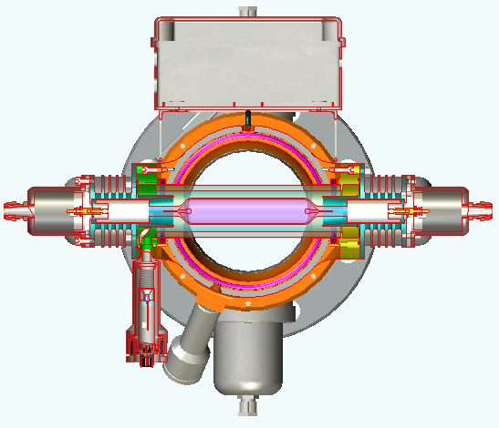
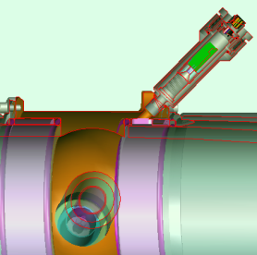
RZ series - Operation principles
Dual sensors configuration provides actual dose measurement
Direct measurement of UV lamp efficiency
Built-in monitor for water Transmittance (UVT)

Slide 29
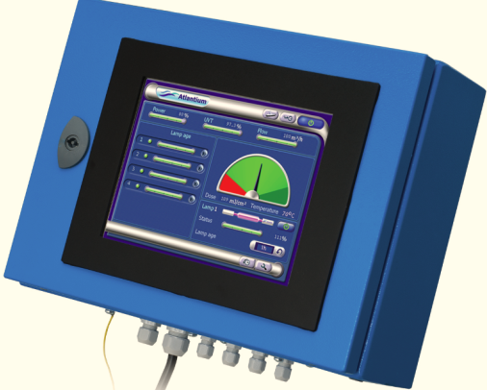
  Automatic Monitoring & Control
Monitoring & Control
  Continuous accurate real-time monitoring of all the factors that determine
  actual UV dose delivered
  Dual sensors provides actual dose measurement
  Connects with plant equipment & controls (I/O’s, Modbus, LAN)

Slide 30

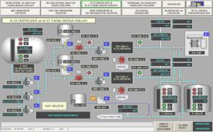
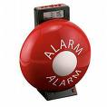



  Automatic Monitoring & Control
Comprehensive I/O Abilities
Computer (TCP/IP)
PLC (I/O’s ,Modbus)
Alarm
Siren
Internet
Valves

Slide 31
  Automatic Monitoring & Control
Dual sensors configuration - provides actual dose measurement
HOD System
Direct measurement of UV source
Additional detector for water UV Transmission
Measuring UV light through water
Conventional UV
Notes:
The HOD has dual sensors: one that measuring UV directly from the lamp and the other that measuring the UV trough the water, that is actually measuring water UVT.
By having two sensors we can control the system better since we can determine whether the water has lower UVT and then increase lamp intensity or whether the lamp efficiency declined.
conventional systems has just one sensor that measure UV light. With one sensor you can’t determine if the UV light decreased because of lower water UVT or lower lamp efficiency.

Slide 32
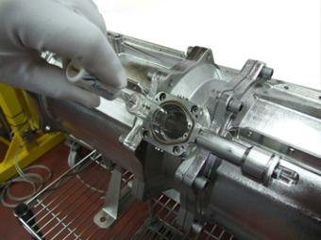
  Low Total Cost of Operation
Low cost maintenance
“Recycling” of the UV Photons ➔ less lamps, low electrical power consumption
Fully automated system requires minimum manpower ➔ sensor per lamp
Inline system, easy to install,
Easy to maintain: Design to reduce maintenance activities ➔ Sensor per lamp, 4-minute lamp replacement
Easily integrated to plant controls
32

Slide 33
  Low Total Cost of Operation
Simple maintenance
Lamps are easy to remove and to replace; no system shutdown
HOD System
Cumbersome lamp & sleeve replacements; System down
Risk of glass and mercury contamination
Conventional UV
Notes:
The second advantage is: simple maintenance.
The lamp is very easy to remove since: lamp is outside of the water, it is a short lamp and there is no need no shutdown the system since the second lamp can still operate.
On he other hand in the conventional systems the lamp is long and inside the water in order to replace it the system needs to be shutdown and the lamps need to unscrewed and should be taken out very carefully. There is always the risk of lamp and glass brakeage and a mercury contamination → may then risk the process water
Another disadvantage is that the heat which the UV lamp induces create favorable conditions to fouling that requires frequent maintenance.

Slide 34
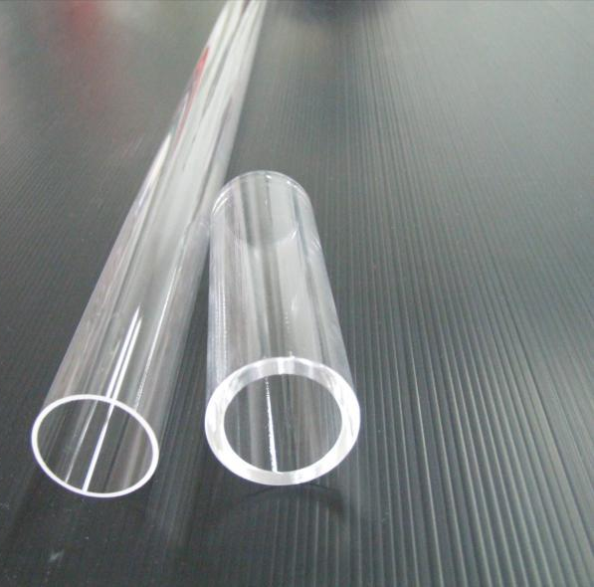
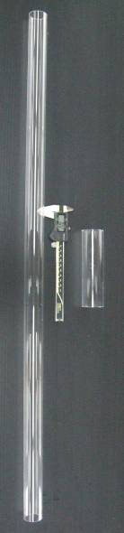
  Low Total Cost of Operation
  Thick quartz tube separates UV lamp from water chamber
  Quick and easy lamp replacement – only 4 minutes
  Avoids risk of broken glass and mercury in water
  No thin Quartz sleeves to replace or break
Conventional sleeve: 1.5mm thick
fragile design high breakage risk.
Atlantium sleeve:
5mm thick
High grade fused silica
Robust design low to minimal breakage risk.
No need for sleeve replacement
34
34

Slide 35
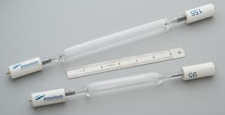
Medium Pressure Vs. Low Pressure UV Lamps
  Medium Pressure high-intensity polychromatic lamps
  1x Medium Pressure High-Intensity Atlantium lamp generates more UV than 16x LP lamps or 2x MP lamps
  Fewer lamps needed: fewer replacements, fewer ballasts: lower costs
  Polychromatic light leverages entire germicidal spectrum
  Inactivates even highly resistant microorganisms and their repair mechanism
  Short lamps much easier to handle and store
35
35

Slide 36
Medium Pressure Vs. Low Pressure UV Lamps
3 Log Crypto – Atlantium Vs. competitor
Lamp type | Number of lamps | Lamps Electrical power [kW] | Flow for 3 log Crypto credit according to the EPA guidelines [gpm] | UVT | System | Company
MP | 1 | 2.29 | 1513 | 94% | RZ300-11 | Atlantium
LP | 12 | 3.96 | 1513 | 94% | xxxxx | xxxxx
Atlantium - MP based technology ➔ Less Lamps (1 Vs. 12)
➔ significantly less maintenance
36
36

Slide 37

Notes:
37
This are conventional UV systems, in all cases the lamps are inside the water.
The key issues of such systems are:
Reliably
Problematic maintenance
And almost no monitoring.
I will elaborate on this issues in the next slids

Slide 38
THANK YOU!
Atlantium Ltd.
Har Tuv Industrial Park
POB 11071, Bet Shemesh 99100, Israel
Tel : + 972 2 992 5001 Fax : + 972 2 992 5005
info@atlantium.com www.atlantium.com
Notes:
38
This are conventional UV systems, in all cases the lamps are inside the water.
The key issues of such systems are:
Reliably
Problematic maintenance
And almost no monitoring.
I will elaborate on this issues in the next slids

